Slide 1
Racine Harbor Through Time
Lesson 1 An Introduction to Coastal Engineering
Wisconsin Sea Grant © October 2025| Coastal Engineering Education: People, Place and Practice: Lesson 1:An Introduction to Coastal Engineering Image used with written permission by JB the Explorer
This curriculum was prepared by Adam Bechle, Ginny Carlton, and Anne Moser under award number NA21NOS4290005 from the Great Lakes Bay Watershed Education and Training (B-WET) program of the National Oceanic and Atmospheric Administration (NOAA), U.S. Department of Commerce. The statements, findings, conclusions and recommendations are those of the author(s) and do not necessarily reflect the views of NOAA or the U.S. Department of Commerce.
Notes:
Image Source: https://www.flickr.com/photos/producerjb/43643260870 Racine Breakwater Lighthouse
JB the Explorer took this photo of the Racine Breakwater Lighthouse in July of 2017 while at the Racine Harbor.
This lighthouse was first lit in November of 1901.
In the distance, you can see the Wind Point Lighthouse.
Image used with written permission by JB the Explorer as provided via JB's Native Garden@PlantNativeWI
Previously on Twitter and now on X @ExplorerJB

Slide 2
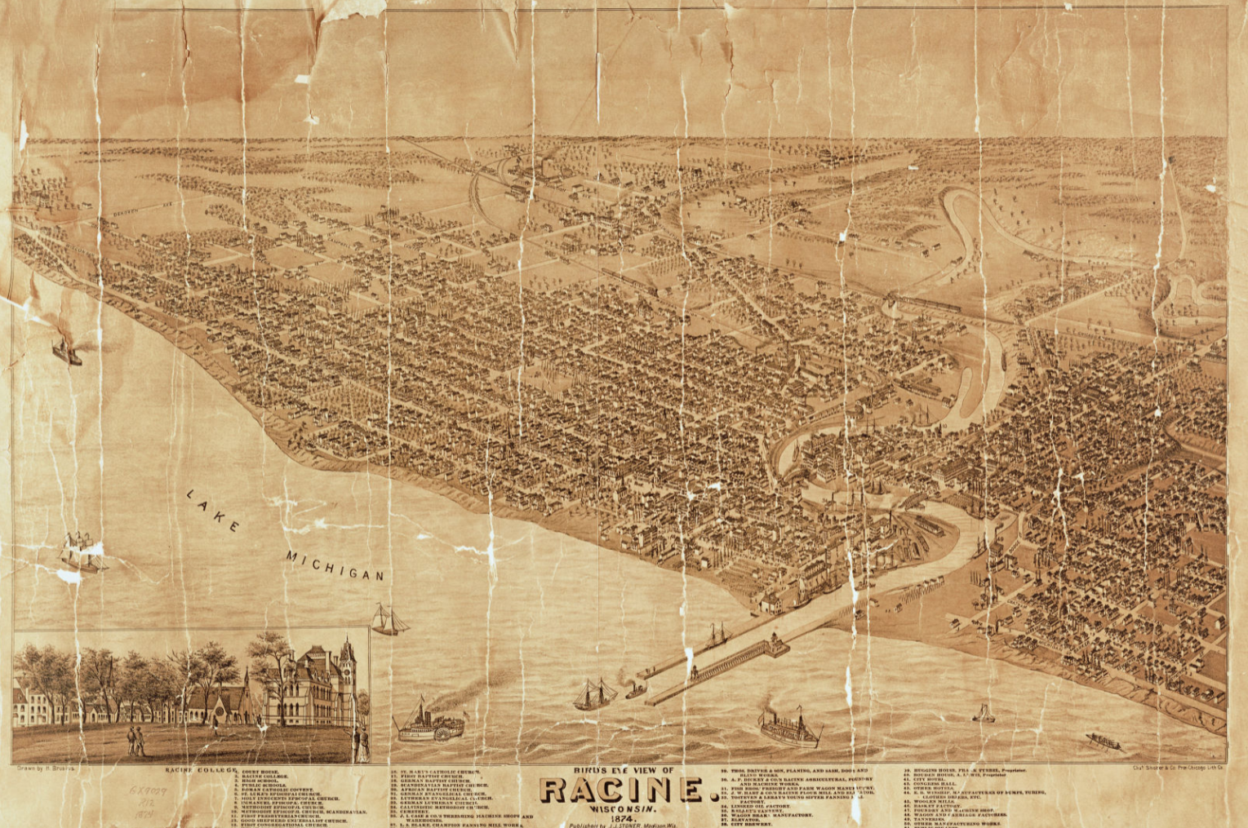
Racine Harbor –
Early map from Lake Michigan perspective
Source: https://content.wisconsinhistory.org/digital/collection/maps/id/130/
Notes:
This is the area of the Racine Harbor we will look at through time.
Map: Birds-eye view of Racine Harbor 1874. Lake Michigan is in the foreground with sailing vessels and steamships plying the waters. Two parallel piers extend from the mouth of the Root River into Lake Michigan and form a channel for ships. A lighthouse situated on the north pier serves to guide the ships as they transit from lake to river. Houses and other buildings are situated in a rough grid pattern on both sides of the river, although a natural buffer along the banks remains.
Image source: Wisconsin Historical Society. Bird's-eye map of Racine, with an inset of Racine College. https://content.wisconsinhistory.org/digital/collection/maps/id/130/
Bird's-Eye View of Racine
Bird's-eye map of Racine, with an inset of Racine College.
Creator Brosius, H. ()
Subjects Architecture, Botany, Bridges, Church buildings, Cities and towns, Dwellings, Human settlements, Intellectual life, Learning and scholarship, Michigan, Lake, Railroads, Rivers, Sailing ships, Shorelines, Steamboats, Streets, Transportation, Trees, Universities and colleges, Urban, Water
Original Date 1874
Date Created 1874
Decade 1870-1879
Place Racine, Racine, Wisconsin, United States
Unique identifier W014358
Legacy Identifier WHi 22693
Call Number D GX9029 R12 1874
Dimensions 79 x 54 cm
Type Map
Medium photomechanical prints
Virtual Collection Maps and Atlases
Physical Collection Map Collection
Sub-Type Maps
Copyright Status NO COPYRIGHT - UNITED STATES
Rights Holder Wisconsin Historical Society
Conditions for Access This image is issued by the Wisconsin Historical Society. Use of the image requires written permission from the staff of the Collections Division. It may not be sold or redistributed, copied or distributed as a photograph, electronic file, or any other media. The image should not be significantly altered through conventional or electronic means. Images altered beyond standard cropping and resizing require further negotiation with a staff member. The user is responsible for all issues of copyright. Please Credit: Wisconsin Historical Society.

Slide 3
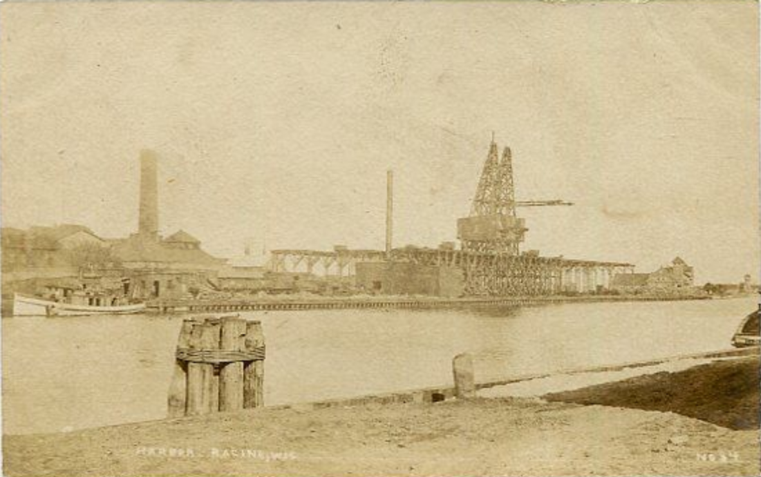
Racine Harbor –
Early image from South Harbor
Source http://www.vindustries.com/racinehistory/features/harbor-of-racine /
Notes:
In this undated photograph, we can observe the Root River as it flows through the Racine Harbor to Lake Michigan. Are there any features within this image that were not included on the original brainstorm list you created?
Image source: Vindustries. Racine History
http://www.vindustries.com/racinehistory/features/harbor-of-racine /

Slide 4
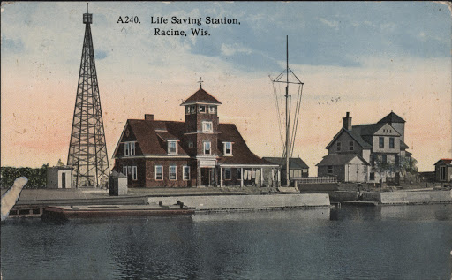
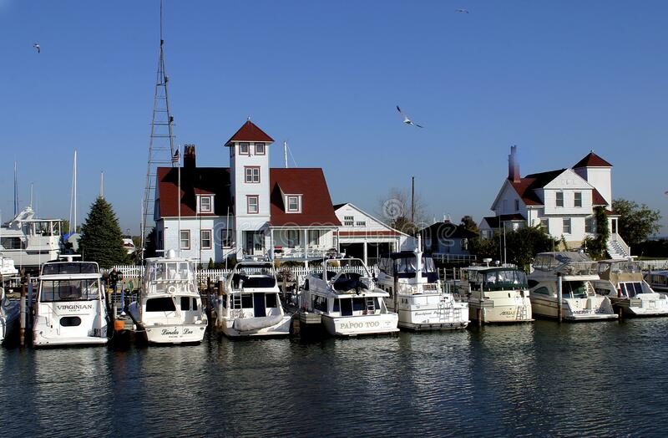
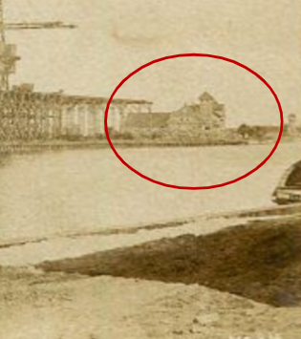
Historic and Modern Pictures of the U.S. Coast Guard Station, Racine Harbor
Source: http://www.vindustries.com/racinehistory/features/harbor-of-racine/
Source http://www.vindustries.com/racinehistory/features/harbor-of-racine
Source: https://www.travelwisconsin.com/architecture/racine-harbor-lighthouse-198114
Notes:
Some things have changed at the harbor, some have not. In the old postcard on the previous slide and in the two older postcards on the left of this slide, we see the U.S. Coast Guard Station (circled in red). It still exists today!
Image source 1: Vindustries. Racine History
http://www.vindustries.com/racinehistory/features/harbor-of-racine
Image source 2: Vindustries. Racine History
http://www.vindustries.com/racinehistory/features/harbor-of-racine /
Image source 3: Travel Wisconsin
Source: https://www.travelwisconsin.com/architecture/racine-harbor-lighthouse-198114

Slide 5
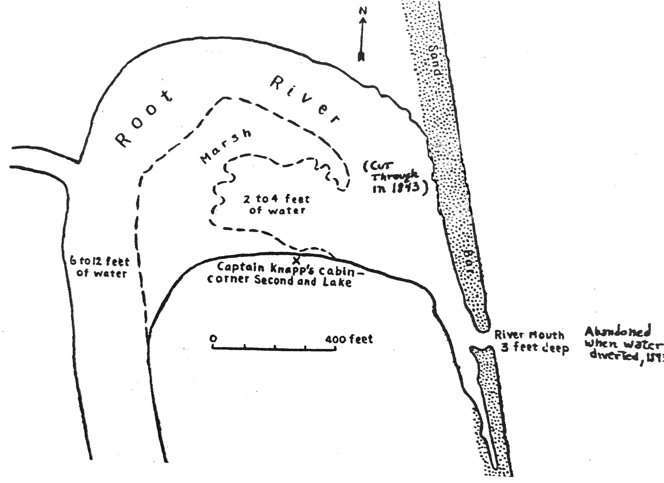
Root River Map Pre-1843
Source: https://rlamps.org/Early-facts.htm
Notes:
Let's look at the harbor through time... Pre-1843 map
At this point, there is no Racine Harbor. In fact, what is now downtown Racine was mostly a marsh. As you see on the map, the Root River was "candy cane" shaped with the stem on a north-south axis and the "crook" toward the east and Lake Michigan.
The stem portion of the “candy cane” contained water that was six to twelve feet deep. The space at the curve of the “candy cane” was a marsh with two to four feet of water.
A long sandbar usually formed where the Root River neared Lake Michigan. The sandbar blocked the river water from moving into the lake. A relatively small gap in the sandbar formed the river mouth, which was approximately three feet deep.
At this time, Captain Knapp had a cabin along the south shore of the marsh. The cabin was located at what is now the corner of Second and Lake streets.
Image source: Racine Lighthouse and Maritime Preservation Society (rLAMPs): https://rlamps.org/Early-facts.htm

Slide 6
Racine Harbor – 1874 Map
Source: https://content.wisconsinhistory.org/digital/collection/maps/id/130/
Notes:
Racine Harbor 1874 map
Starting in 1845, the city of Racine built two jetties that stuck out into the lake, providing a channel protected from waves for ships and boats to navigate up into the Root River. This is early Racine Harbor. At this time in 1874, Racine Harbor is the fifth busiest harbor in all of the Great Lakes, with the main export being wheat.
Racine Harbor was eventually surpassed in shipping by Milwaukee and Chicago, which had better harbor facilities.
Bird's-Eye View of Racine
Bird's-eye map of Racine, with an inset of Racine College.
Image source: Wisconsin Historical Society. Bird's-eye map of Racine, with an inset of Racine College. https://content.wisconsinhistory.org/digital/collection/maps/id/130/
Creator Brosius, H. ()
Subjects Architecture, Botany, Bridges, Church buildings, Cities and towns, Dwellings, Human settlements, Intellectual life, Learning and scholarship, Michigan, Lake, Railroads, Rivers, Sailing ships, Shorelines, Steamboats, Streets, Transportation, Trees, Universities and colleges, Urban, Water
Original Date 1874
Date Created 1874
Decade 1870-1879
Place Racine, Racine, Wisconsin, United States
Unique identifier W014358
Legacy Identifier WHi 22693
Call Number D GX9029 R12 1874
Dimensions 79 x 54 cm
Type Map
Medium photomechanical prints
Virtual Collection Maps and Atlases
Physical Collection Map Collection
Sub-Type Maps
Copyright Status NO COPYRIGHT - UNITED STATES
Rights Holder Wisconsin Historical Society
Conditions for Access This image is issued by the Wisconsin Historical Society. Use of the image requires written permission from the staff of the Collections Division. It may not be sold or redistributed, copied or distributed as a photograph, electronic file, or any other media. The image should not be significantly altered through conventional or electronic means. Images altered beyond standard cropping and resizing require further negotiation with a staff member. The user is responsible for all issues of copyright. Please Credit: Wisconsin Historical Society.

Slide 7
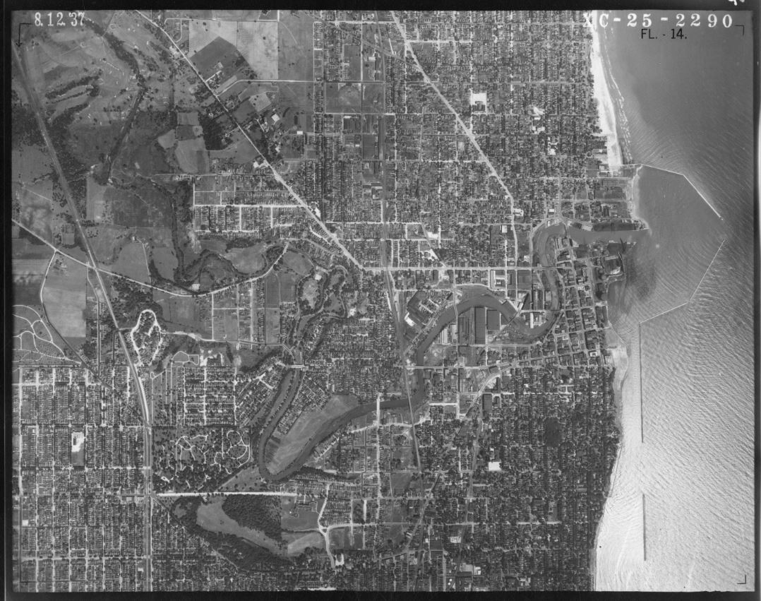
Racine Harbor: 1937 Aerial Photograph
Image: Wisconsin Historic Aerial Imagery Finder
Notes:
Aerial photograph of the Root River area in 1937.
Do you see any change from the previous slide?
The protected harbor is much bigger in 1937 than it was in 1874. A constructed breakwater north of the natural harbor extends out into Lake Michigan and then bends to the southeast. A second constructed breakwater extends from south of the natural harbor out into the lake to the north and east. A small gap between the two breakwaters allows for ships to pass into this protected space. What once had been fully exposed Lake Michigan coastline is now buffered by the two breakwaters.
The city of Racine has also grown. The north-south and east-west grid pattern of the roads is more prominent than in 1874.
Image source: UW-Madison
https://digital.library.wisc.edu/1711.dl/T42FZSGDQT4GB8P

Slide 8
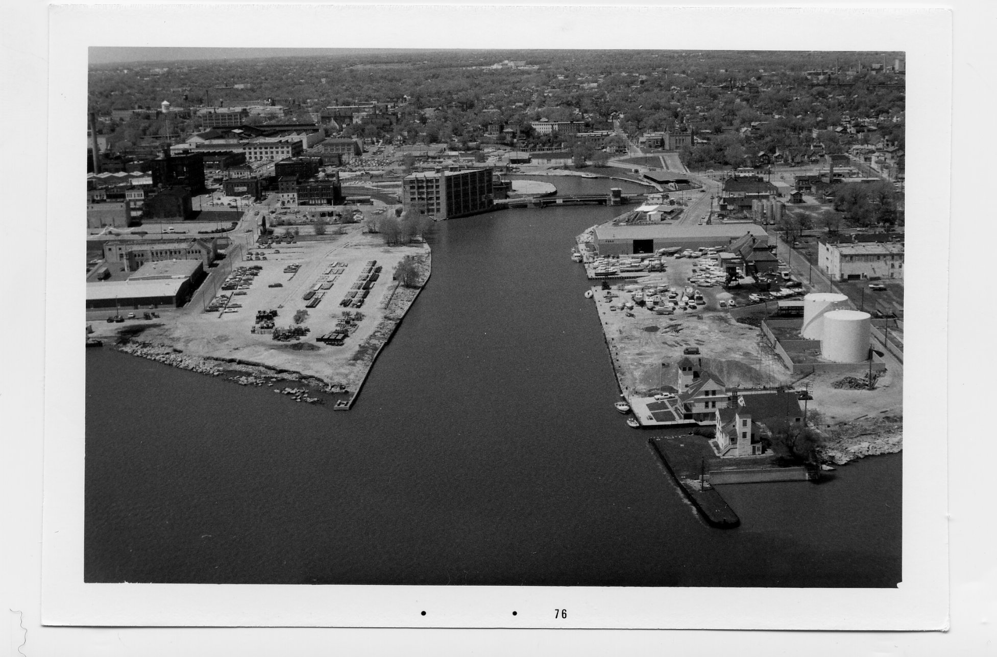
Racine Harbor: 1976 Aerial Photograph
Image: UW Space Science and Engineering Center
Notes:
Aerial photograph of Racine Harbor in 1976.
In 1976, the lakefront in Racine was mostly industrial. However, commercial activity in the harbor had slowed significantly since its heyday in the 1800’s. The U.S. Coast Guard Station still can be seen along the north bank of the river. The riverbanks were now home to a car dealership, a trunk factory and a manufactured gas plant with gas storage tanks and a large coal pile. The Main Street bridge that crosses the river can be seen in the background of the photograph.
Image source: UW Space Science and Engineering Center

Slide 9
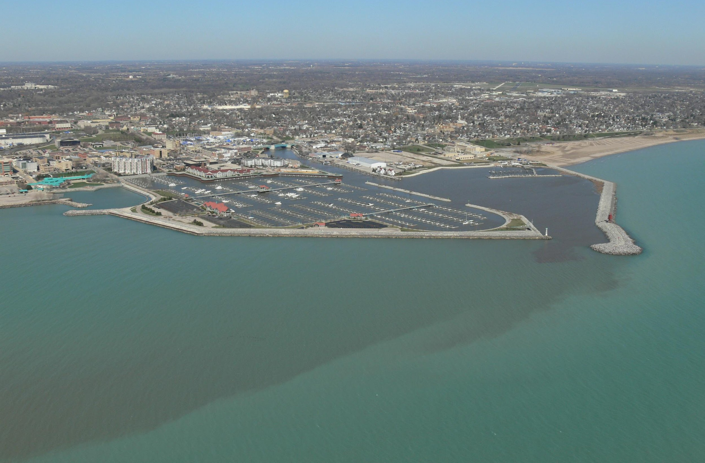
Racine Harbor: 2007 Aerial Photograph
Image: UW Space Science and Engineering 2007
Notes:
Aerial photograph of Racine Harbor in 2007.
The U.S. Coast Guard Station remains on the north bank of the Root River. The area immediately adjacent to the south breakwater is now home to the large Reefpoint Marina. Built in the 1980's, this marina can house hundreds of boats. Building the marina was part of the city's effort to turn focus back towards Lake Michigan and the resource that was so important to the city's founding.
Image source: UW Space Science and Engineering 2007

Slide 10
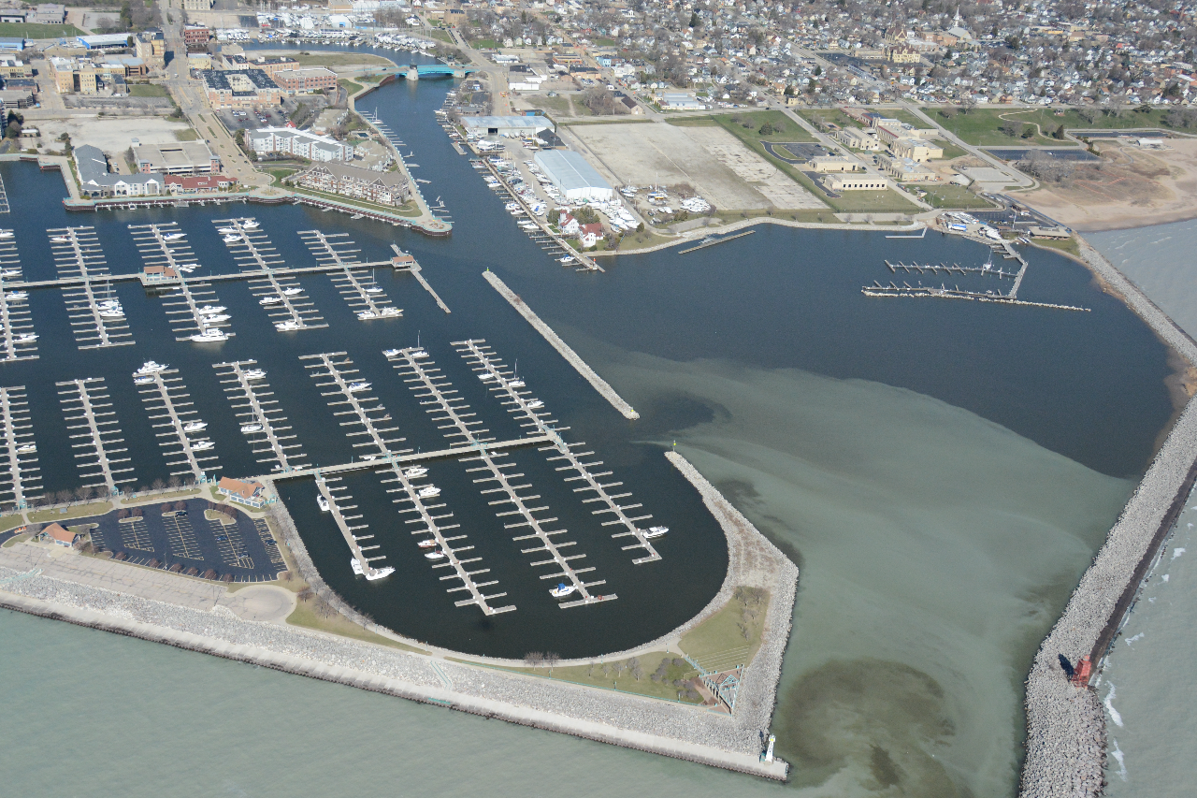
Racine Harbor: 2018 Aerial Photograph
Image: UW Space Science and Engineering 2018
Notes:
Aerial photo of Racine Harbor 2018.
Taken from the perspective of the plane flying over the entrance to the harbor, the many docks and boat slips of the Reefpoint Marina are visible adjacent to the south breakwater. The white Racine Reef Lighthouse can be seen at the tip of the south breakwater wall. The U.S. Coast Guard Station, with its red roof and white brick façade is visible on the north bank of the Root River. The red Racine Breakwater Lighthouse is visible on the northern breakwater wall.
Image source: UW Space Science and Engineering 2018

