Slide 1
The Engineering Design Process
Lesson 1 An Introduction to Coastal Engineering
Wisconsin Sea Grant © October 2025 | Coastal Engineering Education: People, Place and Practice: Lesson 1:An Introduction to Coastal Engineering Image used with written permission by JB the Explorer
This curriculum was prepared by Adam Bechle, Ginny Carlton, and Anne Moser under award number NA21NOS4290005 from the Great Lakes Bay Watershed Education and Training (B-WET) program of the National Oceanic and Atmospheric Administration (NOAA), U.S. Department of Commerce. The statements, findings, conclusions and recommendations are those of the author(s) and do not necessarily reflect the views of NOAA or the U.S. Department of Commerce.
Notes:
Image Source: https://www.flickr.com/photos/producerjb/43643260870 Racine Breakwater Lighthouse
JB the Explorer took this photo of the Racine Breakwater Lighthouse in July of 2017 while at the Racine Harbor.
This lighthouse was first lit in November of 1901.
In the distance, you can see the Wind Point Lighthouse.
Image used with written permission by JB the Explorer as provided via JB's Native Garden@PlantNativeWI
Previously on Twitter and now on X @ExplorerJB

Slide 2
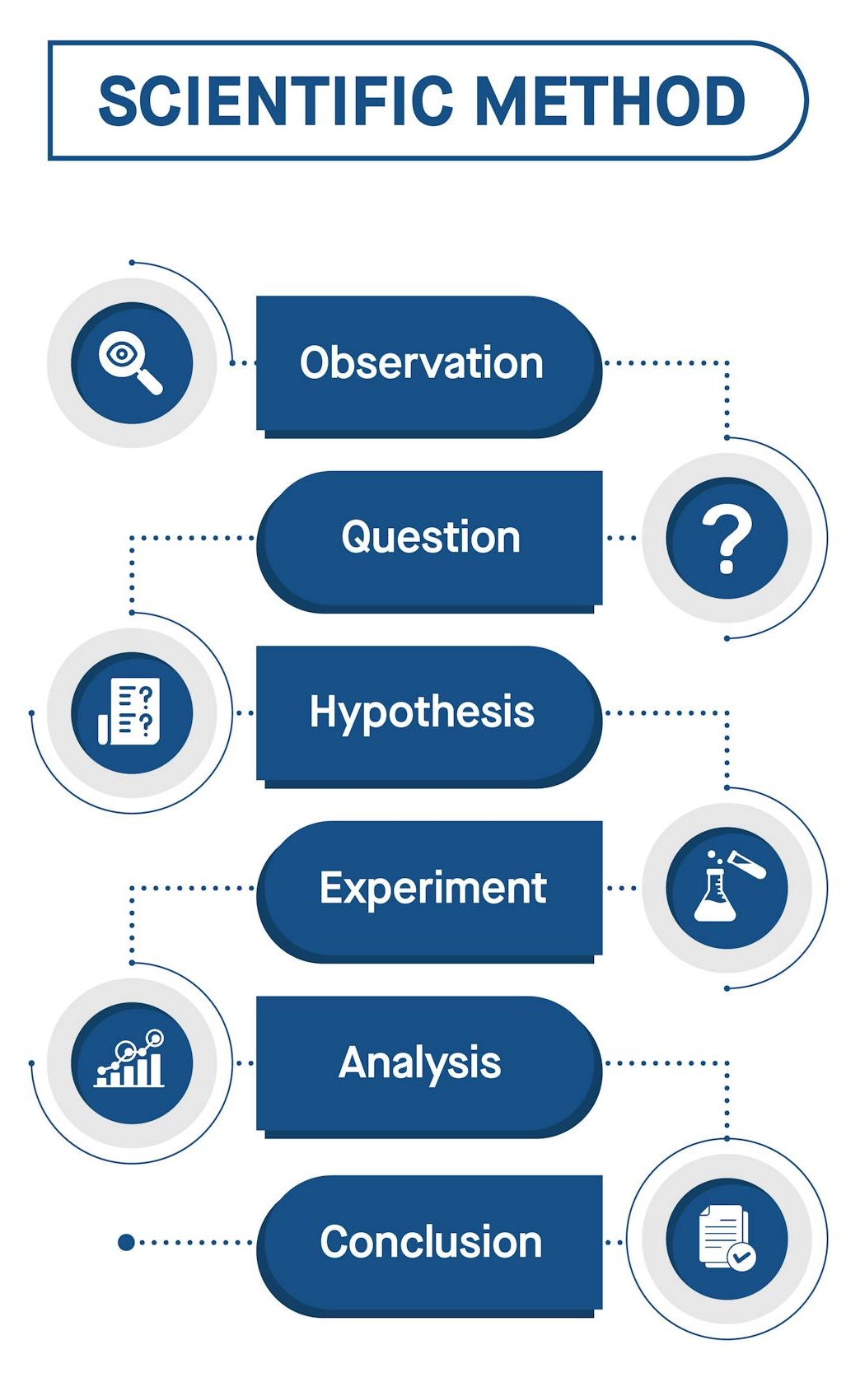
Review the Scientific Method
Graphic by American Journal Experts (AJE)
Notes:
The scientific method consists of six steps The steps are: 1) Observation, 2) Question (Research topic area), 3) Create a hypothesis, 4) Test with experiment, 5) Analyze data, and 6) Report conclusions.
Graphic source: American Journal Experts (AJE). (October 27, 2024). What is the Scientific Method?: How does it work and why is it important? https://www.aje.com/arc/what-is-the-scientific-method

Slide 3
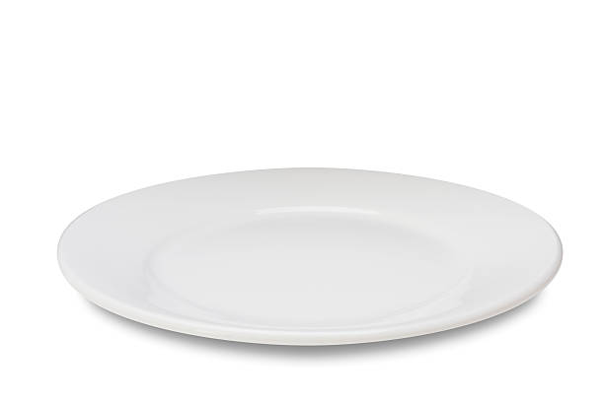
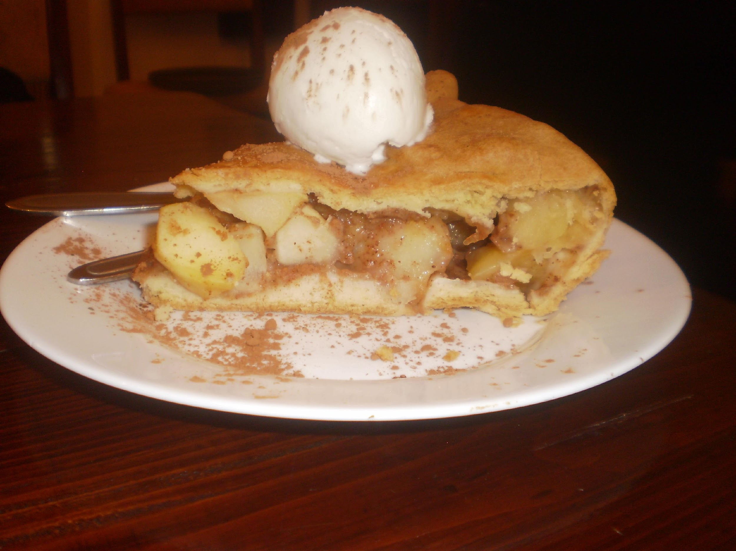
The Engineering Design Process – Create a Utensil
A
B
Notes:
Let's use a real-life example to learn about a different procedure used by engineers - the engineering design process or EDP. We want to get from step A (a plate with apple pie à la mode—or pie with ice cream on top) to step B (an empty plate). Our challenge is to create a utensil that will enable us to eat every morsel of the pie and ice cream.

Slide 4
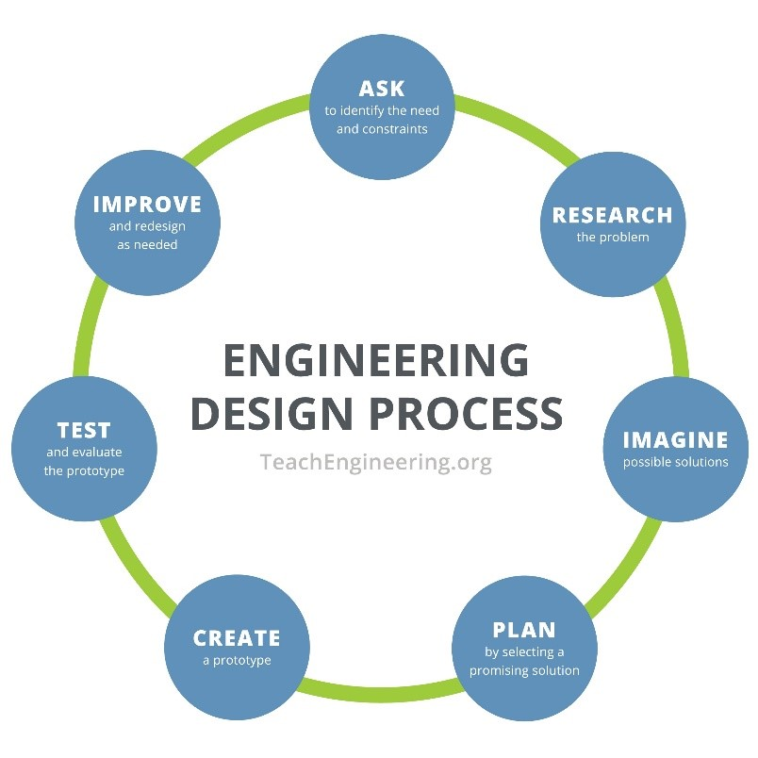
Engineering Design Process
Notes:
The engineering design process (EDP) has seven steps and is an iterative process. You begin by asking a question – What are my needs and constraints?
You continue with the remaining six steps around the circle. After step six, “testing,” you take what you learned and begin again to improve your design.

Slide 5
EDP Steps for Creating a Pie-Eating Utensil
Ask: Identify the Need (Criteria) & Constraints We want to eat delicious pie à la mode but it tends to be messy and we often lose some of the yummy parts (using a fork). It’s also difficult to get bite-sized pieces (using a spoon). We are constrained by how large our utensil should be based on the size of the human mouth.
Research Since we are designing a new utensil, it is imperative that we research how pies are eaten. Books or a web search might tell us, but we can also experiment with various items that we think might work: a fork, a spoon, a shovel.
Imagine: Develop Possible Solutions Using a fork or a spoon, or a shovel for that matter, is not perfect. There must be a better way. I wonder what happens when we combine two tools? Maybe we could develop a “spork” or a “foon”?
Plan: Select a Promising Solution Since we plan to market our new utensil, “Spork” sounds better – let's try that.
Create: Build a Prototype Done!
Test and Evaluate Prototype Eat pie à la mode!
Improve: Redesign as Needed It works just great, the pie à la mode is delicious! A spork is born.
Notes:
So, for our challenge of creating a better utensil for eating pie à la mode, here is an example of the EDP steps.

Slide 6
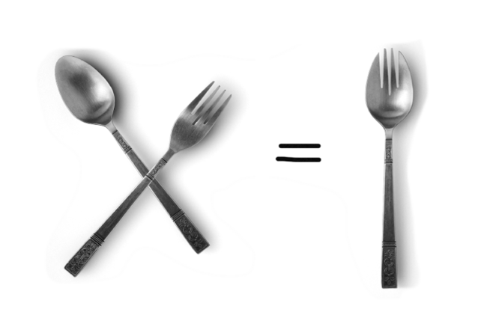
A “Spork”
Notes:
Voila! A spork.

Slide 7
Comparison of Scientific Method and
Engineering Design Process

Slide 8
Image Credits
Scientific Method Diagram by American Journal Experts (AJE). (October 27, 2024). What is the Scientific Method?: How does it work and why is it important?
https://www.aje.com/arc/what-is-the-scientific-method
John Gieriet of the Hotel La Perl as displayed on Wikipedia page “Pie a la Mode” https://en.wikipedia.org/wiki/Pie_%C3%A0_la_Mode
Stocksnap: https://stocksnap.io/search/white%20plate
Teach Engineering: Ignite Stem Learning in K-12. (n.d.) Engineering Design Process. https://www.teachengineering.org/populartopics/designprocess
Fine Art America https://fineartamerica.com/featured/intercross-widi-hardhanu.html?product=poster

