Slide 1
Return to Racine Harbor
Lesson 1 An Introduction to Coastal Engineering
Wisconsin Sea Grant © October 2025| Coastal Engineering Education: People, Place and Practice: Lesson 1:An Introduction to Coastal Engineering Image used with written permission by JB the Explorer
This curriculum was prepared by Adam Bechle, Ginny Carlton, and Anne Moser under award number NA21NOS4290005 from the Great Lakes Bay Watershed Education and Training (B-WET) program of the National Oceanic and Atmospheric Administration (NOAA), U.S. Department of Commerce. The statements, findings, conclusions and recommendations are those of the author(s) and do not necessarily reflect the views of NOAA or the U.S. Department of Commerce.
Notes:
Image Source: https://www.flickr.com/photos/producerjb/43643260870 Racine Breakwater Lighthouse
JB the Explorer took this photo of the Racine Breakwater Lighthouse in July of 2017 while at the Racine Harbor.
This lighthouse was first lit in November of 1901.
In the distance, you can see the Wind Point Lighthouse.
Image used with written permission by JB the Explorer as provided via JB's Native Garden@PlantNativeWI
Previously on Twitter and now on X @ExplorerJB

Slide 2
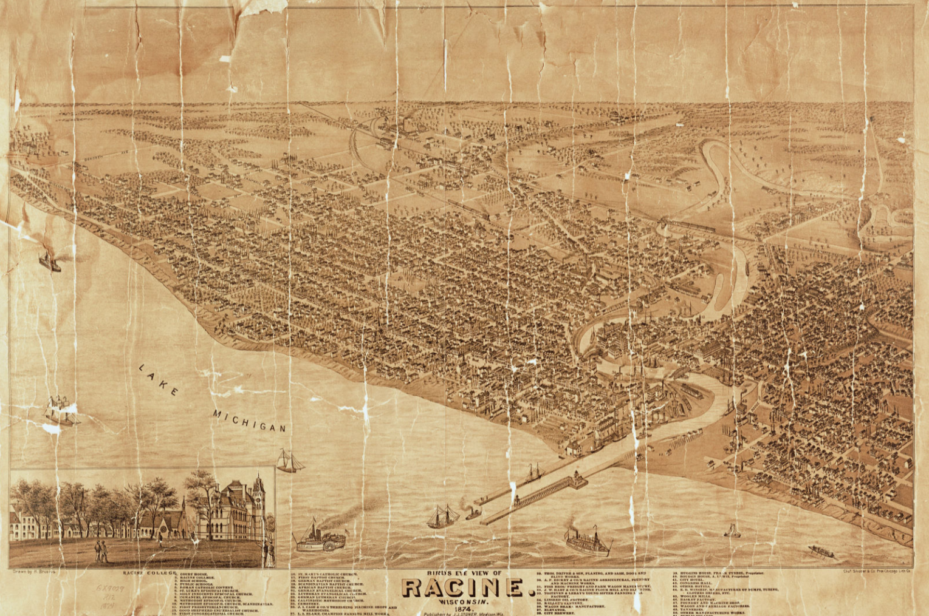
Racine Harbor – 1874 Map
Source: https://content.wisconsinhistory.org/digital/collection/maps/id/130/
Notes:
Say to students: We saw this image in the previous slideshow. Why do you think the city of Racine was established where it was? What was important about this place?
(Direct students’ attention to the fact that the Root River enters Lake Michigan here.)
Image source: Wisconsin Historical Society. Bird's-eye map of Racine, with an inset of Racine College. https://content.wisconsinhistory.org/digital/collection/maps/id/130/

Slide 3
Racine Harbor – 1874 Map: With ship sailing into port
Source: https://content.wisconsinhistory.org/digital/collection/maps/id/130/
Notes:
Say to students: Note boat circled in red. Lake Michigan is at the bottom of the image. The lake lies to the east of the city of Racine. So, if you were in the boat heading toward the city of Racine and the mouth of the Root River, what direction would you be traveling?
Image source: Wisconsin Historical Society. Bird's-eye map of Racine, with an inset of Racine College. https://content.wisconsinhistory.org/digital/collection/maps/id/130/

Slide 4
Racine Harbor – 1874 Map: Featuring bend in the Root River
Source: https://content.wisconsinhistory.org/digital/collection/maps/id/130/
Notes:
Tell students: Notice the bends in the Root River, especially the one further inland.
Image source: Wisconsin Historical Society. Bird's-eye map of Racine, with an inset of Racine College. https://content.wisconsinhistory.org/digital/collection/maps/id/130/

Slide 5
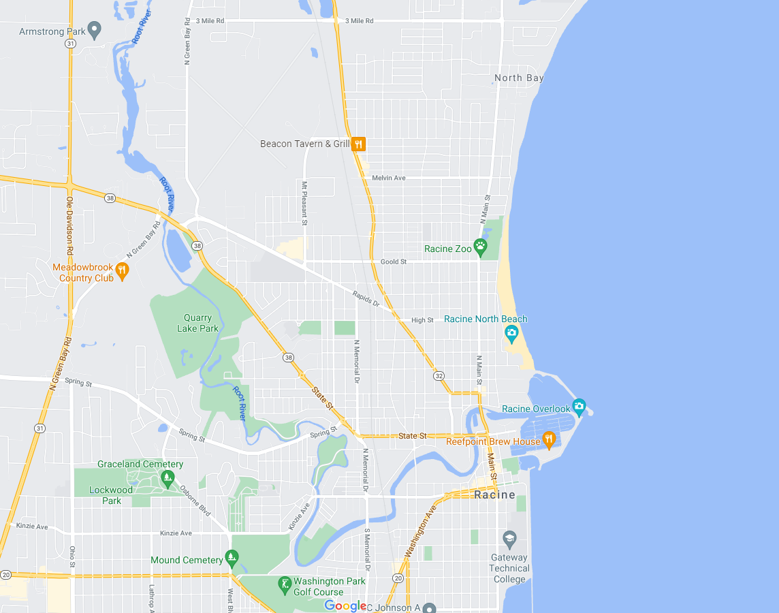
Modern Google Map of City of Racine: Featuring bend in Root River at Cedar Bend Park
Lake Michigan
Cedar Bend Park
Notes:
Google map with location of school highlighted.
Tell students: Notice the same bend in the Root River located at what is now called Cedar Bend Park. This time Lake Michigan is at the right of the image (rather than the bottom as it was before). By convention, we usually orient the top of an image toward north, the right is then east, the bottom is south, and the left is west.
Image source: Google maps

Slide 6
Modern Google Map of City of Racine: Featuring location of Jerstad-Agerholm Middle School
Lake Michigan
Jerstad-Agerholm Middle School
Cedar Bend Park
Notes:
Google map with location of school highlighted.
Ask students: To get from our school to the Root River where it bends at Cedar Bend Park, which direction would you travel? And what direction would you travel from our school to get to Lake Michigan?
Image source: Google maps

Slide 7
Modern Google Map of City of Racine: Featuring location of North Beach
Lake Michigan
Jerstad-Agerholm Middle School
Notes:
Google map with North Beach highlighted.
Formative assessment: Ask students, "To get from our school to North Beach Oasis, what direction would you need to go?“
Image source: Google maps

