Slide 1
Coastal Terms Answer Key
Lesson 2 The Coastal Features and Processes of the Great Lakes
Wisconsin Sea Grant © October 2025| Coastal Engineering Education: People, Place and Practice: Lesson 2 The Coastal Features and Processes of the Great Lakes Image used with written permission by JB the Explorer
This curriculum was prepared by Adam Bechle, Ginny Carlton, and Anne Moser under award number NA21NOS4290005 from the Great Lakes Bay Watershed Education and Training (B-WET) program of the National Oceanic and Atmospheric Administration (NOAA), U.S. Department of Commerce. The statements, findings, conclusions and recommendations are those of the author(s) and do not necessarily reflect the views of NOAA or the U.S. Department of Commerce.
Notes:
Image Source: https://www.flickr.com/photos/producerjb/43643260870 Racine Breakwater Lighthouse
JB the Explorer took this photo of the Racine Breakwater Lighthouse in July of 2017 while at the Racine Harbor.
This lighthouse was first lit in November of 1901.
In the distance, you can see the Wind Point Lighthouse.
Image used with written permission by JB the Explorer as provided via JB's Native Garden@PlantNativeWI
Previously on Twitter and now on X @ExplorerJB

Slide 2
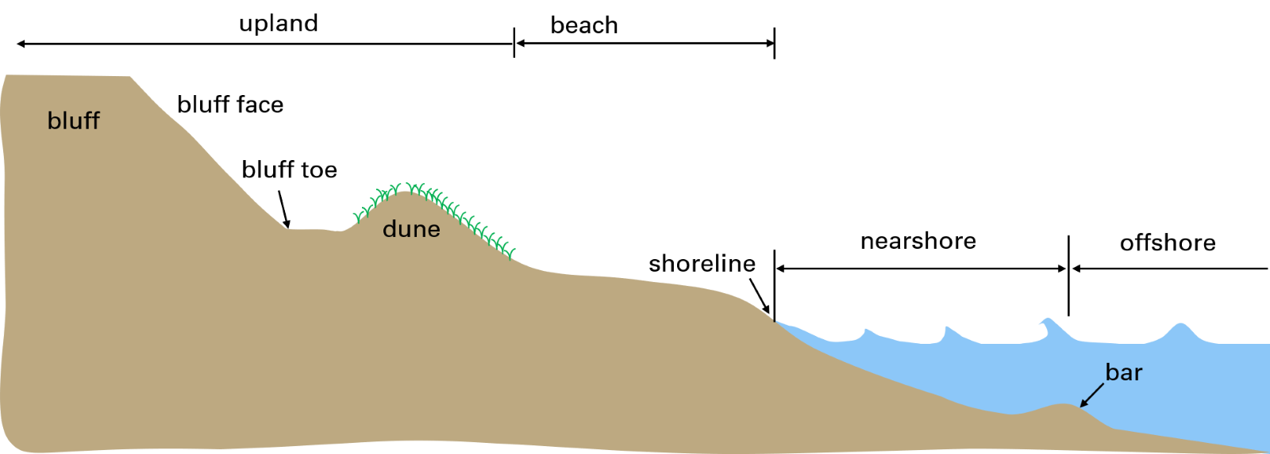
Coastal Terms – Drag and Drop – Answer Key

Slide 3
Coastal Terms
Bar underwater ridge of sand running roughly parallel to the shore. ​
Beach the zone of loose sediment between the shoreline and where there is a line of permanent vegetation or a change in sediment. The beach typically ends where the dune or bluff begins.​
Bluff a soil slope rising above the beach.​
Bluff face the sloping section of a dune, bank, bluff or coastal structure​.
Bluff toe the base of a dune, bank, bluff or coastal structure. ​
Dune the ridge of loose, wind-blown sand. This is often the first location that has permanent vegetation.​
Nearshore the zone of water between where waves begin breaking and the shoreline​.
Offshore the zone of water lakeward of where wave breaking occurs. The offshore area is typically on the lakeward side of a bar.​
Shoreline the point where the lake water meets the land.​
Upland the zone of land above the reach of waves and landward of the beach. The upland typically includes the dunes and/or bluffs.

