Slide 1
Coastal Terms
Lesson 2 The Coastal Features and Processes of the Great Lakes
Wisconsin Sea Grant © October 2025 | Coastal Engineering Education: People, Place and Practice: Lesson 2 The Coastal Features and Processes of the Great Lakes Image used with written permission by JB the Explorer
This curriculum was prepared by Adam Bechle, Ginny Carlton, and Anne Moser under award number NA21NOS4290005 from the Great Lakes Bay Watershed Education and Training (B-WET) program of the National Oceanic and Atmospheric Administration (NOAA), U.S. Department of Commerce. The statements, findings, conclusions and recommendations are those of the author(s) and do not necessarily reflect the views of NOAA or the U.S. Department of Commerce.
Notes:
Image Source: https://www.flickr.com/photos/producerjb/43643260870 Racine Breakwater Lighthouse
JB the Explorer took this photo of the Racine Breakwater Lighthouse in July of 2017 while at the Racine Harbor.
This lighthouse was first lit in November of 1901.
In the distance, you can see the Wind Point Lighthouse.
Image used with written permission by JB the Explorer as provided via JB's Native Garden@PlantNativeWI
Previously on Twitter and now on X @ExplorerJB

Slide 2
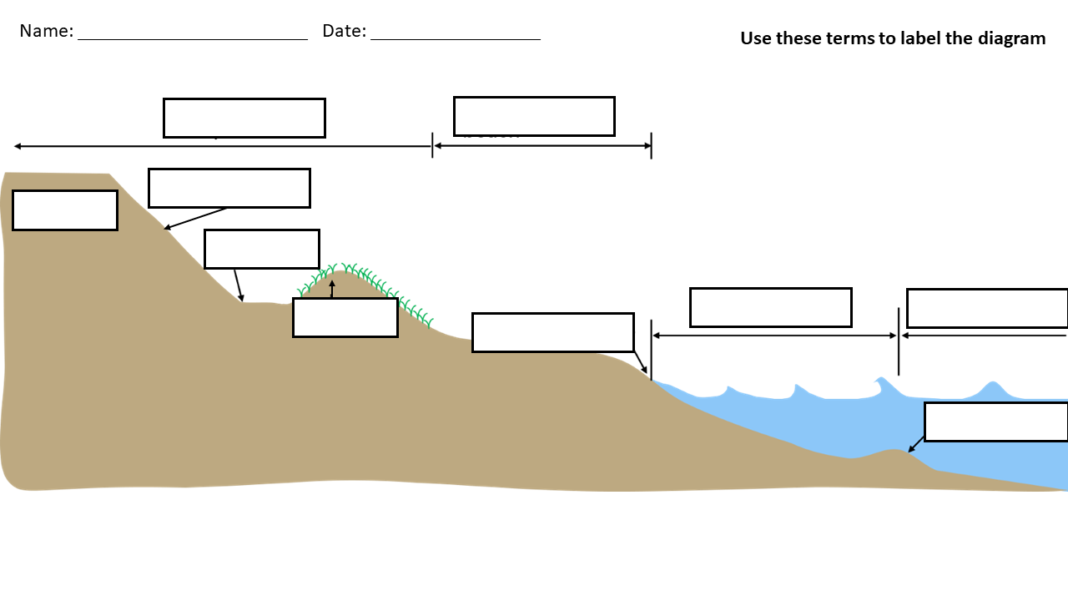
Coastal Terms – Drag and Drop
Name:
Date:
Use these terms to label the diagram
Beach
Dune
Bar
Nearshore
Bluff
Offshore
Bluff face
Shoreline
Bluff toe
Upland

