Slide 1
Four Coastal Processes… that interact to make a mess
Lesson 2 The Coastal Features and Processes of the Great Lakes
Wisconsin Sea Grant © October 2025 | Coastal Engineering Education: People, Place and Practice: Lesson 2 The Coastal Features and Processes of the Great Lakes Image used with written permission by JB the Explorer
This curriculum was prepared by Adam Bechle, Ginny Carlton, and Anne Moser under award number NA21NOS4290005 from the Great Lakes Bay Watershed Education and Training (B-WET) program of the National Oceanic and Atmospheric Administration (NOAA), U.S. Department of Commerce. The statements, findings, conclusions and recommendations are those of the author(s) and do not necessarily reflect the views of NOAA or the U.S. Department of Commerce.
Notes:
Image Source: https://www.flickr.com/photos/producerjb/43643260870 Racine Breakwater Lighthouse
JB the Explorer took this photo of the Racine Breakwater Lighthouse in July of 2017 while at the Racine Harbor.
This lighthouse was first lit in November of 1901.
In the distance, you can see the Wind Point Lighthouse.
Image used with written permission by JB the Explorer as provided via JB's Native Garden@PlantNativeWI
Previously on Twitter and now on X @ExplorerJB

Slide 2
Four coastal processes
Changing water levels
Waves
Currents
Sediment transport
Notes:
The four coastal processes that influence how a beach appears are:
changing water levels;
waves;
currents;
and sediment transport.

Slide 3
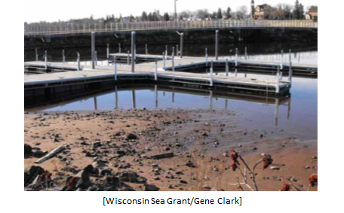
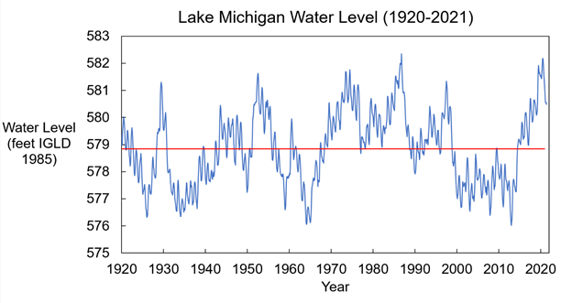
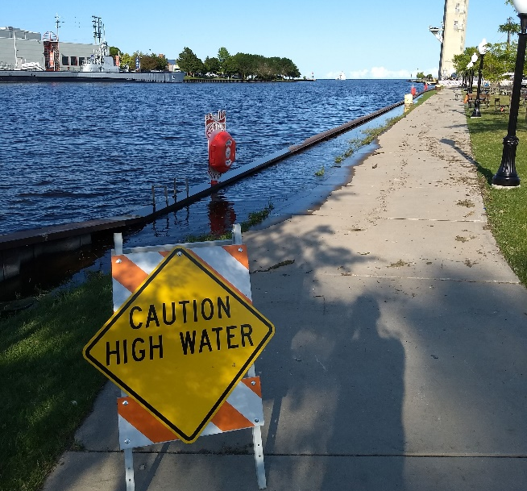
1. Changing water levels
Notes:
High water makes a big impact because it can submerge large portions of the beach underwater.
Low water levels can be problematic for boats because there might not be enough water to float the boat.
Graph source: Wisconsin Sea Grant, Adam Bechle
Image 1 source: Wisconsin Sea Grant, Gene Clark
Image 2 source: Wisconsin Sea Grant, https://sewicoastalresilience.org/resilience-resources/resource-of-the-month/

Slide 4
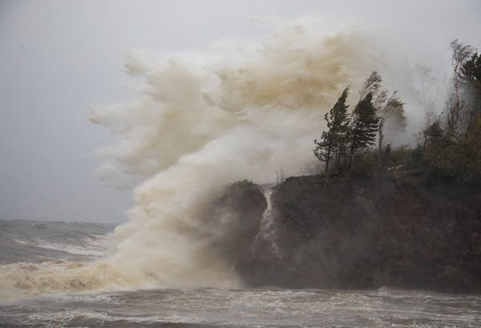
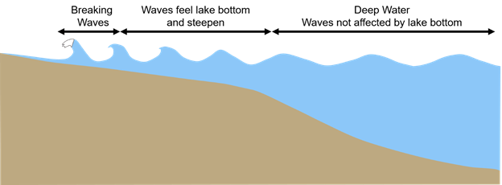
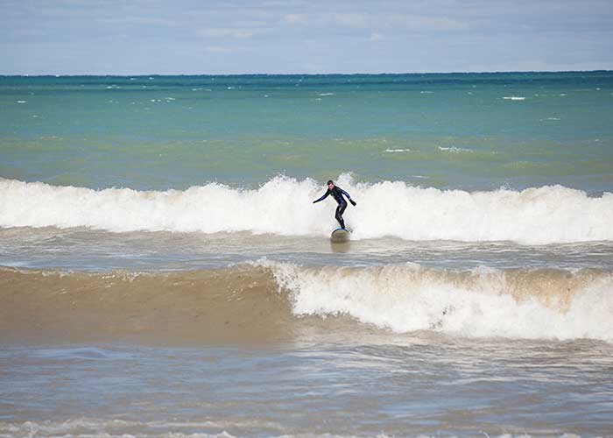
2. Waves
Image source: Boreal.org
Image source: USA Today
Notes:
Waves are the dominant force that work to shape the coast – they erode our shorelines and can cause bluffs to collapse.
The larger the wave, the more energy it has to change the coast.
Lake Michigan waves can even make for good surfing! As the waves enter shallower water, the bottom of the wave “feels” friction with the lake bottom and “tips over” in a process known as breaking.
High water combined with waves means the waves can cause even MORE damage.
Drawing source: Wisconsin Sea Grant, Adam Bechle, Adapted from U.S. Army Corps of Engineers Coastal Engineering Manual
Photo 1 source – Tettegouche State Park (MN) on Lake Superior Conrad Collaco · CBC News · October 10, 2018 Here's why it's been a deadly year for drownings in the Great Lakes
https://www.boreal.org/2018/10/11/181868/heres-why-its-been-a-deadly-year-for-drownings-in-the-great-lakes
Photo 2 source – Lois Alter Mark (Published on March 2, 2020) USA Today 10 Best Sheboygan, the "Malibu of the Midwest“https://10best.usatoday.com/travel/10-reasons-visit-sheboygan-wisconsin-malibu-midwest/

Slide 5
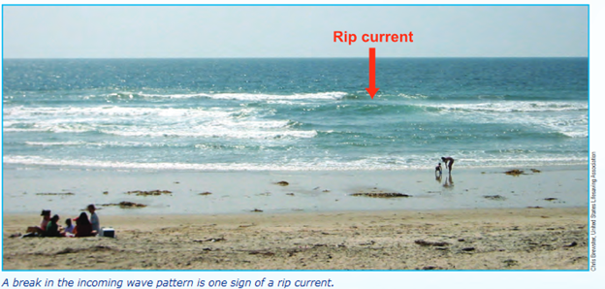
3. Currents
Image source: Chris Brewster, US Lifesaving Association
Notes:
When waves hit the shore, they push water with them. This flow of water is known as a current.
A rip current is a narrow current that moves away from the shore.
If waves hit the coast at an angle, they can push the currents along the shore.
Image source: Chris Brewster, US Lifesaving Association

Slide 6
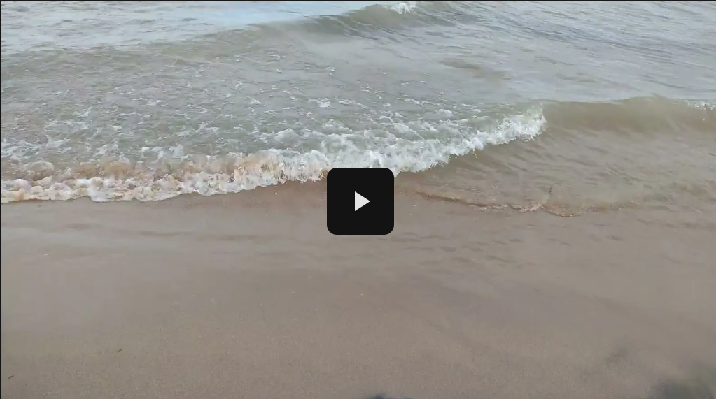
Currents video
Notes:
NOTE TO TEACHER: Before playing the video, point out the stick the students should watch.
Ask: Which direction are the currents flowing in this video? You can watch for particles moving in the water or make an educated guess based on the wave direction.

Slide 7
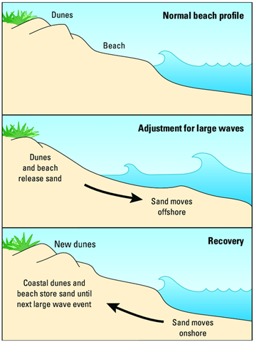
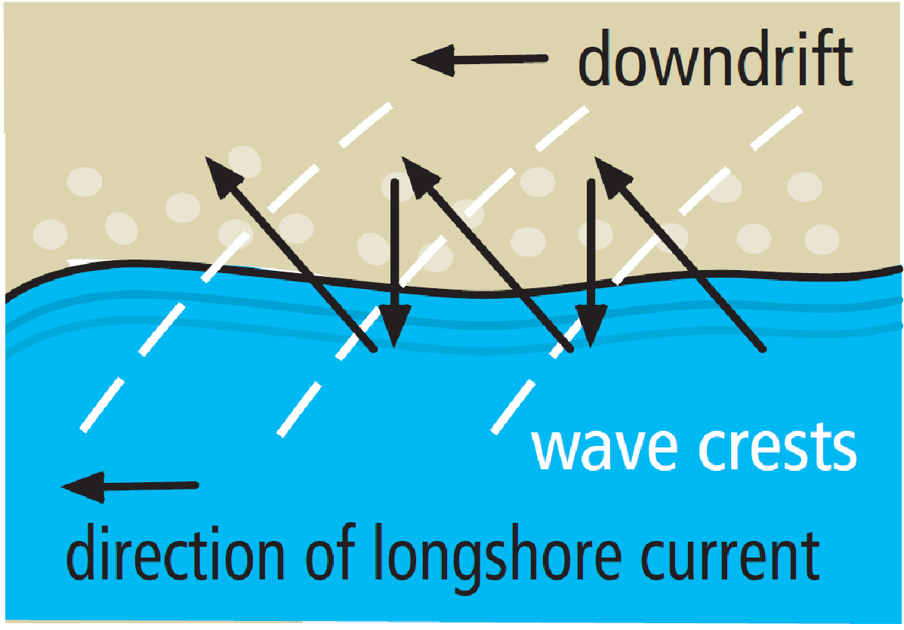
4. Sediment transport
Notes:
Waves and currents can pick up and move sand and other sediments. Depending on the size and direction of the waves, sediment transport can be either offshore (and onshore) or along the shore.
The beach profile adjusts depending on the size of the waves. Larger waves often occur in the late fall and winter, while gentler waves occur in summer.
Panel 1: Normal beach profile: Dunes, beach, and gently sloping lakebed in the nearshore area. Waves are of normal height and break near the shoreline.
Panel 2: Adjustment for large waves: Dunes and beach release sand, causing the height and slope of the beach to decrease as sand moves offshore. A bar typically forms at some distance from the shoreline.
Panel 3: Recovery: Coastal dunes and beach store sand as sand moves onshore until the next large wave event. The height and number of dunes and slope of the beach increases.
Image 2: Diagram of alongshore currents from a birds-eye perspective. (Alongshore currents are also called longshore currents.)
At the bottom half of the diagram is a blue lake. At the top half of the diagram is a tan beach. Randomly spaced tan circles represent individual grains of sand or sediment. (This is a very magnified view.)
The direction of the long current is represented by a leftward pointing arrow, showing current moving from right to left.
A series of three wave crests, represented by parallel, curved white lines, intersect the shoreline at approximately a 30 degree angle.
Due to the longshore current, wave crests, and gravity individual sand grains will move across the beach. In this case, the sand grain will move onto the beach at approximately a 30 degree angle--the same as the wave crest. Then, due to gravity, the sand grain will roll back down the beach toward the lake.
The resulting movement of sand is represented in the image by a series of arrowed lines that ultimately form a zig-zag pattern; with the zig arrows moving from the lake onto the beach at approximately 30 degree angles and the zag arrows moving from the beach to the lake at approximately 90 degree angles.
Drawing source: Wisconsin Sea Grant, Adam Bechle, Adapted from U.S. Army Corps of Engineers Coastal Engineering Manual

Slide 8
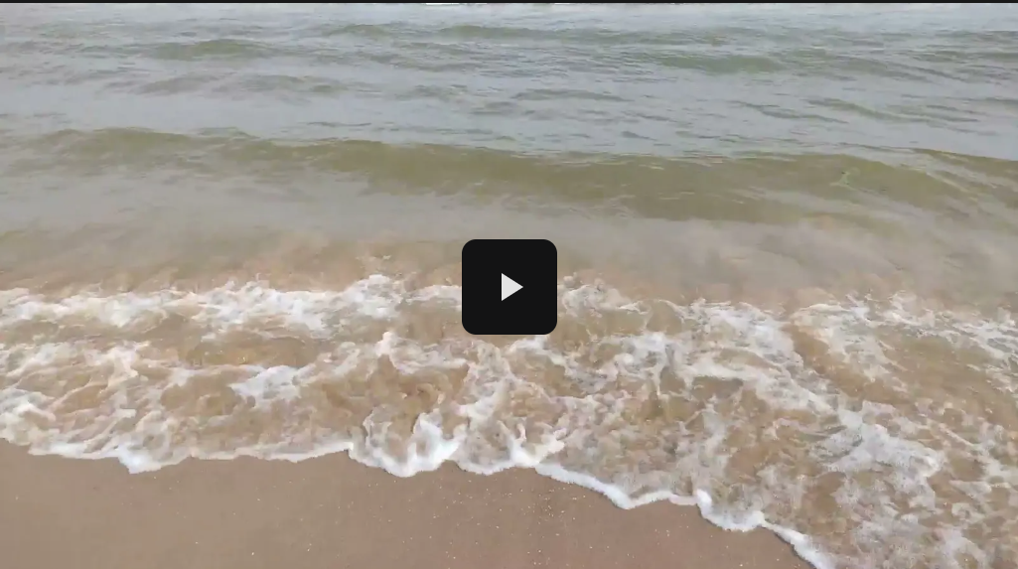
Sediment transport video
Notes:
Can you see the sand being churned up by the waves? This sand is being transported.

