Slide 1
Lake Michigan Water Levels
Lesson 2 The Coastal Features and Processes of the Great Lakes
Wisconsin Sea Grant © October 2025| Coastal Engineering Education: People, Place and Practice: Lesson 2 The Coastal Features and Processes of the Great Lakes Image used with written permission by JB the Explorer
This curriculum was prepared by Adam Bechle, Ginny Carlton, and Anne Moser under award number NA21NOS4290005 from the Great Lakes Bay Watershed Education and Training (B-WET) program of the National Oceanic and Atmospheric Administration (NOAA), U.S. Department of Commerce. The statements, findings, conclusions and recommendations are those of the author(s) and do not necessarily reflect the views of NOAA or the U.S. Department of Commerce.
Notes:
Image Source: https://www.flickr.com/photos/producerjb/43643260870 Racine Breakwater Lighthouse
JB the Explorer took this photo of the Racine Breakwater Lighthouse in July of 2017 while at the Racine Harbor.
This lighthouse was first lit in November of 1901.
In the distance, you can see the Wind Point Lighthouse.
Image used with written permission by JB the Explorer as provided via JB's Native Garden@PlantNativeWI
Previously on Twitter and now on X @ExplorerJB

Slide 2
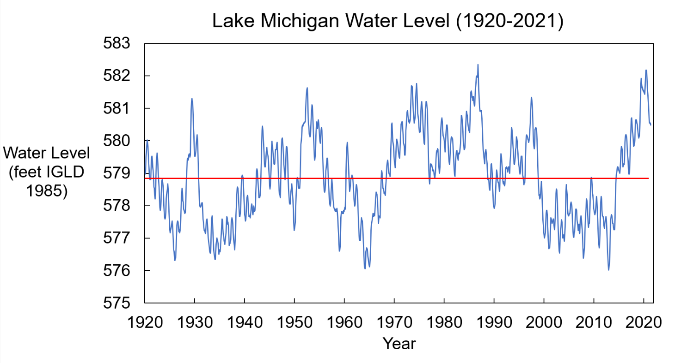
Lake Michigan Water Level (1920-2021)
Notes:
Note to educator:
Look at the graph. Notice that the Y-axis for this graph is not measured in feet, but rather “feet IGLD 1985.” What does “feet IGLD 1985” mean? The “IGLD” stands for “International Great Lakes Datum,” and as you might expect, 1985 stands for the year 1985.
Because of movement of the earth's crust, due to isostatic rebound, the "datum" or elevation reference system used to define water levels within the Great Lakes-St. Lawrence River system must be adjusted every 25 to 35 years.
[Note that isostatic rebound is the gradual rising or "bouncing back" of the earth's crust from the weight of the glaciers that covered the Great Lakes-St. Lawrence River region during the last ice age. The rate of isostatic rebound is not uniform across the basin. This movement causes benchmark location measurements to shift, not only with respect to the initial reference point at the Atlantic Ocean, but relative to each other as well.]
The new reference zero point of IGLD 1985 is located at Point Rimouski/Father’s Point, Quebec.
Graph source: Wisconsin Sea Grant, Adam Bechle

