Slide 1
Four Coastal Engineering Structures Found at North Beach
Lesson 3 Coastal Engineering Structures – Protecting the Shoreline
Wisconsin Sea Grant | October 2025 | Coastal Engineering Education: People, Place and Practice: Lesson 1:An Introduction to Coastal Engineering Image used with written permission by JB the Explorer
This curriculum was prepared by Adam Bechle , Ginny Carlton, and Anne Moser under award number NA21NOS4290005 from the Great Lakes Bay Watershed Education and Training (B-WET) program of the National Oceanic and Atmospheric Administration (NOAA), U.S. Department of Commerce. The statements, findings, conclusions and recommendations are those of the author(s) and do not necessarily reflect the views of NOAA or the U.S. Department of Commerce.
Notes:
Image Source: https://www.flickr.com/photos/producerjb/43643260870 Racine Breakwater Lighthouse
JB the Explorer took this photo of the Racine Breakwater Lighthouse in July of 2017 while at the Racine Harbor.
This lighthouse was first lit in November of 1901.
In the distance, you can see the Wind Point Lighthouse.
Image used with written permission by JB the Explorer as provided via JB's Native Garden@PlantNativeWI
Previously on Twitter and now on X @ExplorerJB

Slide 2
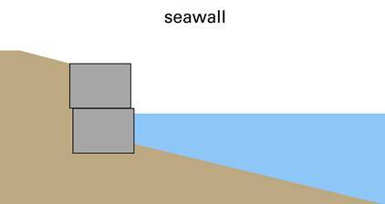
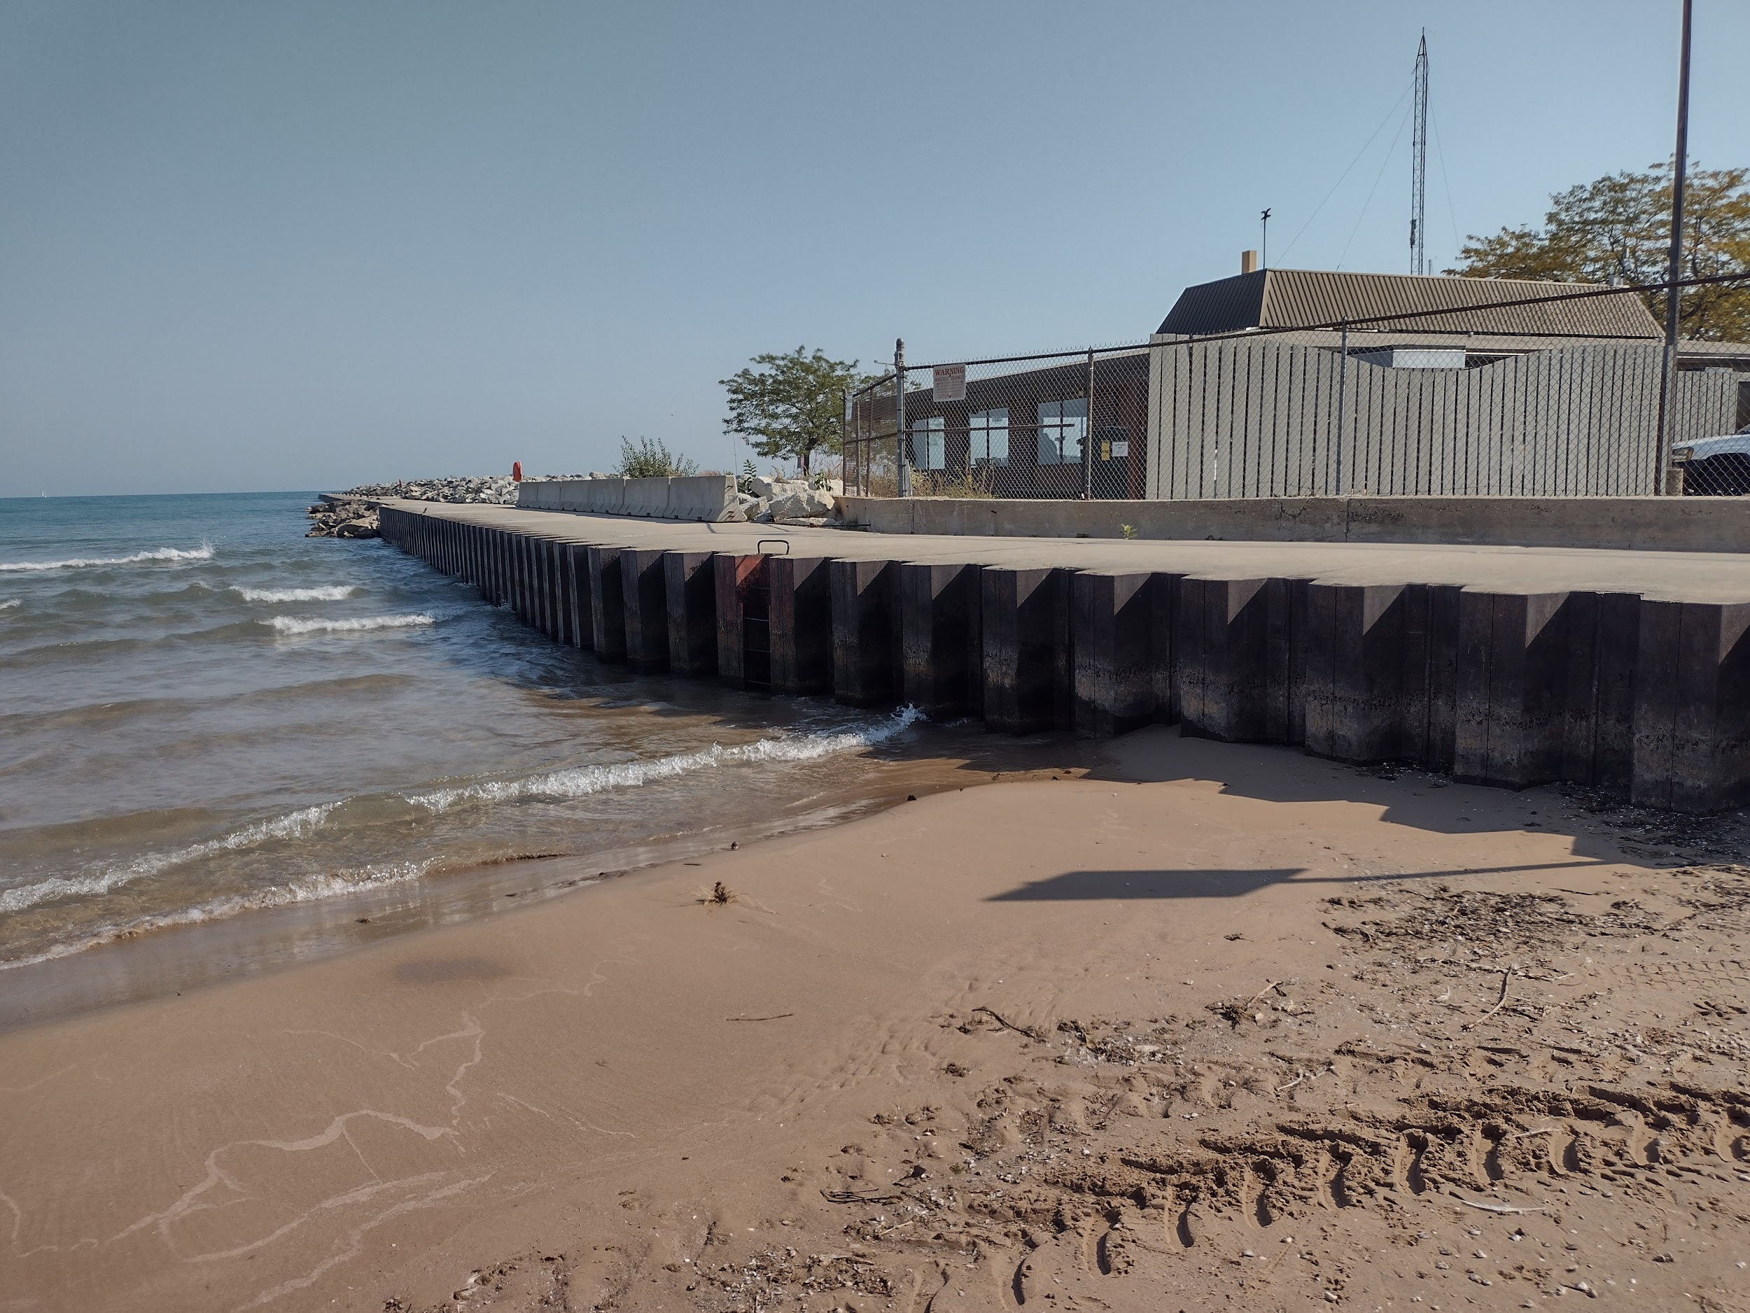
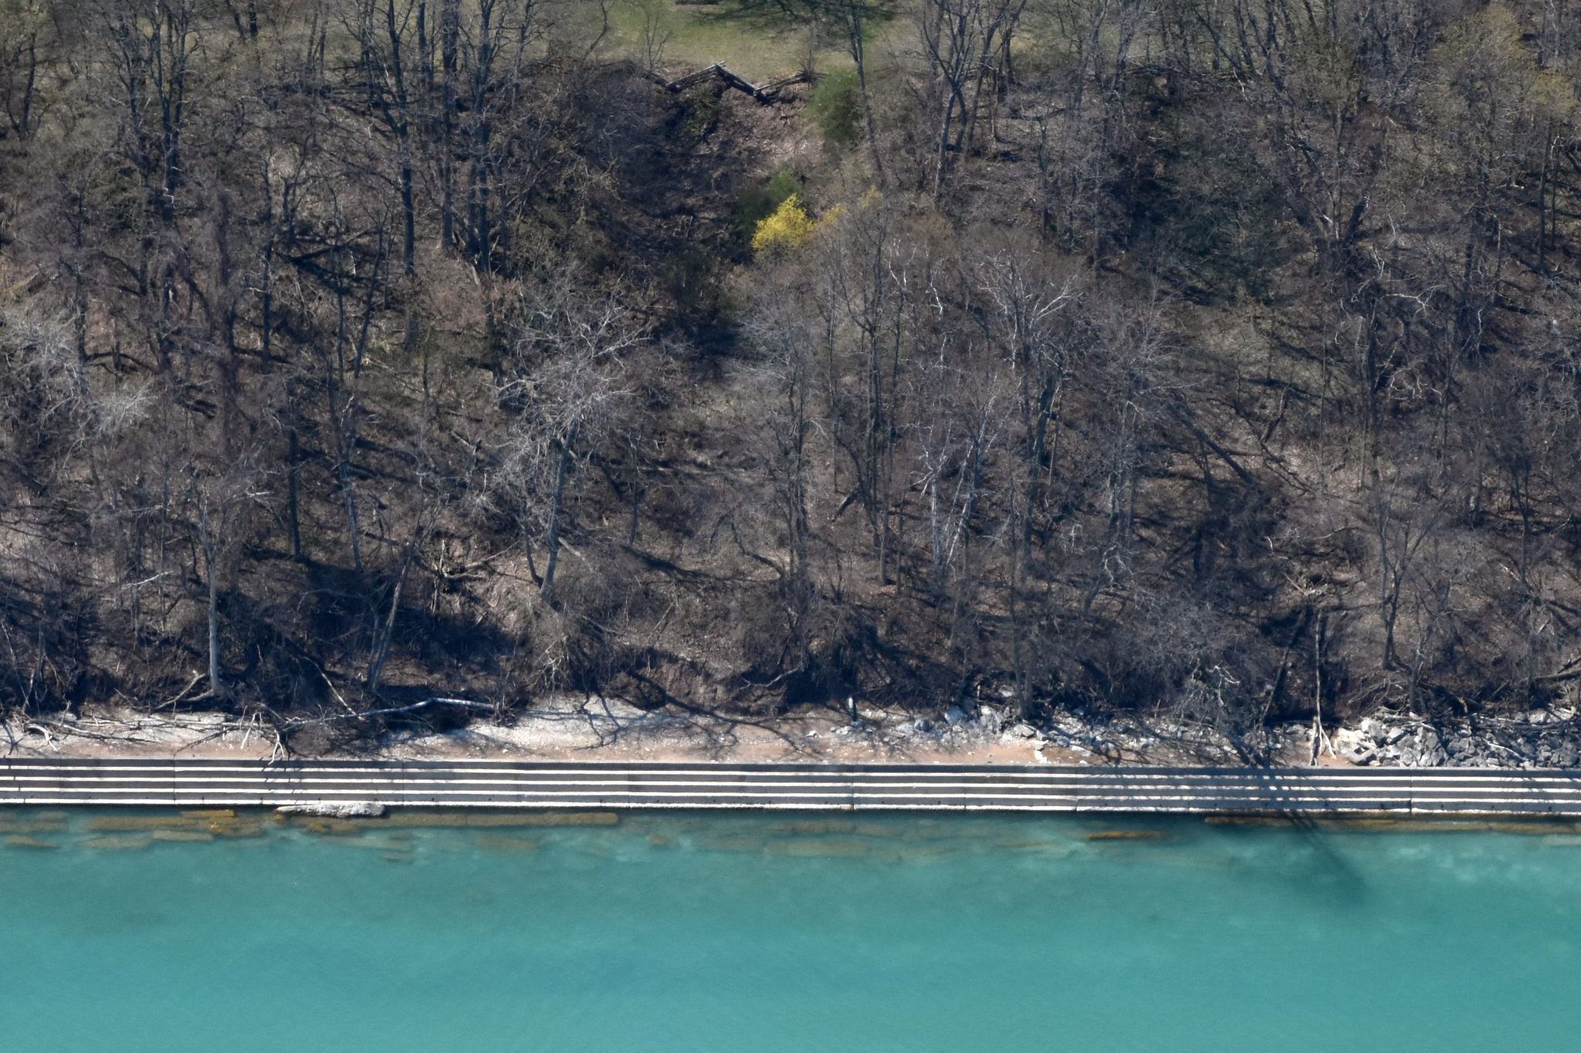
Seawall
Example 1: Steel Seawall at North Beach
Credit: Adam Bechle
Example 2: Concrete Seawall near Milwaukee
Credit: Capt. Dennis Carr

Slide 3
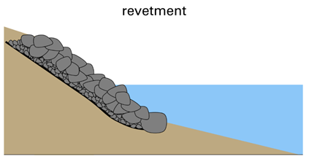
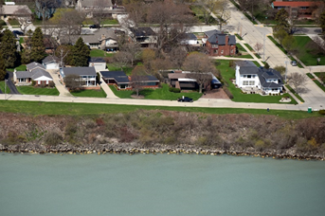
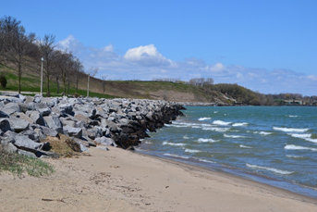
Revetment
Example 1: Revetment at Zoo Beach
Credit: Capt. Dennis Carr
Example 2: Revetment at Bender Park, Oak Creek
Credit: Adam Bechle

Slide 4
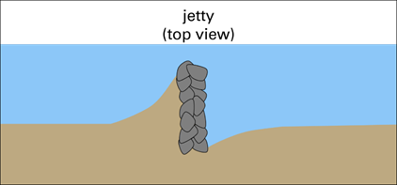
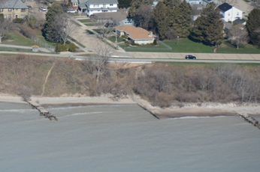
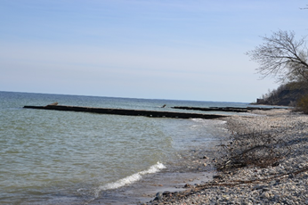
Jetty
Example 1: Jetties at Zoo Beach
Credit: Capt. Dennis Carr
Example 2: Jetties at Sheridan Park
Credit: Adam Bechle

Slide 5
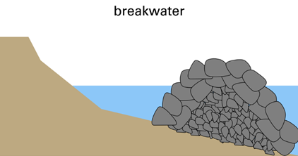
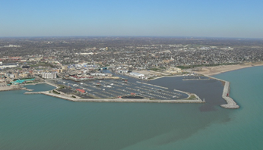
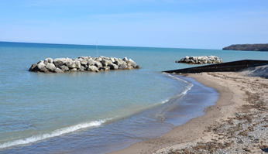
Breakwater
Example 1: Breakwaters protecting Racine Harbor
Credit: Dave Mickelson
Example 2: Breakwaters at Klode Park, Whitefish Bay
Credit: Adam Bechle

