Slide 1
Map It on Google Earth Instructions
Lesson 3 Coastal Engineering Structures – Protecting the Shoreline
Wisconsin Sea Grant | October 2025 | Coastal Engineering Education: People, Place and Practice: Lesson 1:An Introduction to Coastal Engineering Image used with written permission by JB the Explorer
This curriculum was prepared by Adam Bechle , Ginny Carlton, and Anne Moser under award number NA21NOS4290005 from the Great Lakes Bay Watershed Education and Training (B-WET) program of the National Oceanic and Atmospheric Administration (NOAA), U.S. Department of Commerce. The statements, findings, conclusions and recommendations are those of the author(s) and do not necessarily reflect the views of NOAA or the U.S. Department of Commerce.
Notes:
Image Source: https://www.flickr.com/photos/producerjb/43643260870 Racine Breakwater Lighthouse
JB the Explorer took this photo of the Racine Breakwater Lighthouse in July of 2017 while at the Racine Harbor.
This lighthouse was first lit in November of 1901.
In the distance, you can see the Wind Point Lighthouse.
Image used with written permission by JB the Explorer as provided via JB's Native Garden@PlantNativeWI
Previously on Twitter and now on X @ExplorerJB

Slide 2
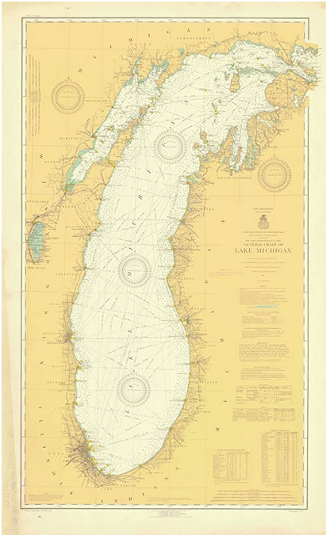
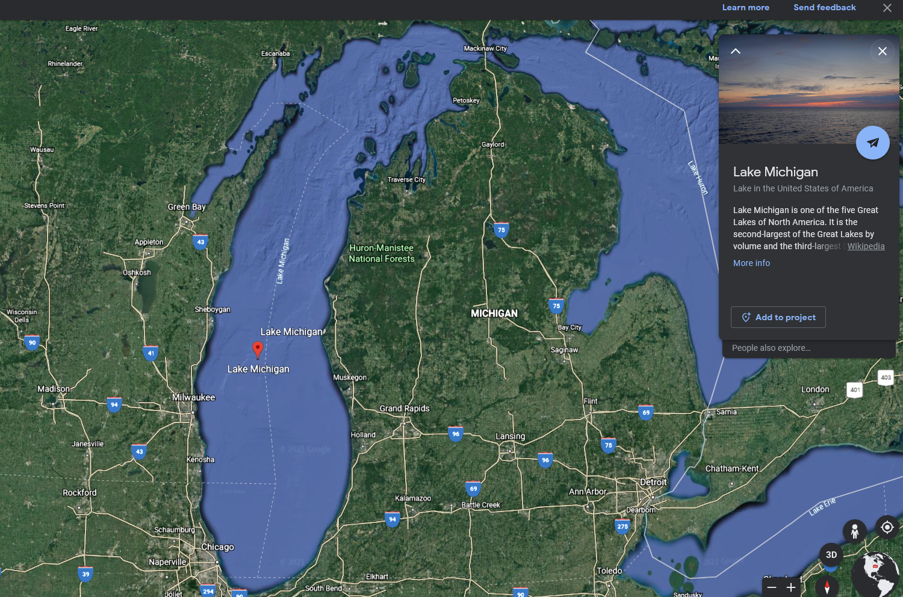
Map It on Google Earth
Notes:
Historical nautical chart 1919. Image source: https://www.amazon.com/Historical-Nautical-Chart-7-1-1919-Michigan/dp/B00KXE0J54

Slide 3
Google Earth Overview

Slide 4
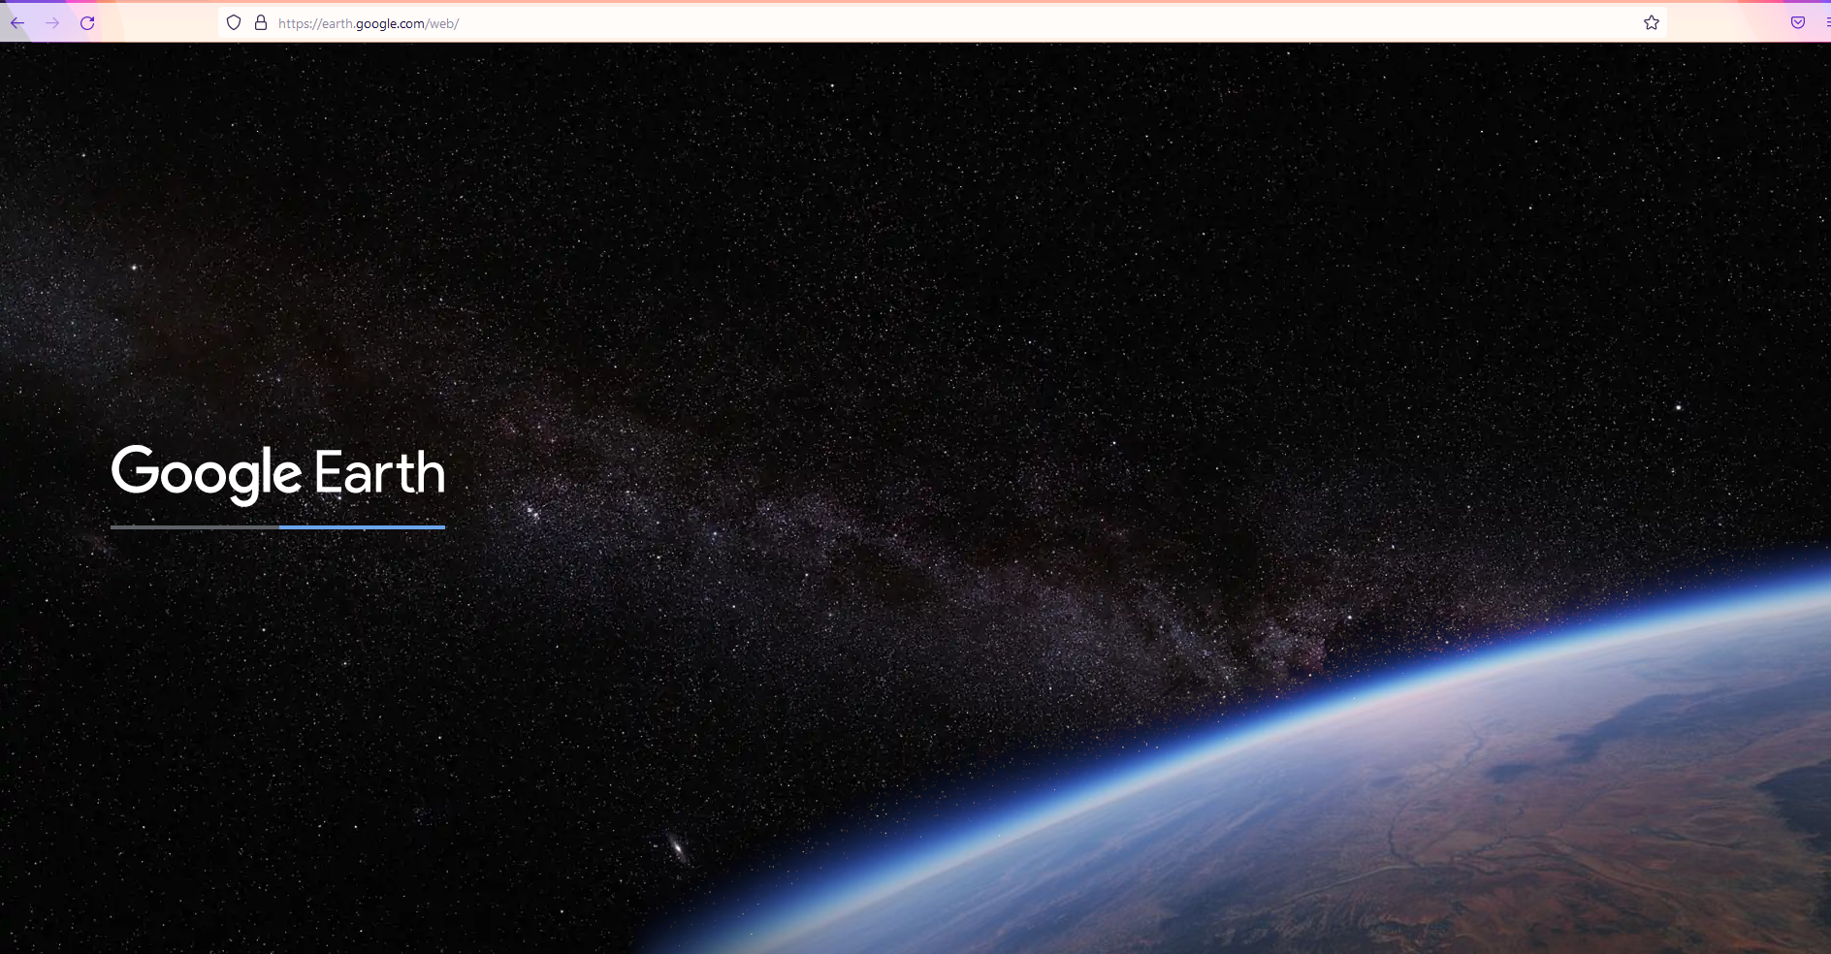
Google Earth Open Screen

Slide 5
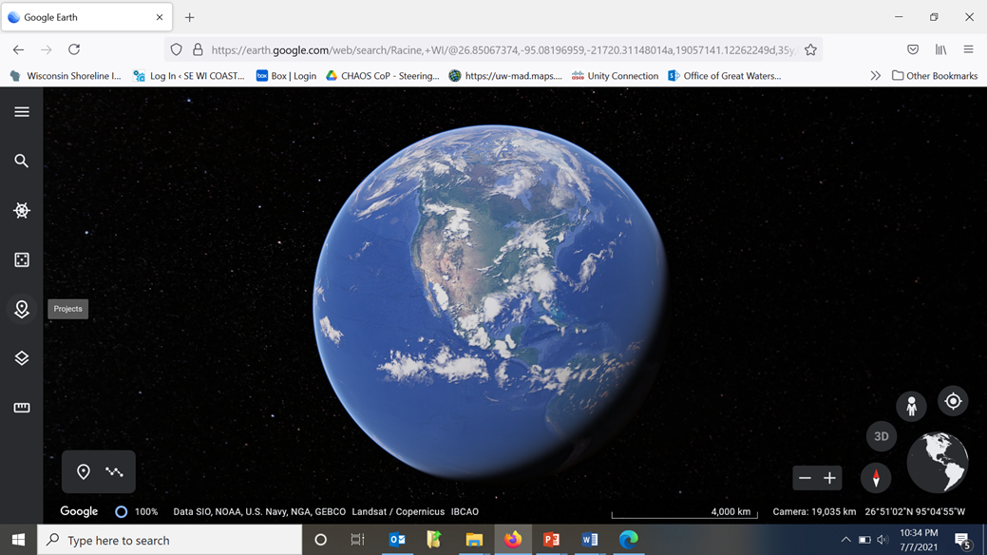
Starting a Project

Slide 6
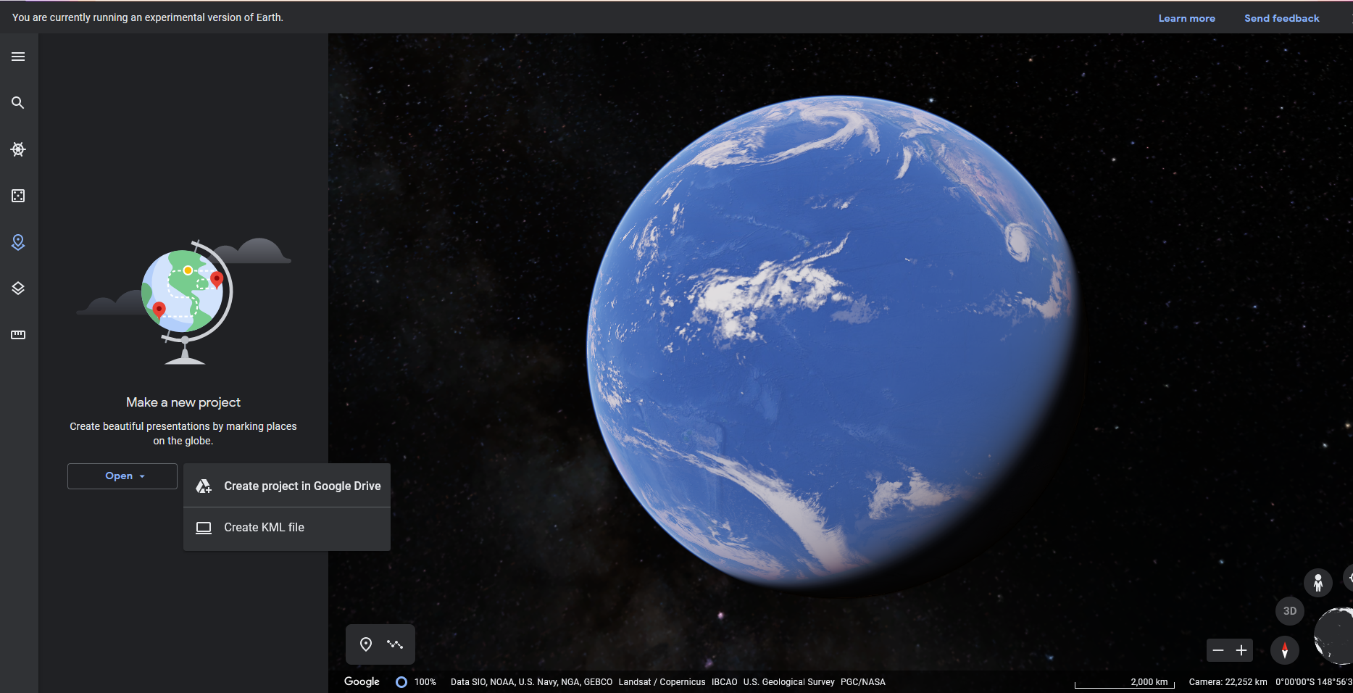
Create a “New Project in Google Drive”

Slide 7
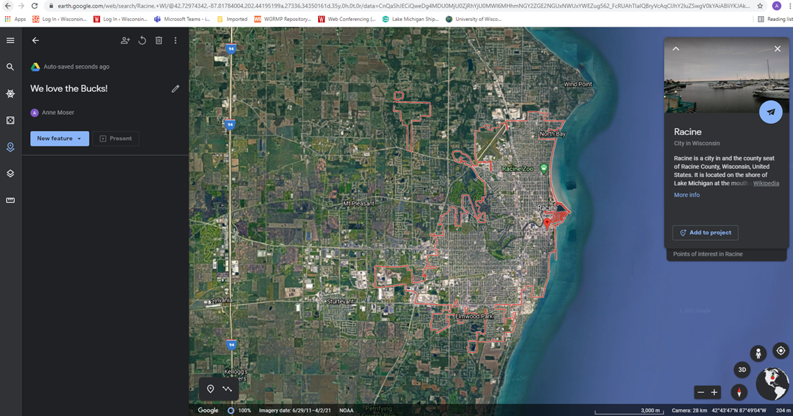
Name Your Project

Slide 8
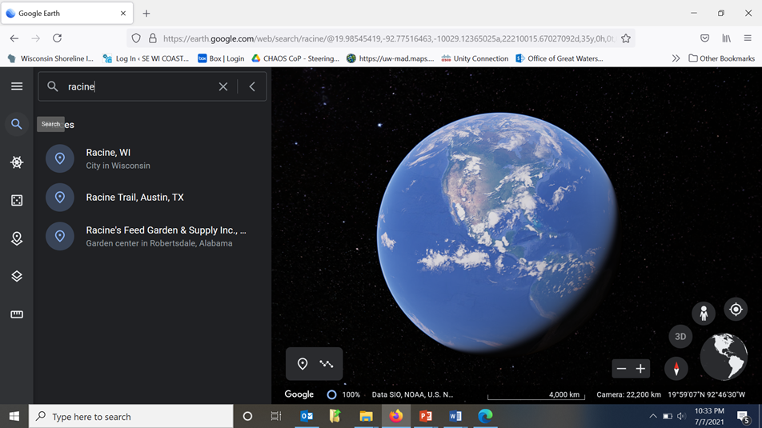
Find a Location

Slide 9
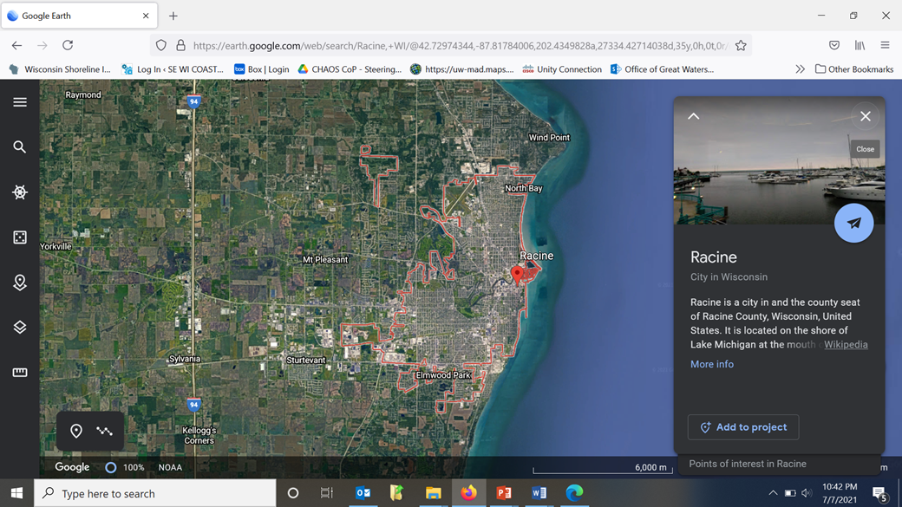
Voila! Racine

Slide 10
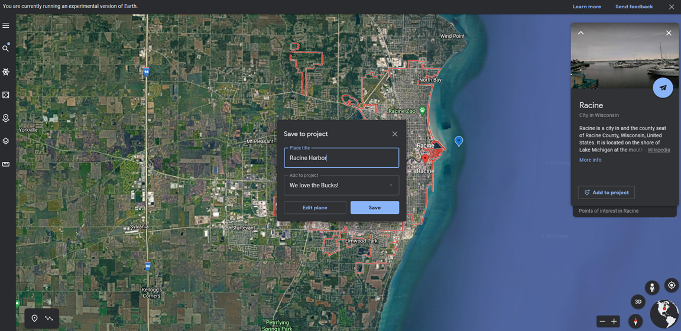
Add a Placemark at an Important Location

Slide 11
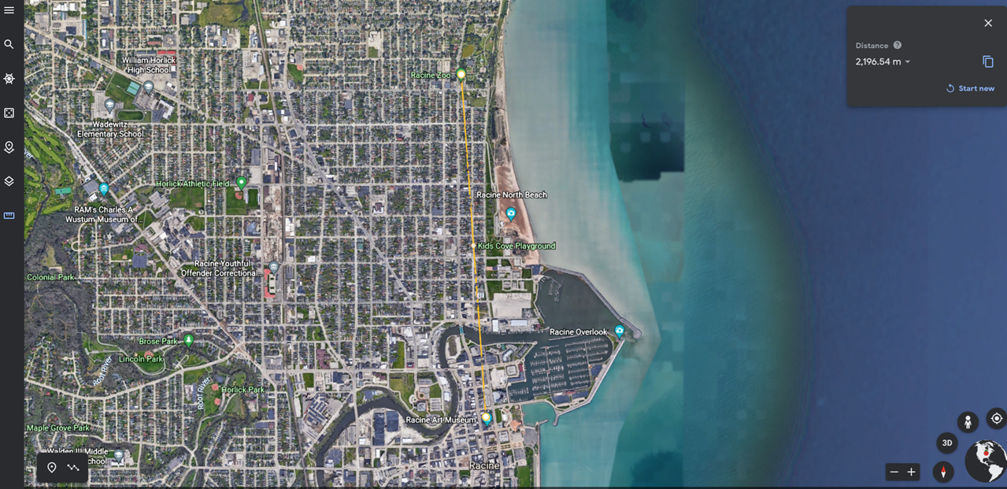
Measuring Distance

Slide 12
To Do List – Find
Create a Google Earth project and find the following features and locations:
Your school (pin this feature)
Lake Michigan
A bend in the Root River
Where the Root River enters Lake Michigan
North Beach (pin the top and the bottom of the sand beach)
Kids Cove Playground at North Beach

Slide 13
To Do List – Measure
Find the following features and locations:
Measure the distance from the Kids Cove Playground at North Beach to the school.
Measure the distance from your school and where the Root River empties into Lake Michigan.
Record the data in the Data Spreadsheet Distances to North Beach (from this link or use the form on next slide).
BONUS! Find two other places of interest and measure their distance.

Slide 14
To Do List – Record Measurements
Team Name | Distance from School to Kids Cove Playground at North Beach | Distance from School to North Beach Bathhouse | BONUS! Location one | BONUS! Location two | BONUS! Distance from location one to location two

Slide 15
To Do List – Coastal Engineering Structures
Find the coastal engineering features listed below and pin them in your Google Earth project.
Revetment
Breakwater
Jetty
Seawall

Slide 16
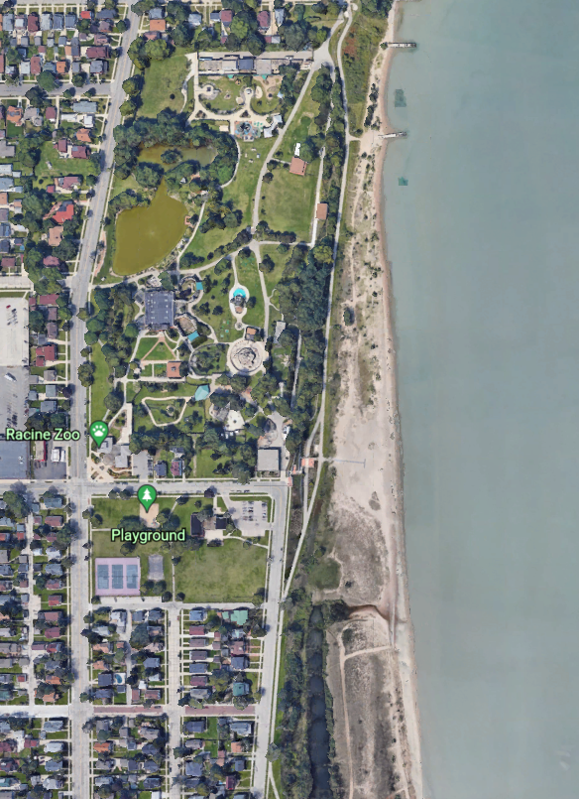
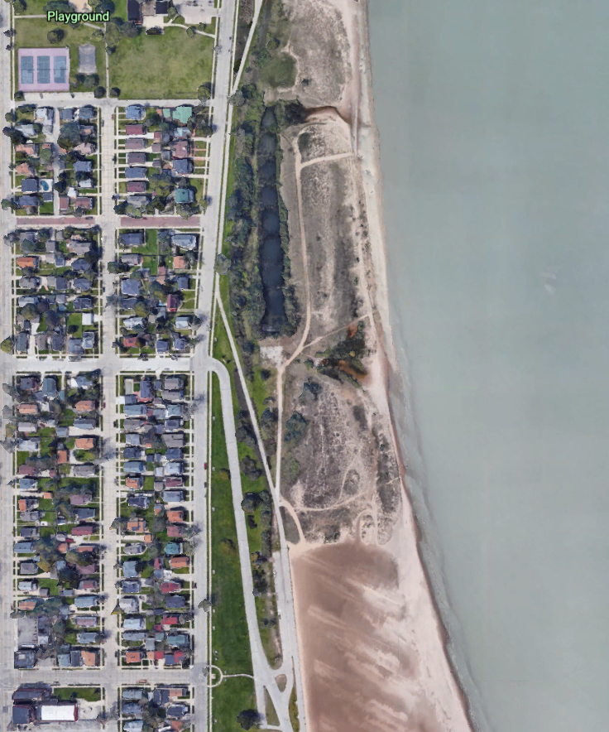
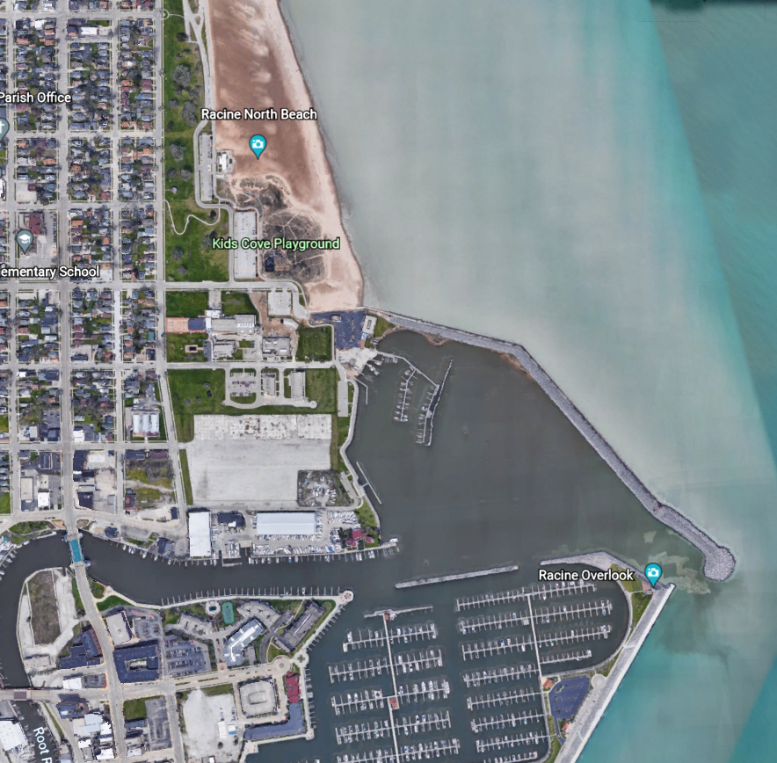
Hint – Look Up and Down the Coast!

Slide 17
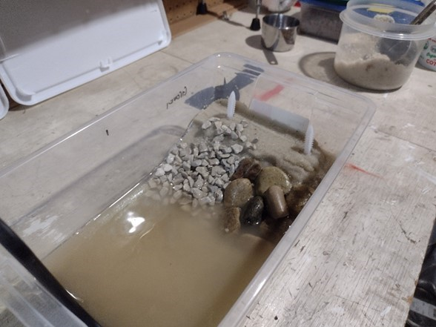
Gravel Revetment | Pond Rock Revetment
Notes:
IMG_20210709_144550968
Clear plastic shoebox ("wave tank") with sand pushed into a pile at one end. Viewed from the top there is a flat plateau of sand.
The gently sloping bluff face is now armored with rocks. The left half of the bluff face has small (pea gravel size) stones. The right side of the box has larger (approximately half-inch) stones.
The putty knife was used to create waves. The water is now turbid with suspended sand particles, and sand particles have also settled out onto this portion of the box.

