Slide 1
Coastal Engineering Structures –The Wave Tank
Lesson 3 Coastal Engineering Structures – Protecting the Shoreline
Wisconsin Sea Grant | October 2025 | Coastal Engineering Education: People, Place and Practice: Lesson 1:An Introduction to Coastal Engineering Image used with written permission by JB the Explorer
This curriculum was prepared by Adam Bechle , Ginny Carlton, and Anne Moser under award number NA21NOS4290005 from the Great Lakes Bay Watershed Education and Training (B-WET) program of the National Oceanic and Atmospheric Administration (NOAA), U.S. Department of Commerce. The statements, findings, conclusions and recommendations are those of the author(s) and do not necessarily reflect the views of NOAA or the U.S. Department of Commerce.
Notes:
Image Source: https://www.flickr.com/photos/producerjb/43643260870 Racine Breakwater Lighthouse
JB the Explorer took this photo of the Racine Breakwater Lighthouse in July of 2017 while at the Racine Harbor.
This lighthouse was first lit in November of 1901.
In the distance, you can see the Wind Point Lighthouse.
Image used with written permission by JB the Explorer as provided via JB's Native Garden@PlantNativeWI
Previously on Twitter and now on X @ExplorerJB

Slide 2
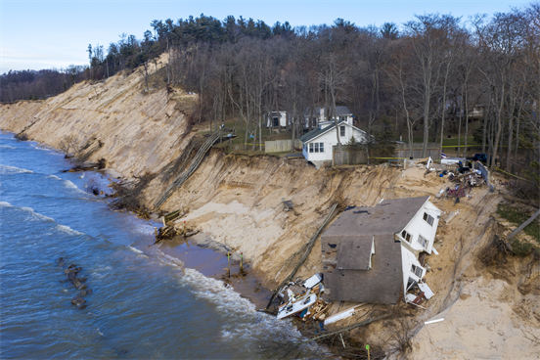
Example Labs
From Lesson 2
Erosion measurement with water level change
https://youtu.be/demkvHdcX1I
From Lesson 3
Lab with revetments
https://www.youtube.com/watch?v=8kcdQCafN-k
Erosion experiment with seawall and revetment
https://www.youtube.com/watch?v=plPyq8V2M3U

Slide 3
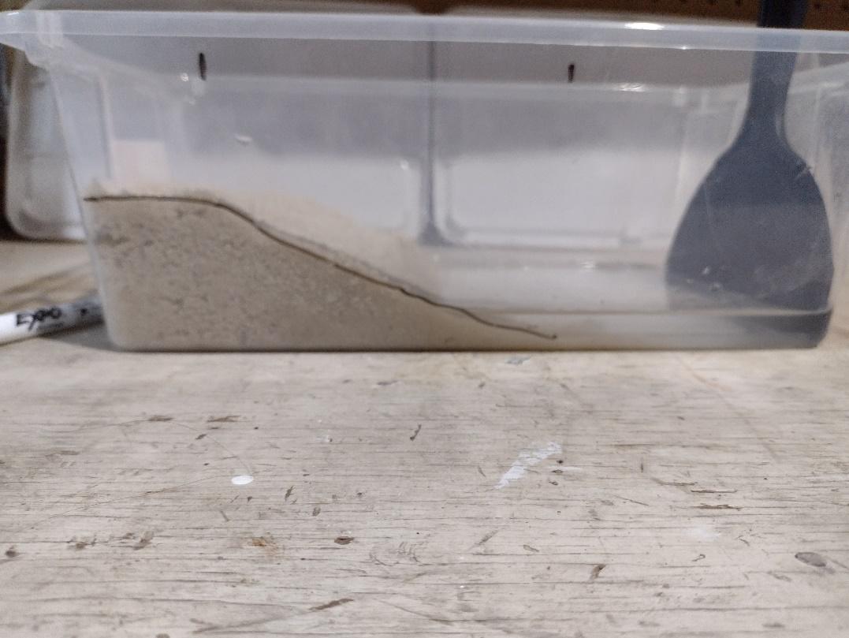
Sample “Wave Tank”
Notes:
IMG_20210709_142925142
Clear plastic shoebox ("wave tank") with sand pushed into a pile at one end. Viewed from the side, the sand pile is a flat plateau at the left of the box and slopes gently down with the sand extending approximately half the length of the box.
Approximately an inch of clear water is in the right-hand side of the box. A 6" putty knife rests along the right-hand wall of the box, parallel to the short end of the box.
A black dry-erase line marks the coastal profile on the long edge of the box.

Slide 4
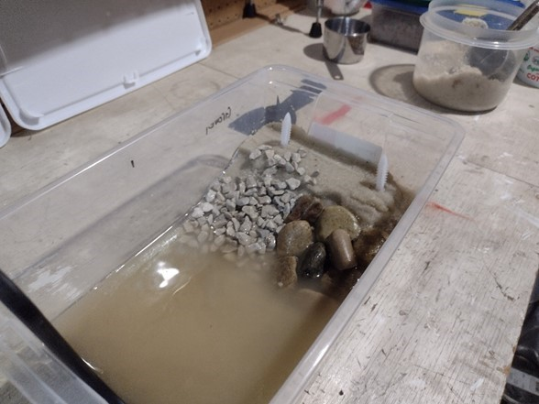
Gravel Revetment | Pond Rock Revetment
Notes:
IMG_20210709_144550968
Clear plastic shoebox ("wave tank") with sand pushed into a pile at one end. Viewed from the top there is a flat plateau of sand.
The gently sloping bluff face is now armored with rocks. The left half of the bluff face has small (pea gravel size) stones. The right side of the box has larger (approximately half-inch) stones.
The putty knife was used to create waves. The water is now turbid with suspended sand particles, and sand particles have also settled out onto this portion of the box.

Slide 5
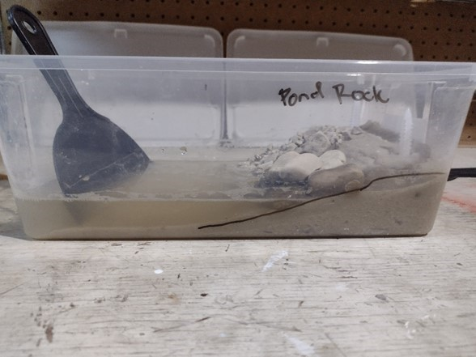
Pond Rock Revetment (Large Rocks)
Notes:
IMG_20210709_144412109
Wave tank viewed from the side with flat plateau of sand with half of the bluff face armored with small rocks (pea gravel) and half armored with half-inch rock.
The original coastal profile is marked on the long side of the box with black dry-erase marker. The line extends to approximately half the length of the box.
The putty knife has been used to create waves.
The height of the sand constituting the original plateau is lower. The slope of the sand is also more gradual. Additionally, the sand now extends all the way across the bottom of the wave tank box.

Slide 6
Pond Rock Revetment + 50 Waves
Notes:
IMG_20210709_144526849
Wave tank as viewed from the pond rock side (half-inch rock) showing the original black line coastal profile and new profile (after 50 waves) drawn onto the long side of the wave tank box.
The new profile is at a reduced height and slope. Additionally, the sand now extends all the way across the bottom of the box.

Slide 7
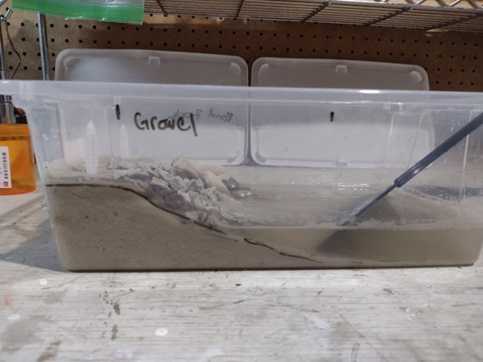
Gravel Revetment (Small Rocks)
Notes:
IMG_20210709_144426247
Wave tank as viewed from the gravel revetment side showing the original black line coastal profile drawn onto the long side of the wave tank box.
The new profile (after 50 waves) is at approximately the same height and slope as the original profile.

Slide 8
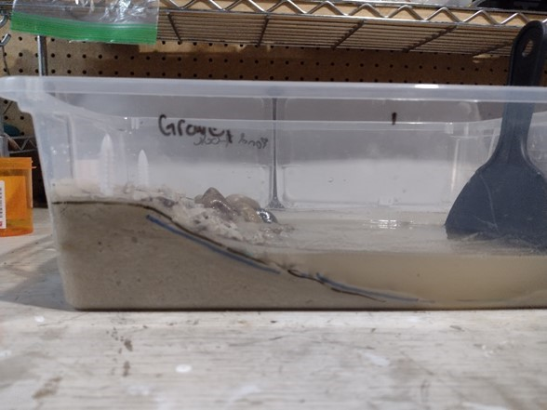
Gravel Revetment + 50 Waves
Notes:
IMG_20210709_144534527
Wave tank as viewed from the gravel revetment side showing the original black line coastal profile and new profile (after 50 waves) drawn onto the long side of the wave tank box.
The new profile is at approximately the same height and slope as the original profile.

Slide 9
After: Gravel Revetment | Pond Rock Revetment
Notes:
IMG_20210709_144550968
Clear plastic shoebox ("wave tank") with sand pushed into a pile at one end. Viewed from the top there is a flat plateau of sand.
The gently sloping bluff face is now armored with rocks. The left half of the bluff face has small (pea gravel size) stones. The right side of the box has larger (approximately half-inch) stones.
The putty knife was used to create waves. The water is now turbid with suspended sand particles, and sand particles have also settled out onto this portion of the box.

Slide 10
After: Gravel Revetment | Pond Rock Revetment -Explanation
Large gaps between pond rocks/large stones allow sand to be eroded from between spaces
Gravel is moved somewhat by waves.
Gaps are small enough to hold sediment, but gravel is not large enough to resist wave forces

Slide 11
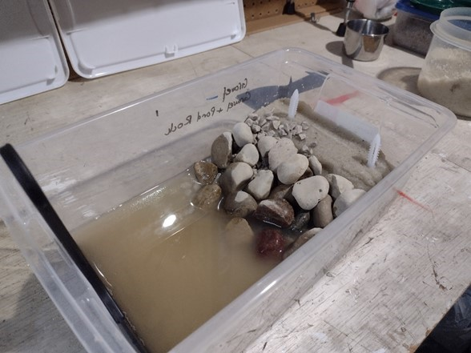
After: Gravel Revetment | More Pond Rock Revetment
Note: This was a continuation of the previous design. Extra layers of pond rock were added directly on gravel/rocks from previous iteration.
Notes:
IMG_20210709_144756111
Clear plastic shoebox ("wave tank") with sand pushed into a pile at one end. Viewed from the top there is a flat plateau of sand.
The gently sloping bluff face is now armored with rocks. The left half of the bluff face has small (pea gravel size) stones. The right side of the box has larger (approximately half-inch) stones. Both of these areas have been overlaid with another layer of half-inch stone.
The putty knife was previously used to create waves. The water is now turbid with suspended sand particles, and sand particles have also settled out onto this portion of the box.

Slide 12
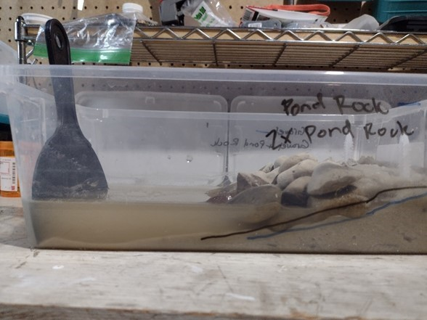
Before: 2 Layers of Pond Rocks- Blue Line
Notes:
IMG_20210709_144800700
Wave tank as viewed from the pond rock (half-inch rock) side of the box showing the original black line coastal profile and new profile (after 50 waves) drawn onto the long side of the wave tank box. The new profile is at a reduced height and slope. Additionally, the sand now extends all the way across the bottom of the box.
A second layer of pond rock (half-inch rock) has been placed over the original layer.

Slide 13
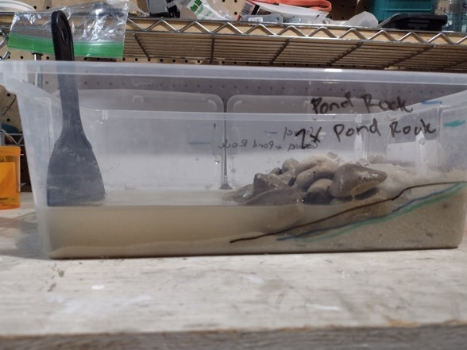
After: 2 Layers of Pond Rocks- Green Line
Notes:
IMG_20210709_144920858
Wave tank as viewed from the pond-rock side of the box. After the putty knife was used to create an additional set of waves, the coastal profile marked in green is once again reduced in height and slope. The depth of the sand at the far end of the box has increased.

Slide 14
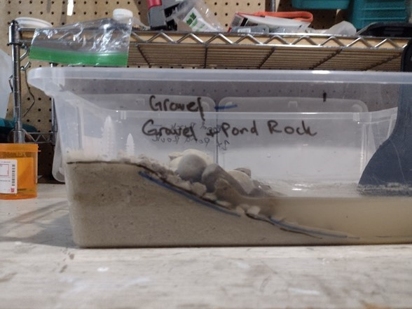
Before: Gravel + Pond Rock Layer- Blue Line
Notes:
IMG_20210709_144807007
Wave tank as viewed from the gravel revetment side showing the original small stones (pea gravel) and additional layer of pond rock (half-inch stones).
The original black line coastal profile and new profile (after 50 waves) are drawn onto the long side of the wave tank box.
The new profile is at approximately the same height and slope as the original profile.

Slide 15
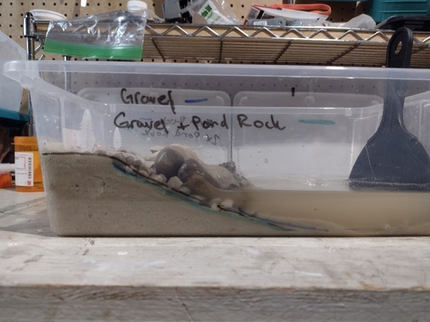
After: Gravel + Pond Rock Layer- Green Line
Notes:
IMG_20210709_144910800
Wave tank as viewed from the gravel revetment side showing the original small stones (pea gravel) and additional layer of pond rock (1/2" stones).
The original black line coastal profile and new profile (after 50 waves) are drawn onto the long side of the wave tank box.
A third coastal profile (testing the original pea gravel and the pond rock) is drawn in green on the long side of the wave tank box. The new green line coastal profile is at approximately the same height and slope as the original black-lined profile and profile from the first wave test.

Slide 16
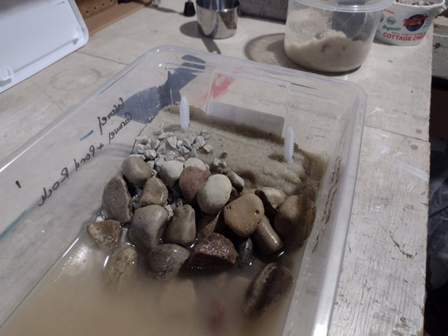
After: Gravel + Rock on Top | 2 Layers of Rock
Notable erosion around the end here
Notes:
IMG_20210709_144933046
Top view of wave tank with pea gravel and layer of pond rock on the left and two layers of pond rock on the right.
After creating additional waves, there is notable erosion in the right-hand corner and right side of the wave tank.

Slide 17
After: Gravel + Rock on Top | 2 Layers of Rock -Explanation
2 Layers of pond rock continue to have sand wash out between large spaces, though somewhat less than with just one layer of rock
  Many real-life rip-rap dumps fail in this way. People who construct them make the mistake of using only large stones because they see successful revetments with large stones and imitate that.
Gravel + Rocks
The gravel blocks sediment washout while rocks hold gravel in place against wave forces resulting in no erosion
  This is how a real revetment is designed and built.

Slide 18
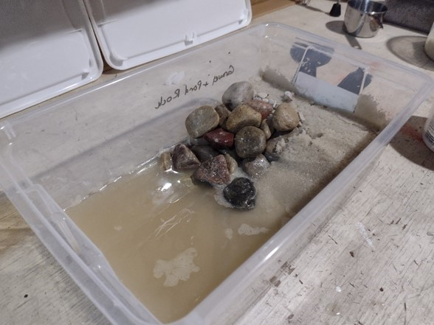
Gravel + Rock | Nourishment (Added Sand)
Notes:
IMG_20210709_145635930
Top view of the wave tank with small stones (pea gravel) and pond stones (half-inch stones) on the left. Two layers of pond stones on the right, covered with an additional layer of sand (nourishment).

Slide 19
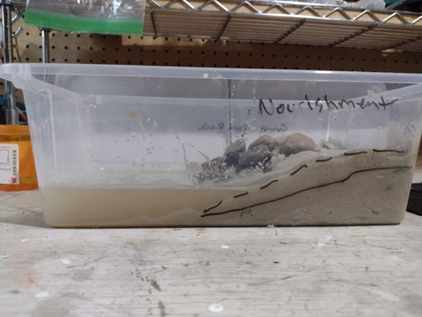
Before: Nourishment (Added sand from original black line to dashed black line)
Notes:
IMG_20210709_145632772
Side view of the pond stone side of the wave tank with two layers of pond stones covered with an additional layer of sand (nourishment).
The original coastal profile is marked in black. The new coastal profile (at a higher level, due to the addition of nourishment sand) is marked with a dashed line.

Slide 20
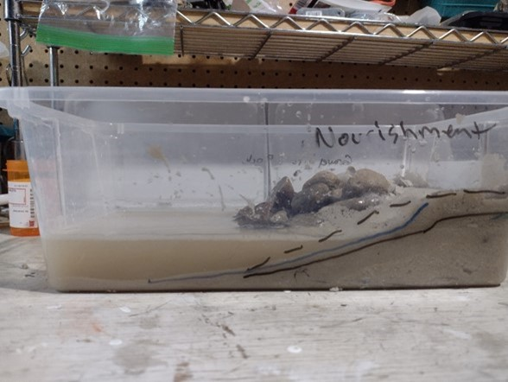
After: Nourishment – Blue Line
Notes:
IMG_20210709_145742382
Side view of pond rock side of the wave tank after putty knife has been used to create waves.
The resulting coastal profile is marked with a blue line. The profile lies above the original coastal profile and below the nourishment profile. Sand has extended further across the long side of the box, almost reaching the end.

Slide 21
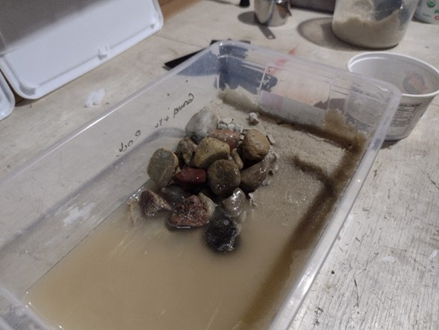
After: Gravel + Rock | Nourishment
Notes:
IMG_20210709_145748196
Top view of the wave tank with small gravel (pea gravel) and pond stone on the left and "nourished" beach on the right.
After the putty knife has been used to create waves, sand from the nourished beach has washed into the water, creating a bluff face with a distinct edge between the bluff face and the top of the bluff.

Slide 22
After: Gravel + Rock | Nourishment - Explanation
2 Layers of pond rock continue to have sand wash out between large spaces, though somewhat less than with just one layer of rock
  Many real-life rip-rap dumps fail in this way. People who construct them make the mistake of using only large stones because they see successful revetments with large stones and imitate that.
Gravel + Rocks
The gravel blocks sediment washout while rocks hold gravel in place against wave forces resulting in no erosion
  This is how a real revetment is designed and built.

Slide 23
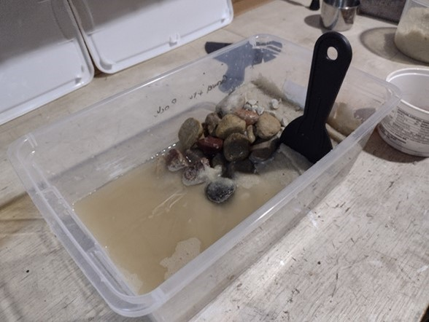
Before: Gravel + Rock | Seawall
Notes:
IMG_20210709_145907446
Top view of the wave tank with small gravel (pea gravel) and pond stone on the left and "nourished" beach on the right.
A 3" putty knife has been inserted vertically into the bluff face, just below the bluff edge. This putty knife serves to model a seawall.

Slide 24
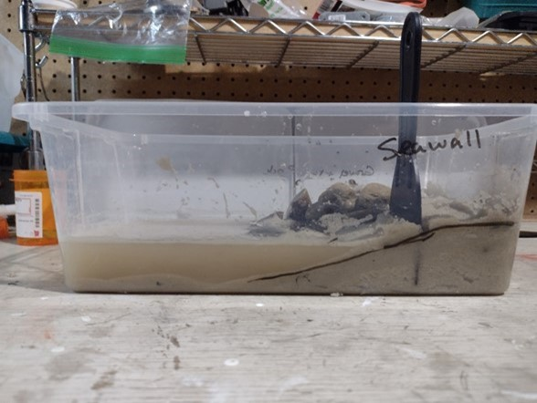
Before: Seawall – Black Line
Notes:
IMG_20210709_145902821
Side view of the wave tank from the "nourished" beach side.
A 3" putty knife has been inserted vertically into the bluff face, just below the bluff edge. This putty knife serves to model a seawall.

Slide 25
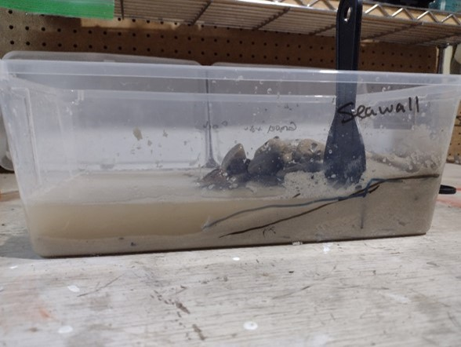
After: Seawall – Blue Line
It’s hard to see, but the profile erodes down sharply in front of the seawall. The eroded sand is moved out into the water in front of the seawall. The beach is mostly gone.
Notes:
IMG_20210709_150005757
Side view of the wave tank from the "nourished" beach side.
A 3" putty knife has been inserted vertically into the bluff face, just below the bluff edge. This putty knife serves to model a seawall.
After using the large putty knife to create waves, the coastal profile has eroded down sharply in front of the seawall. The eroded sand has moved out into the water.

Slide 26
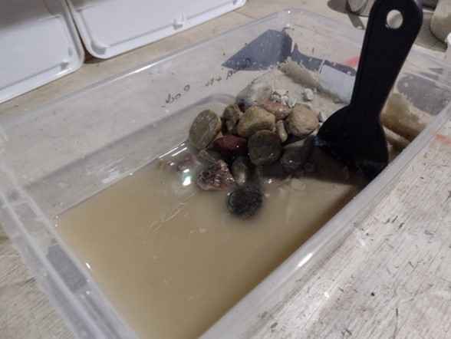
After: Gravel + Revetment | Seawall
Notes:
IMG_20210709_150009328
Top view of the wave tank with the small gravel (pea gravel) and pond stone revetment on the left, and "nourished" beach with 3" putty knife seawall on the right.
After using the large putty knife to create waves, the coastal profile has eroded down sharply in front of the seawall. The eroded sand has moved out into the water. Virtually no beach remains.

Slide 27
After: Gravel + Revetment | Seawall - Explanation
Seawall protects upland but beach erodes away from in front of the seawall
Gravel + Rock still holds up

Slide 28
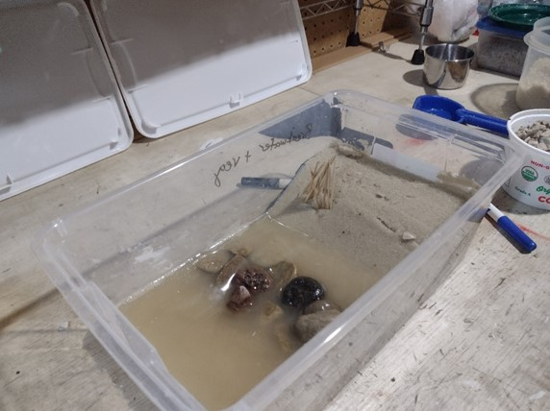
Offshore Breakwater – Vegetation | No Veg.
Notes:
IMG_20210709_150819335
Top view of a wave tank. In this version there is a sand beach in one-third of the box and water in two-thirds. At approximately the midway point of the wave tank, parallel to the shoreline, there is a breakwater consisting of pond rocks.

Slide 29
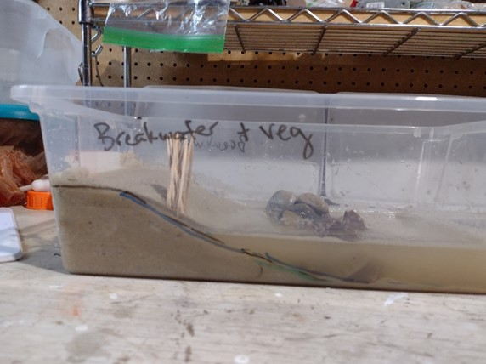
Before: Breakwater + Vegetation – Black Line
Notes:
IMG_20210709_150806755
Side view of wave tank with coastal profile marked in black dry-erase marker. The profile is a flat plateau with a gently sloping beach reaching two-thirds of the length of the long side of the box.
A breakwater consisting of pond stones sits at approximately the mid-point of the box and occupies the entire width.
A series of small vertical sticks have been placed into the bluff face and beach in order to represent vegetation.

Slide 30
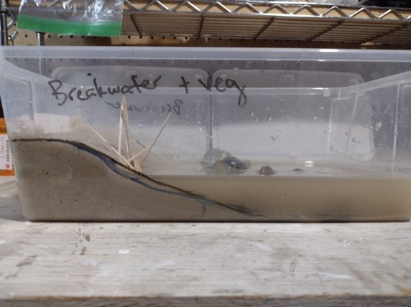
After: Breakwater + Vegetation – Blue Line
Notes:
IMG_20210709_151031448
A side view of a wave tank with a breakwater and "vegetation" represented by sticks stuck into the bluff face and beach.
After the putty knife has been used to make waves, the sticks are no longer standing vertically. Some have the tops facing the bluff, others have the tops facing the lake. Still other sticks are pointing to the left and right. It is a jumble.
The original coastal profile is marked in black dry-erase marker. The new coastal profile is marked in a blue line that at the point of the vegetation is below the original line.

Slide 31
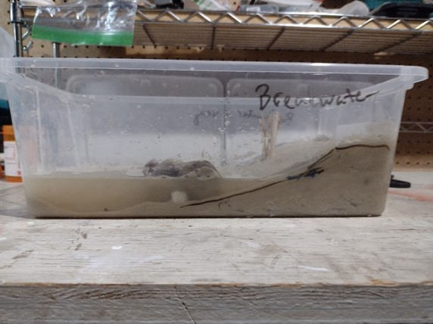
Before: Breakwater No Vegetation – Black Line
Notes:
IMG_20210709_150816652
Side view of wave tank with coastal profile marked in black dry-erase marker. The profile is a flat plateau with a gently sloping beach reaching two-thirds of the length of the long side of the box.
A breakwater consisting of pond stones sits at approximately the mid-point of the box and occupies the entire width.

Slide 32
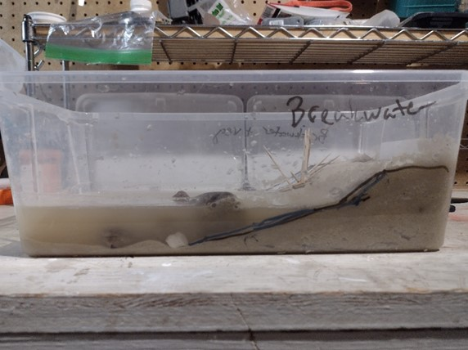
After: Breakwater No Vegetation
Notes:
IMG_20210709_151043733
Side view of wave tank with coastal profile marked in black dry-erase marker. The profile is a flat plateau with a gently sloping beach reaching two-thirds of the length of the long side of the box.
A breakwater consisting of pond stones sits at approximately the mid-point of the box and occupies the entire width.
After the putty knife has been used to make waves, a new coastal profile has been drawn onto the box. This line follows the contours of the original line and lies slightly below it.

Slide 33
After: Breakwater - Explanation
Breakwater blocks waves somewhat to slow erosion but doesn’t stop it
Vegetated beach holds sand, but erosion occurs below water line
Unvegetated beach erodes slightly

Slide 34
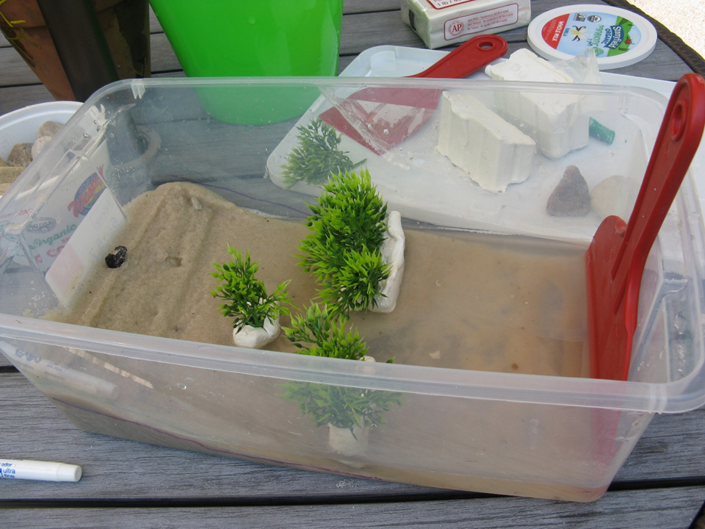
Idea for a nature-based shoreline:
Aquarium vegetation stuck into modeling clay
Coastal Engineering Structures: The Wave Tank
Notes:
IMG_1489
Top view of a wave tank. In this version there is a sand beach in on third of the box and water in two-thirds. At approximately the midway point of the wave tank, parallel to the shoreline is a breakwater consisting of green aquarium vegetation stuck into pieces of white clay. On the left side of the beach, the beach is bare sand.

