Slide 1
Our Racine Today
Lesson 4 Stormwater Management
Wisconsin Sea Grant | October 2025 | Coastal Engineering Education: People, Place and Practice: Lesson 4: Stormwater Management Image used with written permission by JB the Explorer
This curriculum was prepared by Adam Bechle, Ginny Carlton, and Anne Moser under award number NA21NOS4290005 from the Great Lakes Bay Watershed Education and Training (B-WET) program of the National Oceanic and Atmospheric Administration (NOAA), U.S. Department of Commerce. The statements, findings, conclusions and recommendations are those of the author(s) and do not necessarily reflect the views of NOAA or the U.S. Department of Commerce.
Notes:
Image Source: https://www.flickr.com/photos/producerjb/43643260870 Racine Breakwater Lighthouse
JB the Explorer took this photo of the Racine Breakwater Lighthouse in July of 2017 while at the Racine Harbor.
This lighthouse was first lit in November of 1901.
In the distance, you can see the Wind Point Lighthouse.
Image used with written permission by JB the Explorer as provided via JB's Native Garden@PlantNativeWI
Previously on Twitter and now on X @ExplorerJB

Slide 2
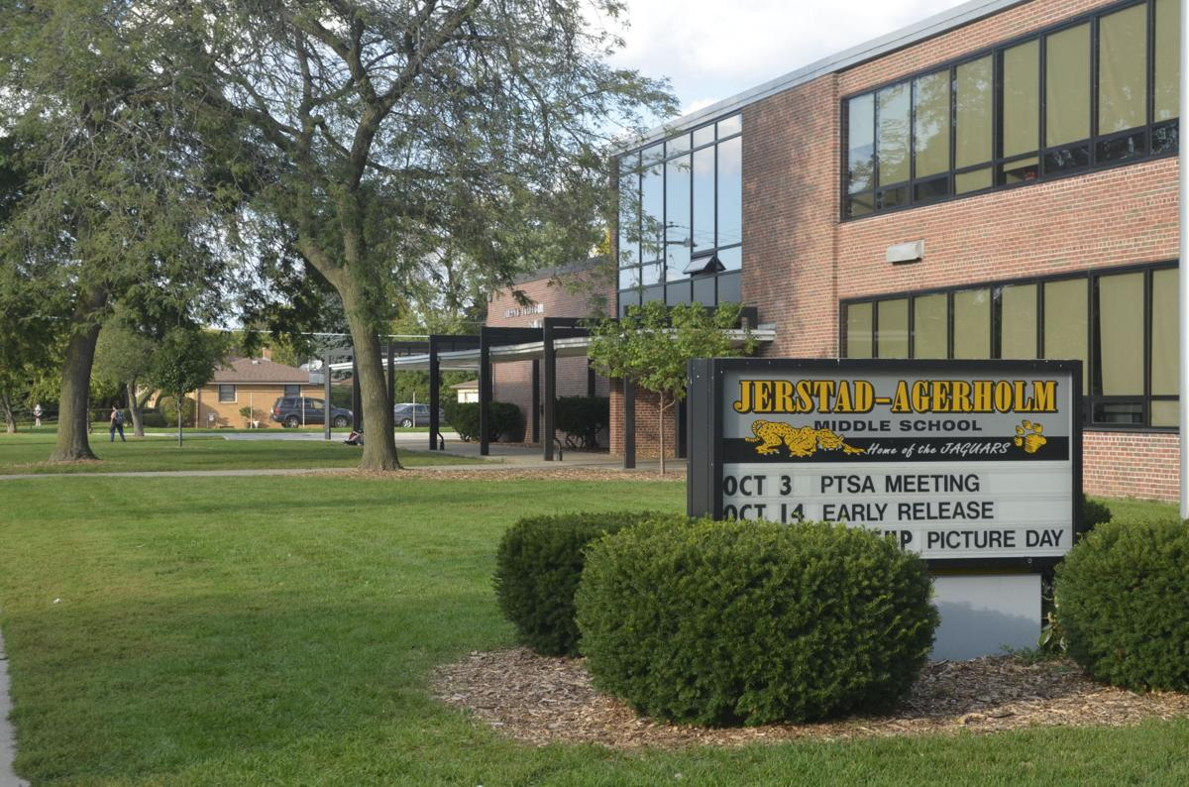
Jerstad-Agerholm Middle School
Image source: Racine Journal Times
Notes:
Where does the rain go in this picture of our school?
Image source: Racine Journal Times: https://journaltimes.com/news/local/article_eb125cc8-90fc-5482-b9b5-ed48c580e1ba.html

Slide 3
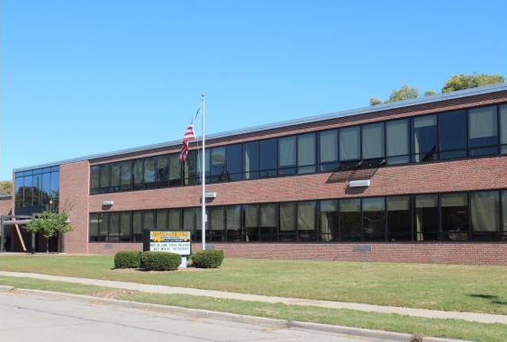
Jerstad-Agerholm Middle School (from Street)
Image source: Racine Unified School District
Notes:
Where does the water move in this picture of Jerstad-Agerholm Middle School? Note the streets and sidewalks and the way the roof is constructed.
Image source: Racine Unified School District
https://core-docs.s3.us-east-1.amazonaws.com/documents/asset/uploaded_file/4795/RUSD/4405012/RUSD_Board_Binder_-_2023_Update__03.12.24.pdf

Slide 4
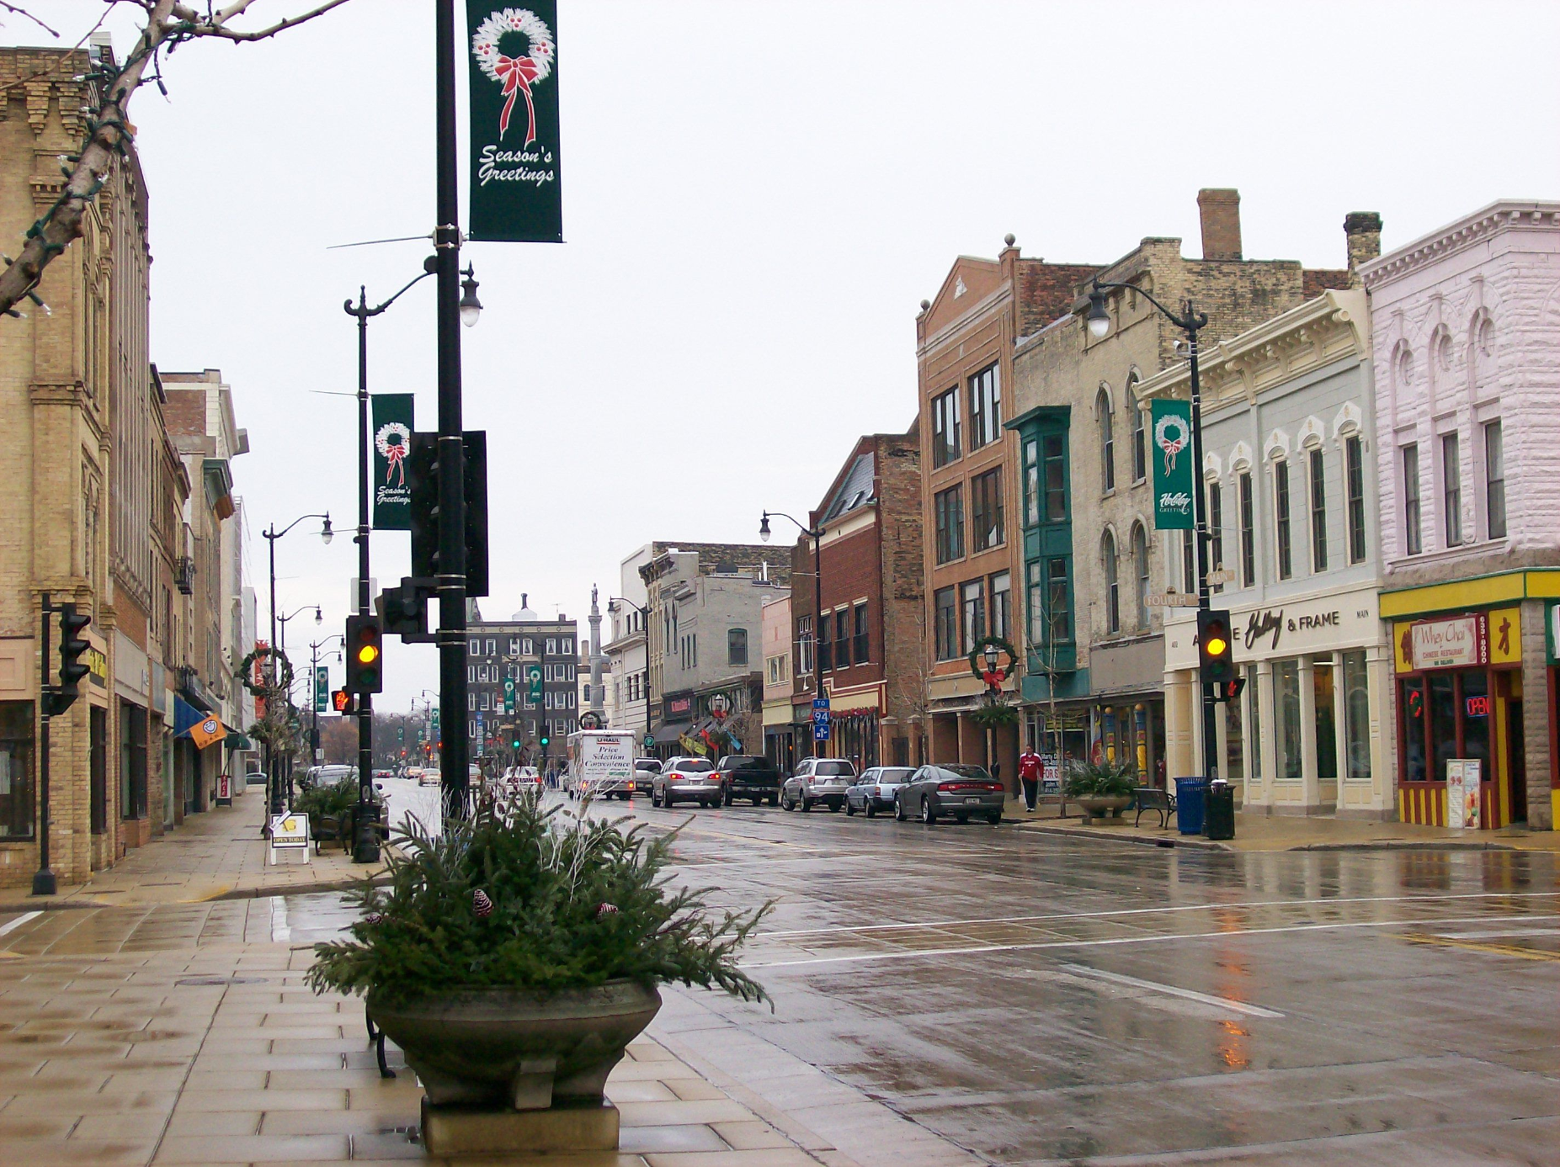
Downtown Racine, WI
Image source: UniverCity Racine County
Notes:
In this image of downtown Racine, is there anything to absorb the rain?
Image source: UniverCity Racine County
https://univercity.wisc.edu/racinecounty/

Slide 5
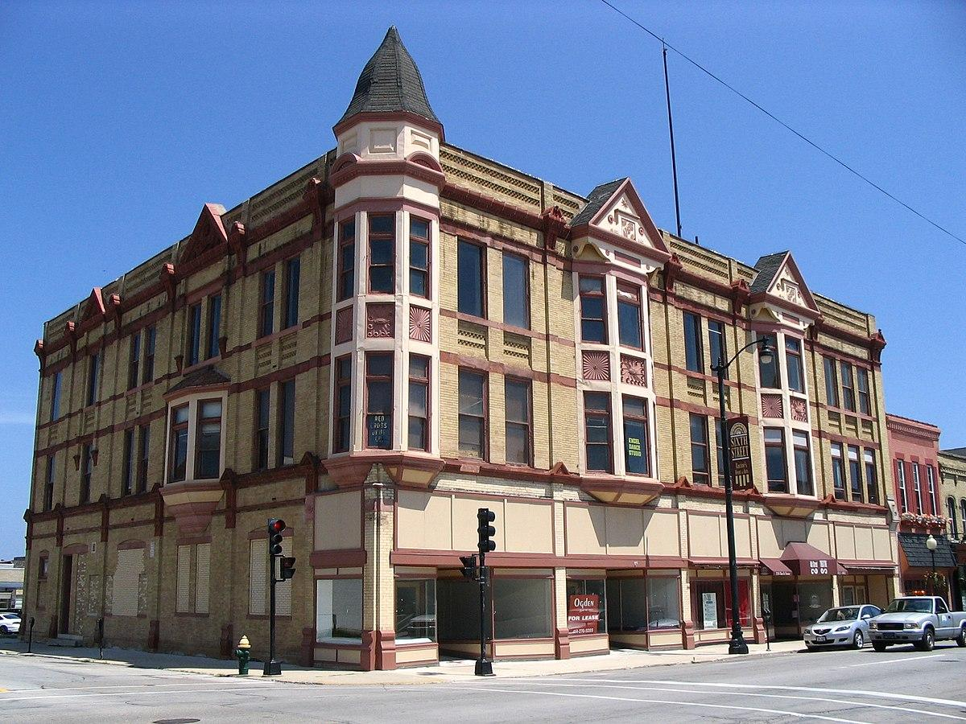
YMCA Building, Racine, WI
Image: Unknown author is licensed under CC BY-SA.
Notes:
The YMCA building has located at 314-320 6TH ST in Racine was built in 1886. It has obviously been here for a long time. What can go wrong?
Information source: Wisconsin Historical Society: https://www.wisconsinhistory.org/Records/Property/HI11322
Image source: Unknown author is licensed under CC BY-SA

Slide 6
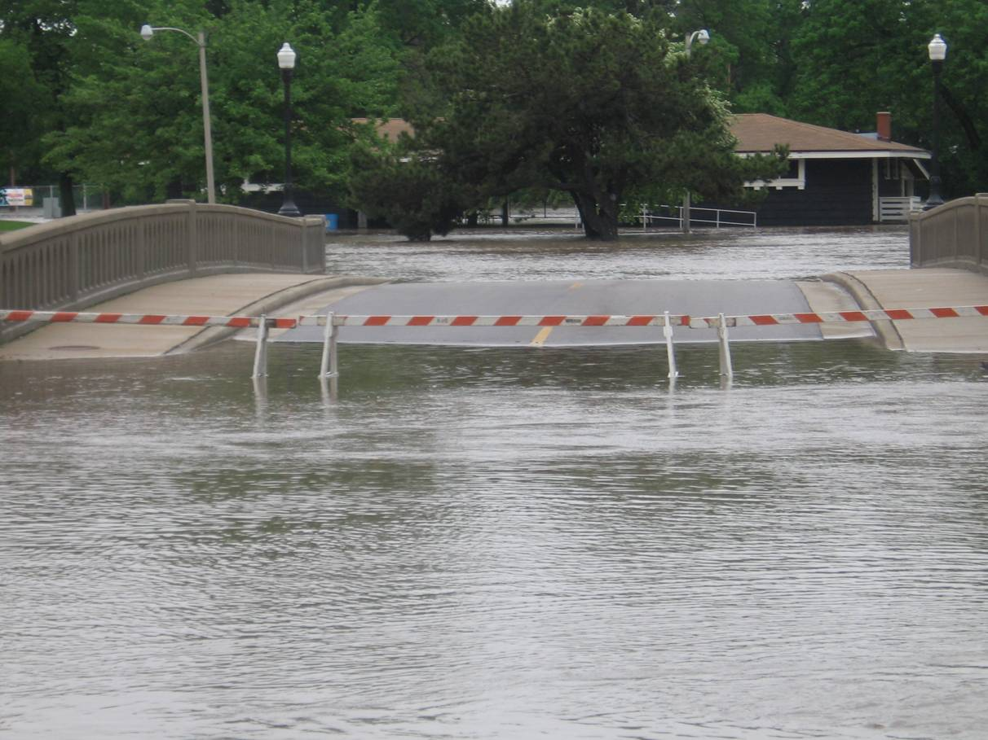
Flooding on Both Sides of Bridge
Image: National Weather Service (link).
Notes:
North Horlick Drive Bridge - https://www.weather.gov/mkx/0608flooding
Image source: National Weather Service
https://www.weather.gov/mkx/0608flooding

Slide 7
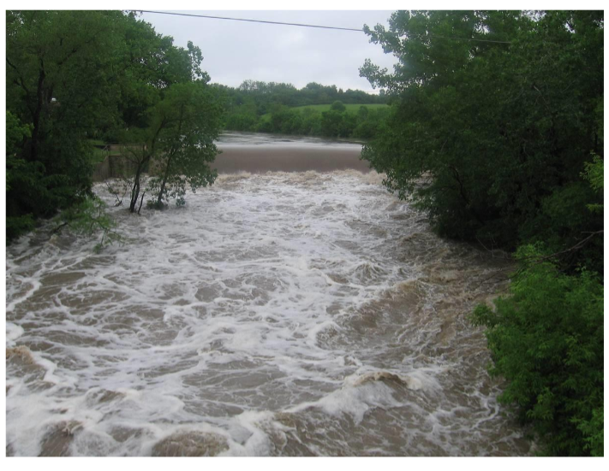
Root River Flooding
Image: National Weather Service (link).
Notes:
Horlick Dam
Image source: National Weather Service
https://www.weather.gov/mkx/0608flooding

