Slide 1
Flooding at North Beach: When storm water has nowhere to go
Lesson 4 Stormwater Management
Wisconsin Sea Grant | October 2025 | Coastal Engineering Education: People, Place and Practice: Lesson 4: Stormwater Management Image used with written permission by JB the Explorer
This curriculum was prepared by Adam Bechle, Ginny Carlton, and Anne Moser under award number NA21NOS4290005 from the Great Lakes Bay Watershed Education and Training (B-WET) program of the National Oceanic and Atmospheric Administration (NOAA), U.S. Department of Commerce. The statements, findings, conclusions and recommendations are those of the author(s) and do not necessarily reflect the views of NOAA or the U.S. Department of Commerce.
Notes:
Image Source: https://www.flickr.com/photos/producerjb/43643260870 Racine Breakwater Lighthouse
JB the Explorer took this photo of the Racine Breakwater Lighthouse in July of 2017 while at the Racine Harbor.
This lighthouse was first lit in November of 1901.
In the distance, you can see the Wind Point Lighthouse.
Image used with written permission by JB the Explorer as provided via JB's Native Garden@PlantNativeWI
Previously on Twitter and now on X @ExplorerJB

Slide 2
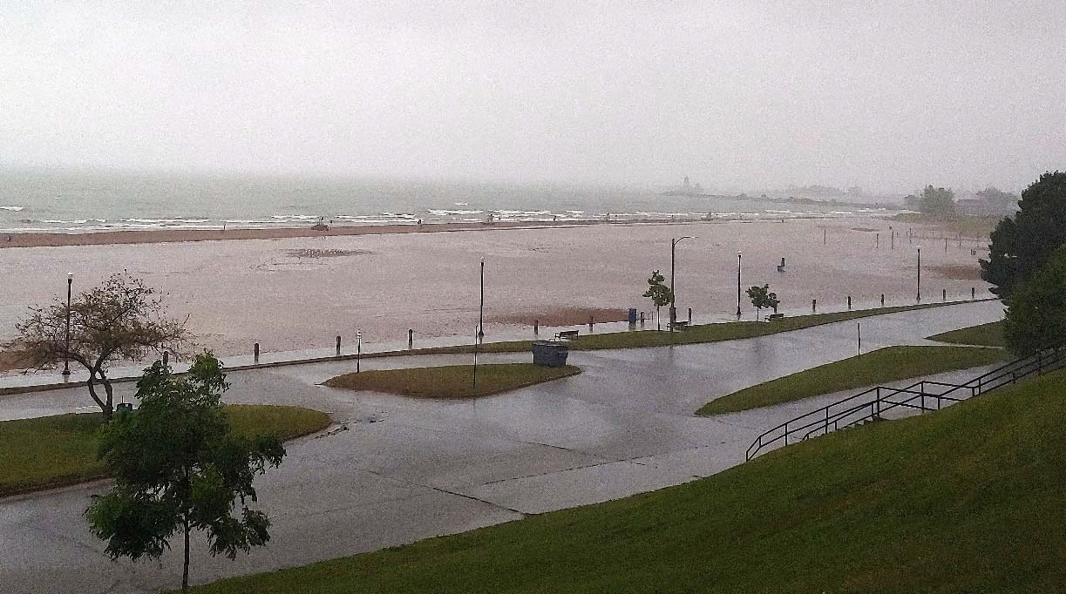
Flooding at North Beach
when stormwater has nowhere to go...
Image source: City of Racine
Notes:
Understanding where stormwater goes is especially important during big rain events.
This intense rainfall event in August 2019 flooded North Beach, Racine, Wisconsin.
Lake Michigan is seen in the background with waves breaking on the beach. There is standing water on the beach and sidewalks.
Image source: City of Racine

Slide 3
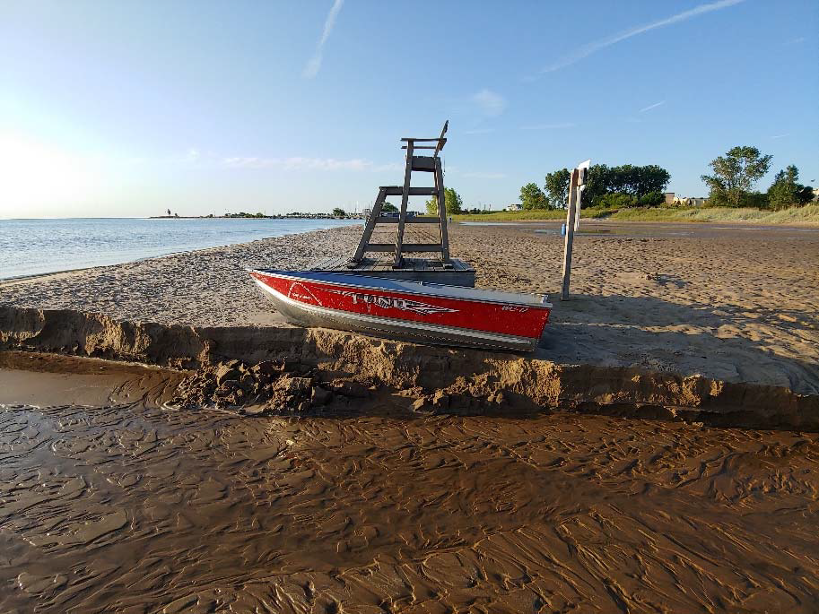
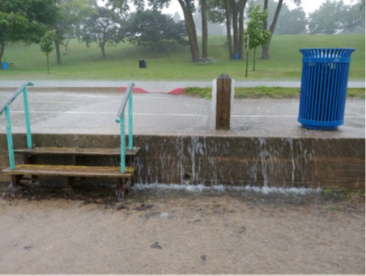
Flooding at North Beach
August 2019
Runoff to North Beach from impervious surfaces to the west during intense rainstorm
Erosion adjacent to North Beach lifeguard stand after storm event.
Images City of Racine
Notes:
A big rain event in 2019 shows what type of damage can occur.
For example, there is erosion of the sand adjacent to the North Beach lifeguard stand after the storm event. Additionally, runoff from the impervious surfaces such as sidewalks creates small waterfalls as it moves over the concrete wall toward the beach.
Images source: City of Racine

Slide 4
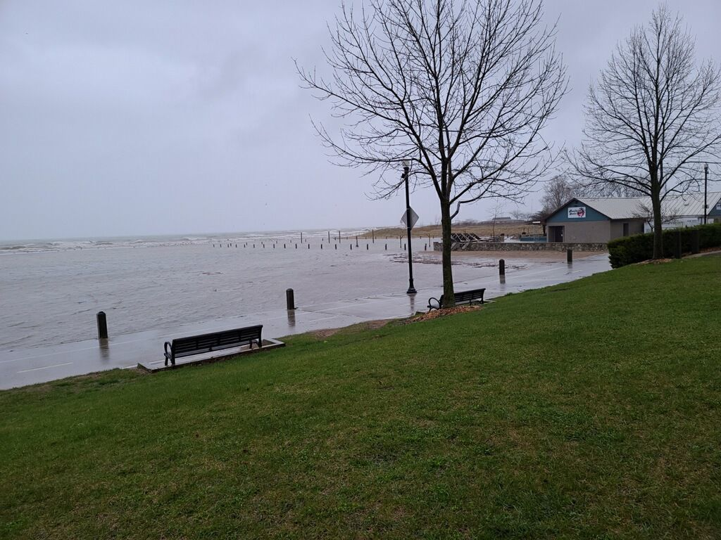
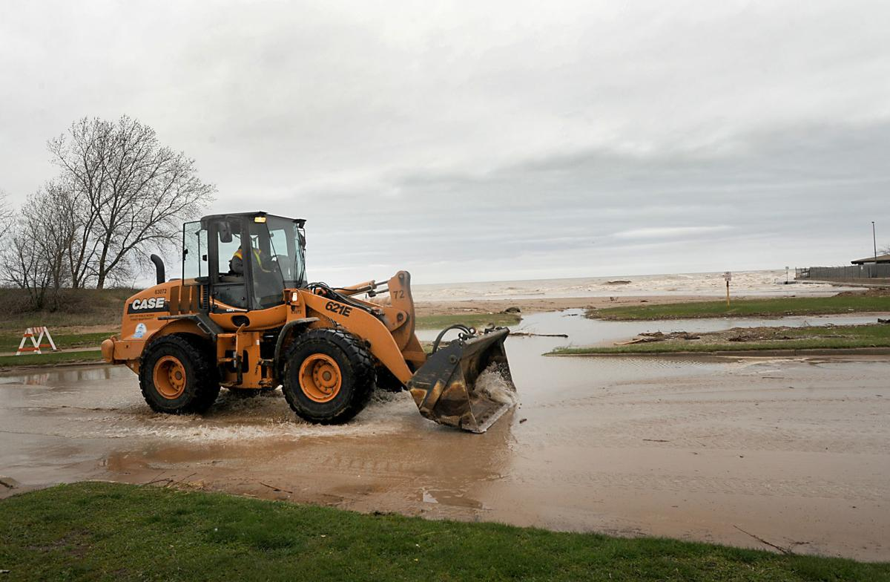
And again....Flooding at North Beach
April 2020
More than 3 inches of rain fell in three days.
Images Racine Journal Times
Notes:
And we see large rain events happening more frequently. Another flooding event at North Beach occurred in April 2020 when more than 3 inches of rain fell in three days.
Images source: Racine Journal Times

Slide 5
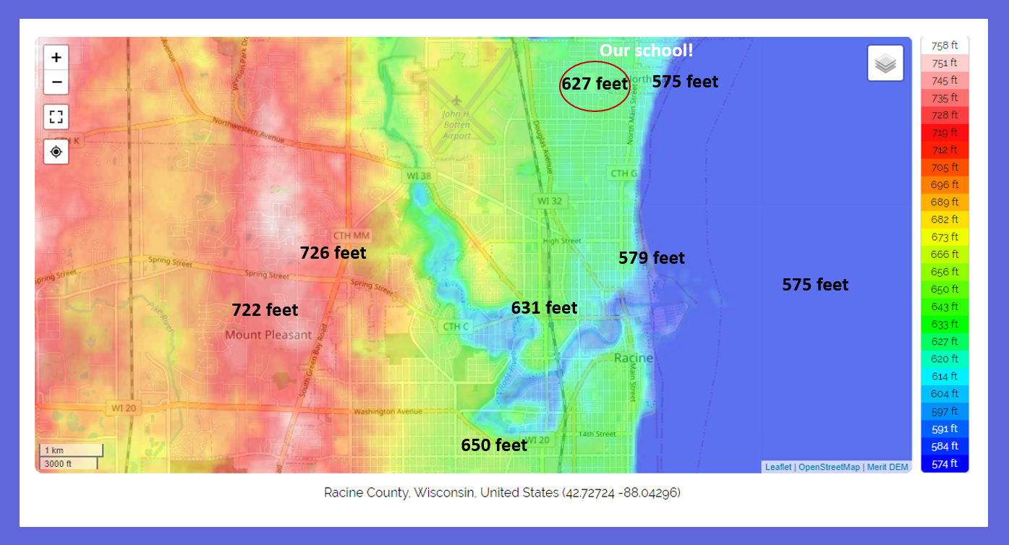
View One of How Water Moves: Elevation
Topographic Map – City of Racine WI
Image source: Google Maps
Image source: https://en-us.topographic-map.com/maps/k446/Racine-County/
Notes:
So let's follow the path of water in our city.
You can see elevations marked on this online topographic map. What does that mean for the direction water travels? [Water flows downhill]
The lowest point in the surrounding area is Lake Michigan. So eventually all precipitation in the Racine area will make its way to Lake Michigan.
Image source: Google Maps

Slide 6
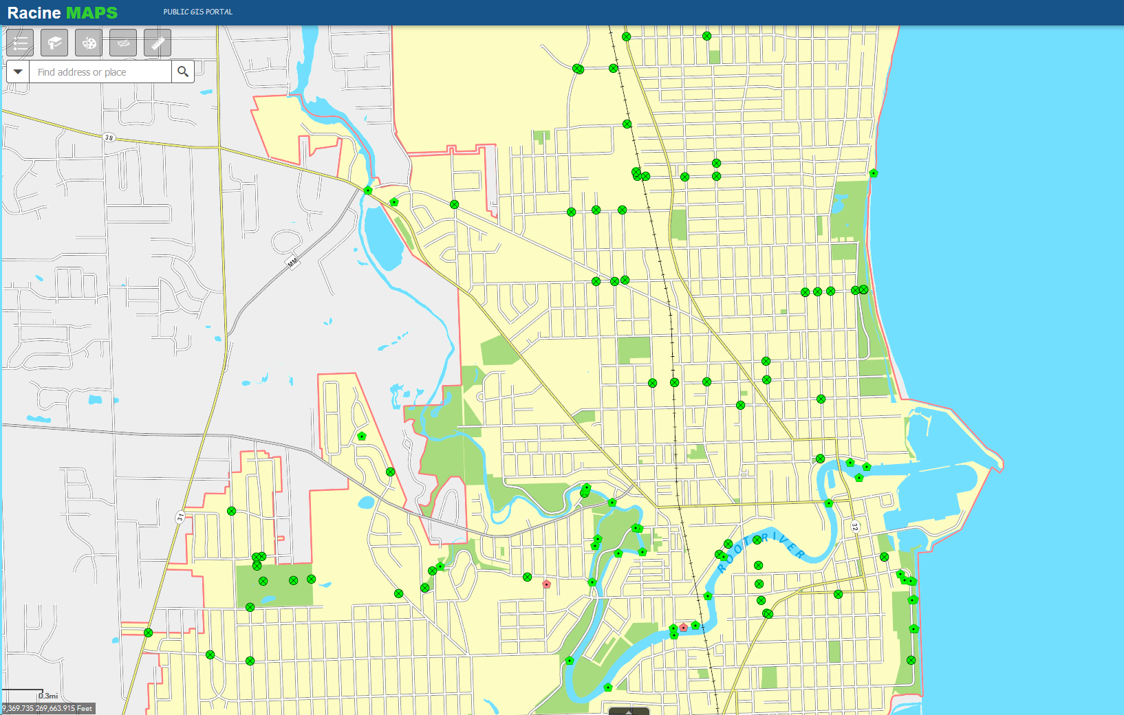


View Two of How Water Moves:
Stormwater System Map of outfalls and storm structures City of Racine, WI
Image: City of Racine Geographic Information System https://gis.cityofracine.org/RacineGIS/
Notes:
In this picture, we see a couple of things in the legend. One is OUTFALL, the place where water (a river, drain, or sewer pipe) empties into the sea, a river, or a lake.
We also see something called STORM STRUCTURE. We are going to talk about that tomorrow but that is a structure that engineers have built to deal with stormwater runoff.
Many of the storm structures and active outfalls occur along the path of the Root River. Other clusters of storm structures occur in Lockwood Park and between Goold and High Streets at the English Street outfall.
Image source: City of Racine

Slide 7
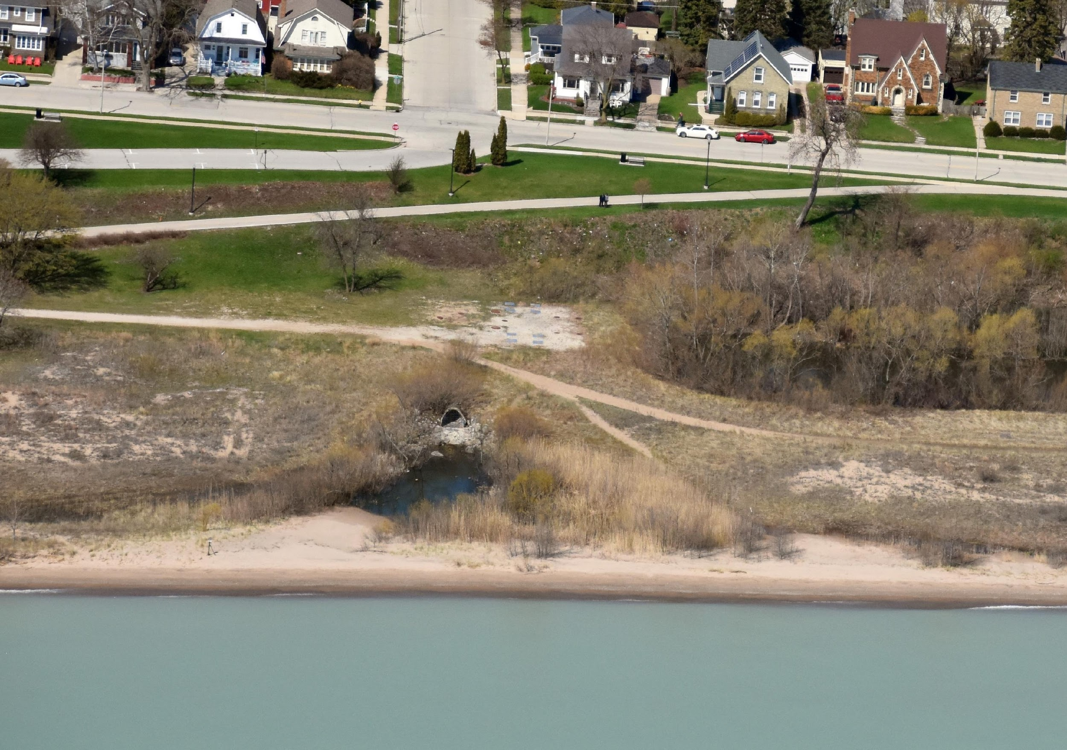
Storm sewer outfall at North Beach, Racine, WI
Image source: Capt. Dennis Carr
Notes:
A storm sewer outfall at North Beach. This outfall drains stormwater that has been collected in the storm sewer system from the streets nearby.
The outfall pipe is a corrugated metal tube whose opening sits on a bed of rocks. Between the bed of rocks and small sandy area there is standing water. Beyond the thin strip of sand lies Lake Michigan. The stormwater will drain into Lake Michigan.
Image source: Capt. Dennis Carr

Slide 8
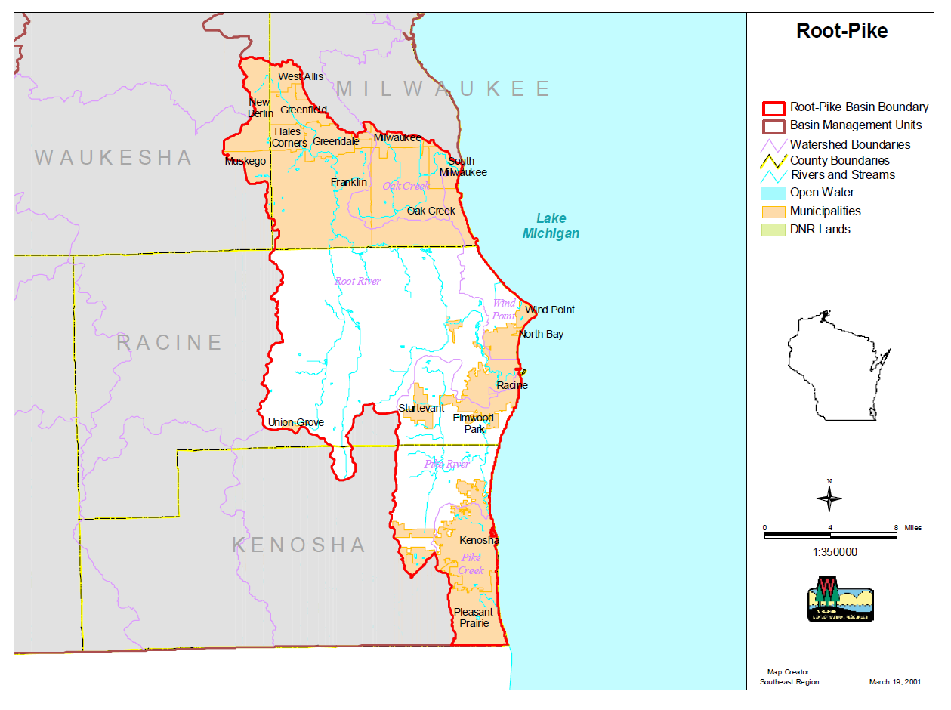
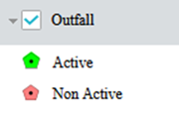

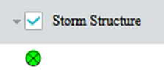
View Three of How Water Moves:
Through a Watershed Root-Pike Watershed boundary
Image: Wisconsin Department of Natural Resources https://dnr.wisconsin.gov/sites/default/files/topic/Watersheds/rootPikeMap.pdf
Notes:
So the previous two maps are contained in this map. This the Root-Pike Watershed boundary. This shows us how the water that is in the red boundary lines drains into Lake Michigan. The main point is: LOTS of water can enter Lake Michigan during storms and can cause flooding and bring pollutants with it.
Image: Wisconsin Department of Natural Resources https://dnr.wisconsin.gov/sites/default/files/topic/Watersheds/rootPikeMap.pdf

