Slide 1
The Hydrologic Cycle
Lesson 4 Stormwater Management
Wisconsin Sea Grant | October 2025 | Coastal Engineering Education: People, Place and Practice: Lesson 4: Stormwater Management Image used with written permission by JB the Explorer
This curriculum was prepared by Adam Bechle, Ginny Carlton, and Anne Moser under award number NA21NOS4290005 from the Great Lakes Bay Watershed Education and Training (B-WET) program of the National Oceanic and Atmospheric Administration (NOAA), U.S. Department of Commerce. The statements, findings, conclusions and recommendations are those of the author(s) and do not necessarily reflect the views of NOAA or the U.S. Department of Commerce.
Notes:
Image Source: https://www.flickr.com/photos/producerjb/43643260870 Racine Breakwater Lighthouse
JB the Explorer took this photo of the Racine Breakwater Lighthouse in July of 2017 while at the Racine Harbor.
This lighthouse was first lit in November of 1901.
In the distance, you can see the Wind Point Lighthouse.
Image used with written permission by JB the Explorer as provided via JB's Native Garden@PlantNativeWI
Previously on Twitter and now on X @ExplorerJB

Slide 2
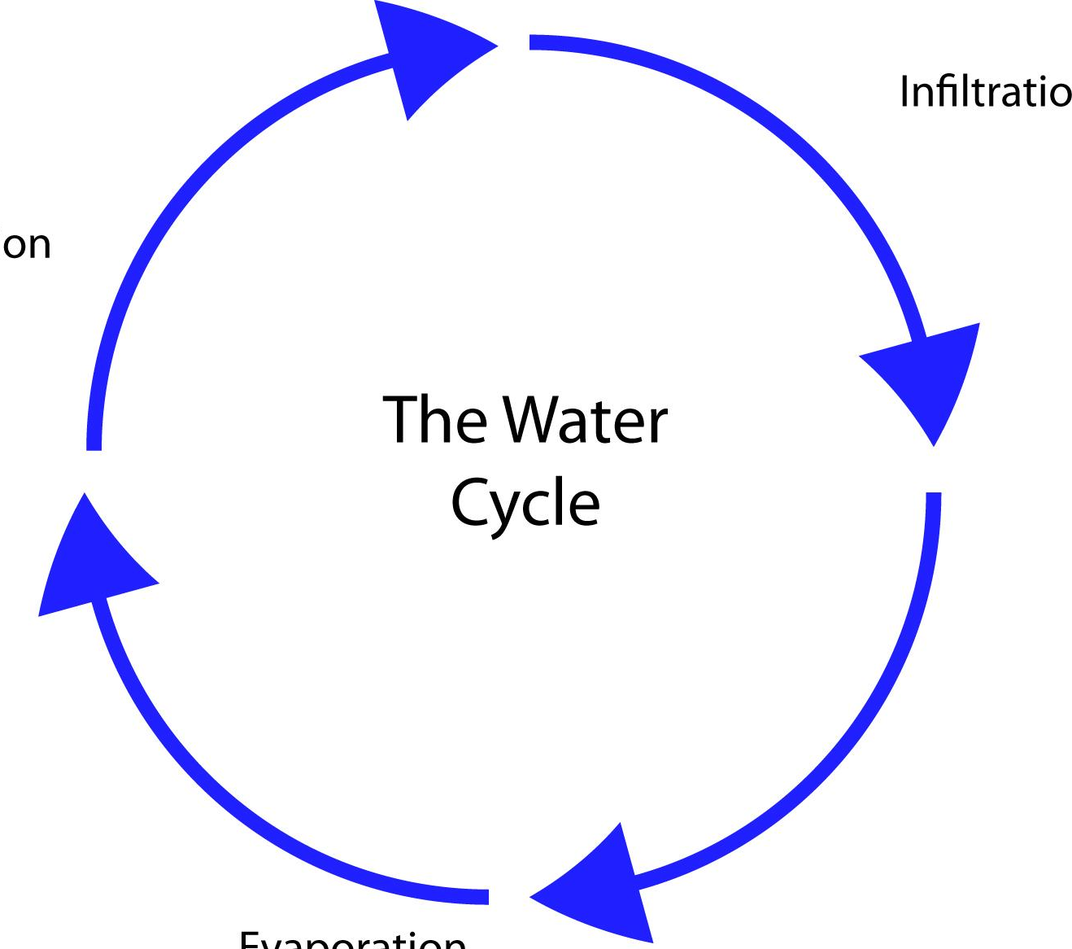
The Hydrologic Cycle – elementary school edition
Infiltration
Precipitation
Runoff
Evaporation
Notes:
Let's recall the water cycle or hydrologic cycle. This illustrates what the hydrologic cycle might have looked like in elementary school – four simple steps a water droplet takes.
Reminder definitions for educator
Precipitation Water that is falling from the sky, typically in the form of rain, snow, sleet, or hail.
Infiltration Movement of water into the ground. How fast water can flow into the ground is called the infiltration rate.
Evaporation The process of changing from liquid to gas. Evaporation releases water on the land and in lakes and rivers into the atmosphere.

Slide 3
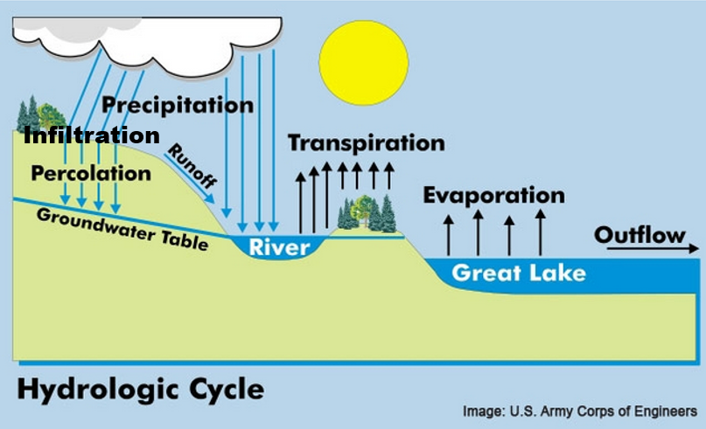
The Hydrologic Cycle – middle school edition
Notes:
We are going to dig a bit deeper into the water cycle, what scientists call the HYDROLOGIC CYCLE. We can see additional terms have been added. [With a mouse click, the students will see "infiltration and percolation" circled, the focus of the rest of the lesson.]
Today, we are going to look at what happens after precipitation – when the water infiltrates and percolates. Precipitation is water that originates from rain, including snow and ice melt. This water is called STORMWATER and it can INFILTRATE into the soil and PERCOLATE (move through the soil itself). Sometimes it can be stored on the land surface in ponds and puddles or can evaporate. What we are concerned with is when rain and snow events are so large the stormwater can't infiltrate or be stored in a pond. If there is enough stormwater coming down, it can cause all kinds of problems: erosion, flooding, the introduction of pollutants, just for a few examples.
Reminder definitions for educator
Stormwater Water on the landscape that originates as precipitation, including rain and melted snow or ice.
Infiltration Movement of water into the ground. How fast water can flow into the ground is called the infiltration rate.
Percolation Movement of water through the ground.
Additional terms within hydrologic cycle diagram
Precipitation Water that is falling from the sky, typically in the form of rain, snow, sleet, or hail.
Runoff Water that drains off the land in a lake’s watershed to the lake. It is impacted by precipitation over land, evaporation over land, and transpiration (water sucked up by plants).
Transpiration When plants release water into the air. Plants' roots take up water, which is transferred to the stems and leaves. Water is transpired into the atmosphere through the leaves.
Evaporation When water changes from liquid to gas. Evaporation releases water on the land and in lakes and rivers into the atmosphere.
Groundwater table The boundary (not a straight line) between the saturated zone (where water fills the space between soil particles) and the unsaturated zone (where air fills the space between soil particles).
Outflow A removal of water to a particular portion of the hydrologic system of the watershed.
Image source: U.S. Army Corps of Engineers

Slide 4
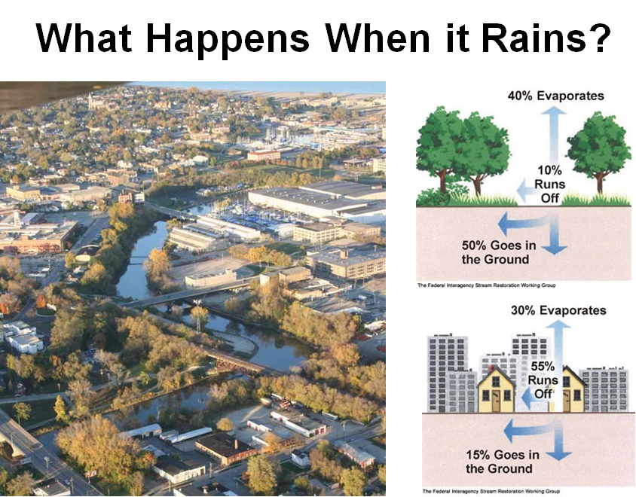
What happens when it rains?
Natural Ground Cover
75% - 100% Impervious Surfaces
Notes:
And we will see in this lesson that natural and built structures can influence how much stormwater can infiltrate and percolate... We see an example on the right of how it looks different between a rural and an urban landscape.
Aerial image of the city of Racine, Wisconsin, illustrating three bridges crossing the Root River.
1. Sixth Street Bridge is at the lower left corner of the image.
2. Marquette Street bridge is at the center of the image.
3. Main Street bridge is toward the top of the image.
The roofs of buildings along the river and Lake Michigan at the very top of the image are also visible.
Diagram of what happens when it rains on natural ground cover represented by three deciduous trees and grass.
40% evaporates
10% runs off
50% goes into the ground
Diagram of what happens when it rains on surfaces that are 75% to 100% impervious as represented by houses and tall city buildings.
30% evaporates
55% runs off
15% goes into the ground
Notice the significant change in runoff and infiltration between the natural ground cover and impervious surfaces sites.
Diagram source: The Federal Interagency Stream Restoration Working Group. (2001, August). Stream Corridor Restoration: Principles, Processes and Practices Handbook revised. p. 3-23 via UW-Stevens Point. https://www3.uwsp.edu/cnr-ap/UWEXLakes/PublishingImages/resources/restoration-project/StreamRestorationHandbook.pdf

