Slide 1
Racine, Wisconsin
Water Trivia
Lesson 5 Introduction to Green Infrastructure
Wisconsin Sea Grant | October 2025 | Coastal Engineering Education: People, Place and Practice: Lesson 5: Introduction to Green Infrastructure Image used with written permission by JB the Explorer
This curriculum was prepared by Adam Bechle, Ginny Carlton, and Anne Moser under award number NA21NOS4290005 from the Great Lakes Bay Watershed Education and Training (B-WET) program of the National Oceanic and Atmospheric Administration (NOAA), U.S. Department of Commerce. The statements, findings, conclusions and recommendations are those of the author(s) and do not necessarily reflect the views of NOAA or the U.S. Department of Commerce.
Notes:
Image Source: https://www.flickr.com/photos/producerjb/43643260870 Racine Breakwater Lighthouse
JB the Explorer took this photo of the Racine Breakwater Lighthouse in July of 2017 while at the Racine Harbor.
This lighthouse was first lit in November of 1901.
In the distance, you can see the Wind Point Lighthouse.
Image used with written permission by JB the Explorer as provided via JB's Native Garden@PlantNativeWI
Previously on Twitter and now on X @ExplorerJB

Slide 2

Racine Water Trivia Question One
Drop 1: During an average year Racine receives
about __________ inches of precipitation
(not including snow)
  a) between 25 and 30 inches
  b) between 31 and 35 inches
  c) between 36 and 40 inches
  d) between 41 and 45 inches
Notes:
Source of data: https://www.usclimatedata.com/climate/racine/wisconsin/united-states/uswi0575
US climate statistics

Slide 3
RACINE WATER TRIVIA! Question 1 Answer
C. between 36 and 40 inches
Racine averages 36 inches of rain per year.
Looking at the graph which month has the most rainfall?
Fact Source: US Climate Data
Notes:
August is the month with the most rainfall with approximately four inches.

Slide 4
Racine Water Trivia Question 2
Drop 2: During an average year Racine receives
about __________ inches of snowfall
  a) between 25 and 30 inches
  b) between 31 and 35 inches
  c) between 36 and 40 inches
  d) between 41 and 45 inches
Notes:
Source of data: https://www.usclimatedata.com/climate/racine/wisconsin/united-states/uswi0575
US climate statistics

Slide 5
RACINE WATER TRIVIA! Question 2 Answer
D. between 41 and 45 inches
Racine averages 43 inches of snowfall per year.
Looking at the graph which month has the most snowfall?
Fact Source: US Climate Data
Notes:
January is the month with the most snowfall with approximately 14 inches.

Slide 6
Racine Water Trivia Question 3
Drop 3: The _______ runs through the city of Racine as it flows into Lake Michigan through Racine Harbor.
  a) Root River
  b) Milwaukee River
  c) Racine River
  d) Michigan River

Slide 7
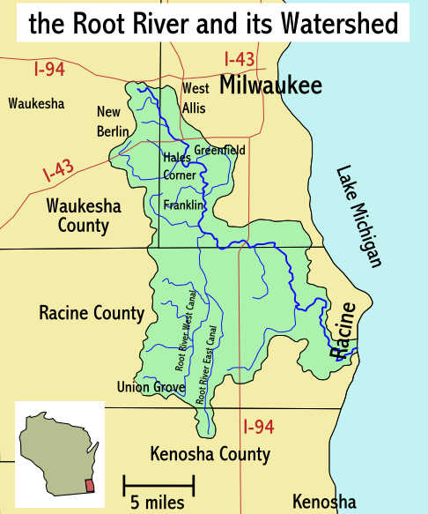
RACINE WATER TRIVIA! Question 3 Answer
A. Root River
The Root River drains a land area (watershed) of approximately 190 square miles.
Fact Source: US Climate Data
Notes:
The Root River watershed covers parts of Waukesha and Racine counties with a small portion extending into Kenosha County.
Includes the communities of Greenfield, Hales Corner, Franklin, Union Grove, and Racine.

Slide 8
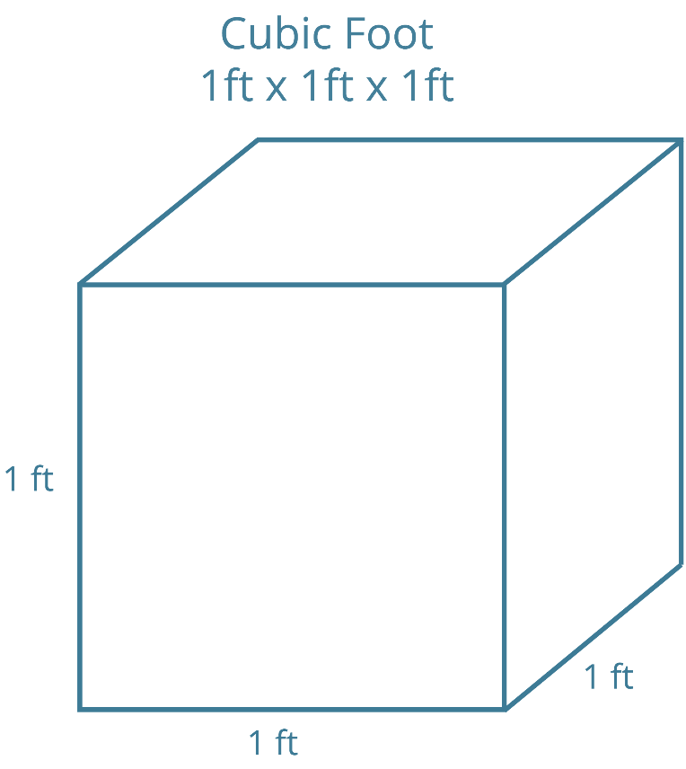
Racine Water Trivia Question 4
Drop 4: The average rate of flow for the Root River is approximately
  a) 100 cubic feet per second
  b) 120 cubic feet per second
  c) 140 cubic feet per second
  d) 160 cubic feet per second

Slide 9
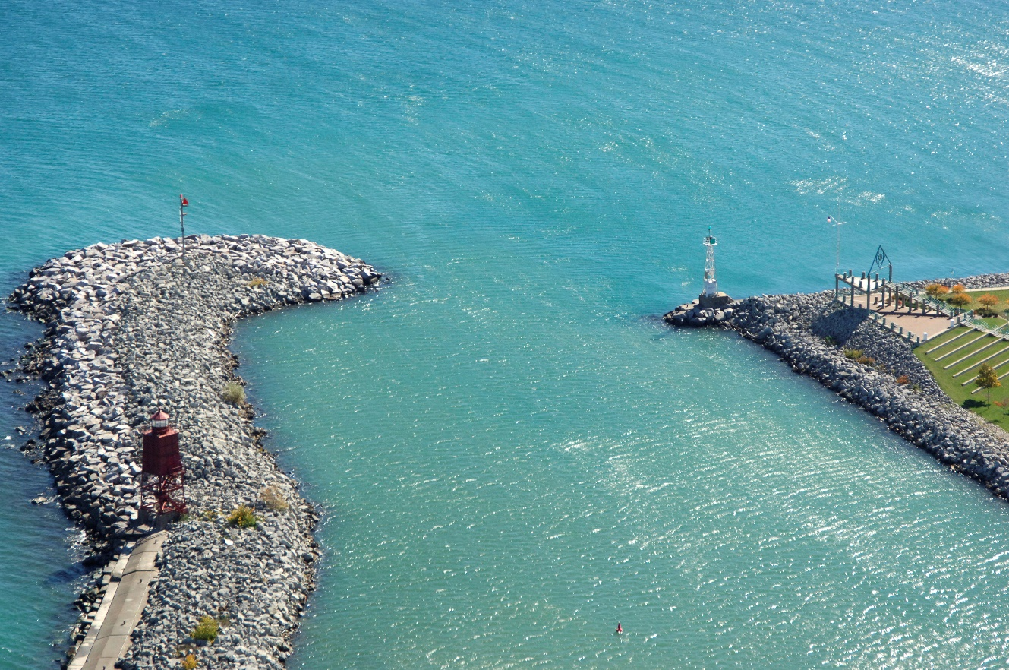
RACINE WATER TRIVIA! Question 4 Answer
D. approximately 160 cubic feet per second
The Root River’s peak flow was measured at 8,200 cubic feet per second!
Fact Source: US Geological Survey
Image Source: Marinas.com
Notes:
The flow range for the river is summarized below
Peak Flow 8,200 cubic feet per second
Minimum Flow 1.0 cubic feet per second
Long-Term Average Flow 162 cubic feet per second
My source: file:///C:/Users/glcar/AppData/Local/Temp/2020%20Racine%20RWWU%20Facilities%20Plan%20Volume%201.pdf
There source: United States Geological Survey and SEWRPC
Image source: https://marinas.com/view/inlet/nvi55y_Root_River_Inlet_Racine_WI_United_States#&gid=1&pid=2

Slide 10
Racine Water Trivia Question 5
Drop 5: The city of Racine has a fee to help pay for stormwater management.
  a) True
  b) False

Slide 11
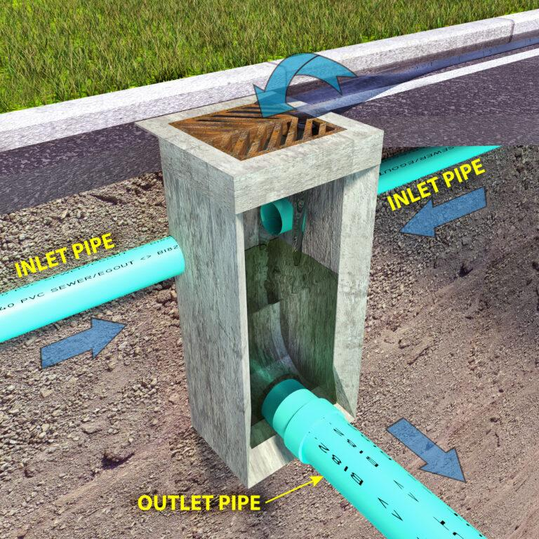
RACINE WATER TRIVIA! Question 5 Answer
A. True
For a typical residential single-family home, the storm water rate is about $124 per year.
The fee helps pay for the series of pipes that make up the engineered stormwater management system.
Fact Source: City of Racine
Image Source: GSM Plumbing
Notes:
Yes. As adopted in the 2019 budget, for a typical residential, single-family home in the City, the storm water rate is $123.77 annually.
Storm water maintenance is designed to prevent runoff pollution from entering bodies of water. Storm Water Utilities were authorized by the State several years ago and the associated fees go towards infrastructure maintenance. Maintenance of storm water infrastructure includes: repairing storm water sewers, fixing storm water inlets (catch basins), maintaining storm water ponds (dry and wet), street sweeping, leaf collection, keeping sediment out of rivers, streams and lakes. Maintenance of storm water manholes and cleaning sediment from storm water manholes is an activity that is also funded by this fee. Maintaining storm water in Wisconsin is important and Cities have defined criteria to achieve compliance with rigid and stringent state water quality standards. Maintenance of ditches and/or concrete curb lines are funded by the storm water fee as they both transport storm water to storm sewers and rivers and the lake.
The Great Lakes CCC Reduce The Runoff program in Racine County can help you receive free landscaping for preventing stormwater flooding, sewer back-ups, soil erosion and sewage in local waterways on or near your property. If your property qualifies for landscape improvements, we may install soil amendments, core aeration, rain gardens, stormwater trees, bioswales and permeable pavement. Help us reduce stormwater runoff and improve the health and beauty of Racine County properties, streams, and Lake Michigan!
Source: https://www.cityofracine.org/Water/StormWaterFee/
Source: https://greatlakesccc.org/reduce-the-runoff/
Image source: https://gsmplumbing.com.au/blog/what-is-stormwater-drainage/

