Slide 1
Green Infrastructure
Lesson 5 Introduction to Green Infrastructure
Wisconsin Sea Grant | October 2025 | Coastal Engineering Education: People, Place and Practice: Lesson 5: Introduction to Green Infrastructure Image used with written permission by JB the Explorer
This curriculum was prepared by Adam Bechle, Ginny Carlton, and Anne Moser under award number NA21NOS4290005 from the Great Lakes Bay Watershed Education and Training (B-WET) program of the National Oceanic and Atmospheric Administration (NOAA), U.S. Department of Commerce. The statements, findings, conclusions and recommendations are those of the author(s) and do not necessarily reflect the views of NOAA or the U.S. Department of Commerce.
Notes:
Image Source: https://www.flickr.com/photos/producerjb/43643260870 Racine Breakwater Lighthouse
JB the Explorer took this photo of the Racine Breakwater Lighthouse in July of 2017 while at the Racine Harbor.
This lighthouse was first lit in November of 1901.
In the distance, you can see the Wind Point Lighthouse.
Image used with written permission by JB the Explorer as provided via JB's Native Garden@PlantNativeWI
Previously on Twitter and now on X @ExplorerJB

Slide 2
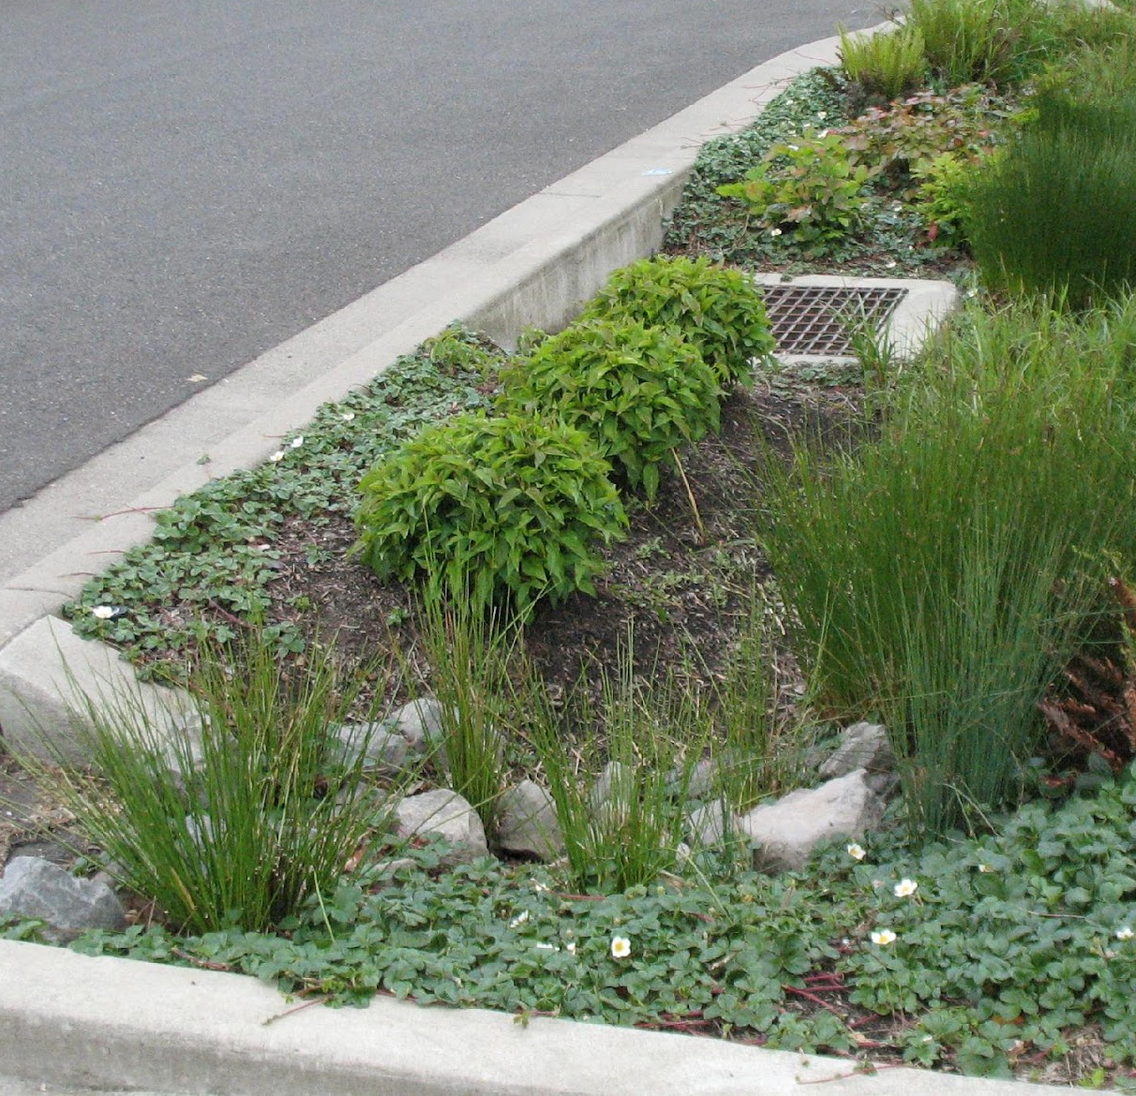
What Is
Green Infrastructure?
A set of practices that incorporates natural features to manage stormwater runoff.
By increasing infiltration, transpiration and evaporation, green infrastructure can reduce runoff and improve the water quality of stormwater.
Image source: https://www.flickr.com/photos/dcgreeninfrastructure/5036625486
Notes:
Image source: https://www.flickr.com/photos/dcgreeninfrastructure/5036625486

Slide 3
Components of Green Infrastructure
Some of the natural features that engineers include in green infrastructure plans are:
Plants to increase transpiration of water.
Soils with a high infiltration rate to improve water percolation through the soil.
Landscaping to direct stormwater to specially engineered areas that can store runoff and let it infiltrate, evaporate, or be transpired.
Notes:
Question - Think back to yesterday’s lesson (Lesson 4). What type of soils might engineers use to build green infrastructure that can cause water to infiltrate quickly? Answer: sandy soils

Slide 4
Examples of Green Infrastructure
Rain gardens
Green roofs
Constructed wetlands
Bioswales
Permeable pavement
Rainwater harvesting
Notes:
We’ll take a closer look at each of these examples of green infrastructure and their connections to the hydrologic cycle in the next few slides.

Slide 5
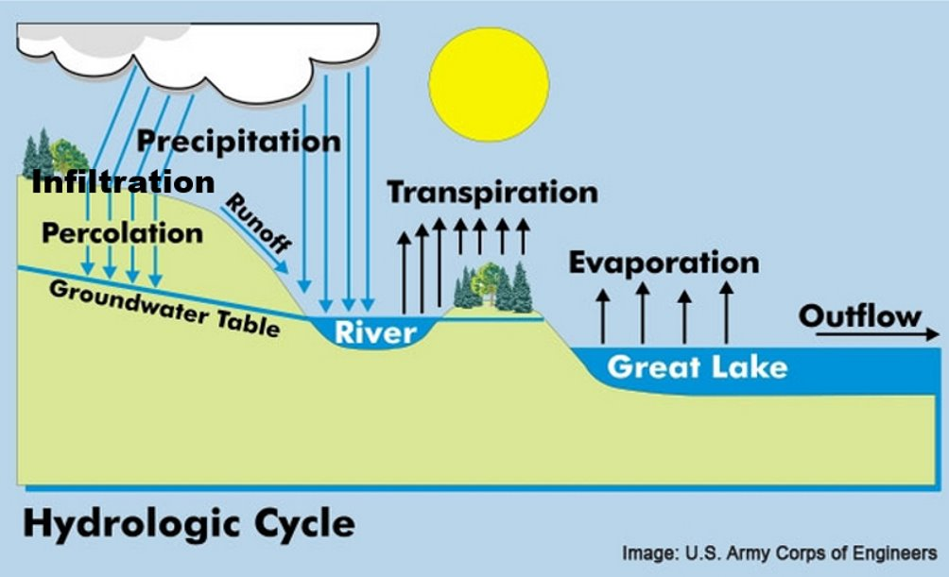
Connection to Hydrologic Cycle #1
1. Decrease runoff and enhance transpiration
Notes:
Image source: U.S. Army Corps of Engineers

Slide 6
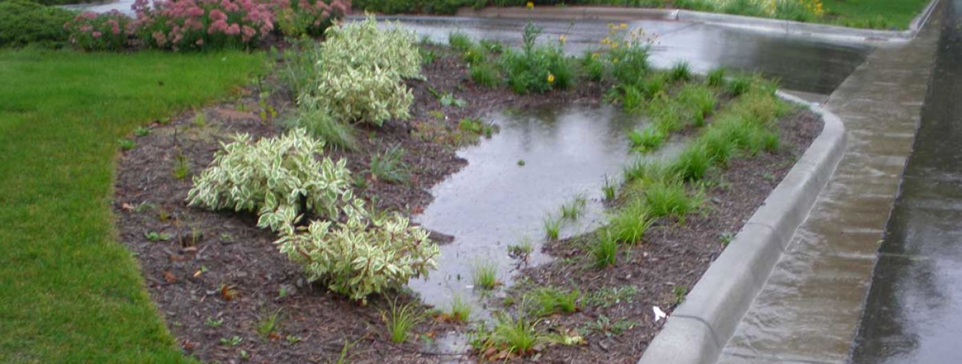
1. Rain Gardens
Shallow, vegetated basins that:
Collect runoff from roofs and roads
Infiltrate water through highly permeable soils
Transpire water with water-loving plants
Filter pollutants from the water
Image Source: University of Minnesota Extension
Notes:
Rain gardens are shallow, vegetated basins that collect and absorb runoff from rooftops, sidewalks, and streets. Rain gardens infiltrate, evaporate and transpire stormwater runoff –
Found near North Beach at Sam Myers Beach in Racine.
Image Source: University of Minnesota Extension

Slide 7
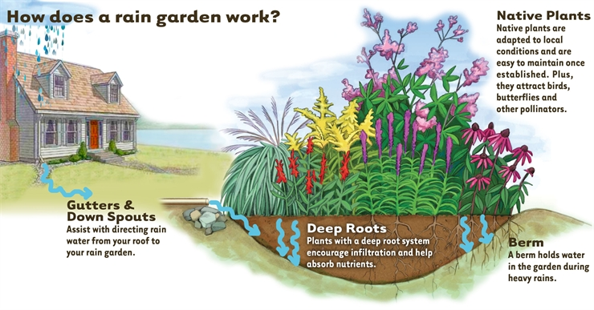
1. Rain Gardens – How Do They Work?
Image Source: Tip of the Mitt Watershed Council
Notes:
Image Source: Tip of the Mitt Watershed Council

Slide 8
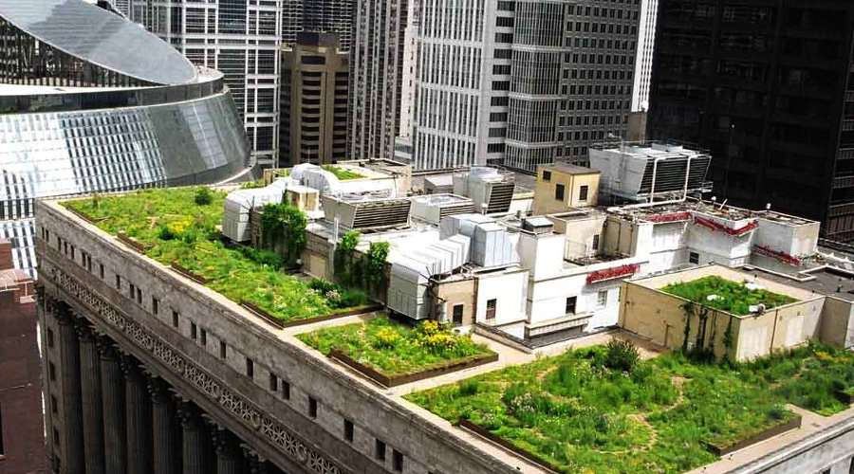
2. Green Roofs
Roofs covered with soil and plants to:
Capture rain that falls on the roof
Transpire water with water-loving plants
Image Source: DOE/NREL -Photographer: Katrin Scholz-Barth green roof on Chicago City Hall
Notes:
Green roofs are covered with growing media (like soil) and vegetation. Green roofs infiltrate, evaporate and transpire the stormwater that would normally become roof runoff (found in Racine on a hotel)
Being installed on a hotel in downtown Racine (Hotel Verdant)​
Installed on Milwaukee Public Museum - https://www.mmsd.com/what-we-do/green-infrastructure/green-roofs
Image Source: DOE/NREL -Photographer: Katrin Scholz-Barth green roof on Chicago City Hall

Slide 9
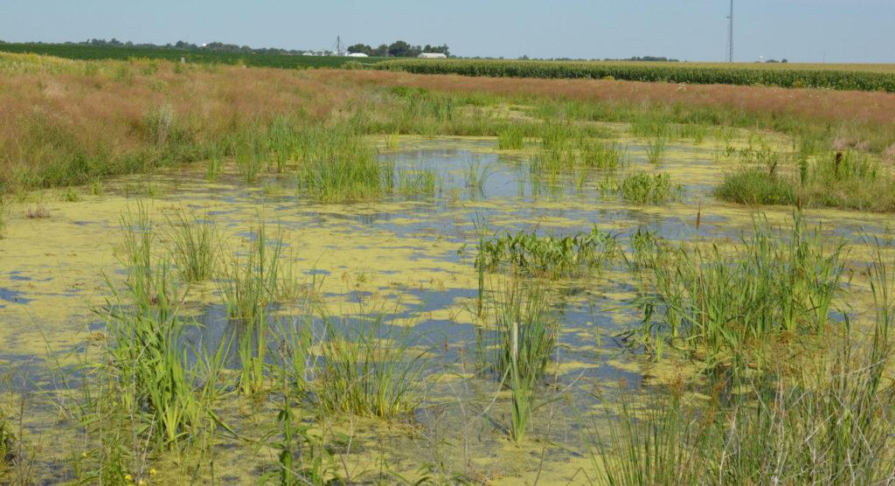
3. Constructed Wetlands
Basins that hold water and support wetland plants to:
Collect runoff from surrounding areas
Transpire water with water-loving plants
Evaporate water as it sits in the wetland
Filter pollutants from the water
Image Source: Wisconsin Wetlands Association – constructed wetland that helps clean runoff from a farm field
Notes:
Constructed wetlands mimic the functions of natural wetlands to capture and store stormwater. Constructed wetland can have standing water on the surface or water saturated just below the soil surface. Constructed wetlands infiltrate, evaporate, transpire and filter stormwater runoff. (The English Street Outfall, found at North Beach is a constructed wetland!)
Image Source: Wisconsin Wetlands Association – constructed wetland that helps clean runoff from a farm field

Slide 10
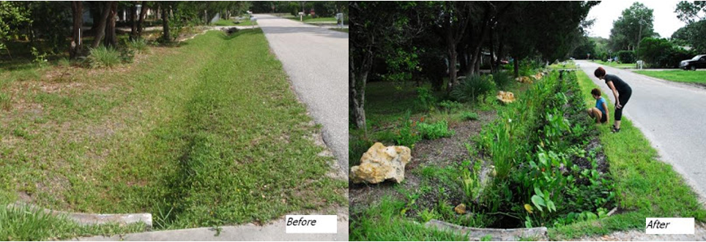
4. Bioswales
Vegetated channels that stormwater flows through.
Swales slow, infiltrate, and filter stormwater runoff
Found at North Beach (dune and swale wetland is a bioswale)
Image Source: Phillipi Creek https://www.phillippicreek.org/how-to-build-a-rain-garden-or-bioswale/
Notes:
Bioswales are vegetated channels that stormwater flows through. Vegetated swales slow, infiltrate, and filter stormwater runoff (found at North Beach and at the Pershing Park Boat Launch near Festival Park).
In addition to these four examples of green infrastructure, we can also include planter boxes, green streets and alleys, green parking, urban tree canopy ( trees intercept rainfall before it hits the ground), and land conservation.
Image Source: Phillipi Creek https://www.phillippicreek.org/how-to-build-a-rain-garden-or-bioswale

Slide 11
Connection to Hydrologic Cycle #2
1. Decrease runoff and enhance transpiration
2. increase infiltration
3. decrease runoff to engineered gray storm management system
Notes:
Image source: U.S. Army Corps of Engineers

Slide 12
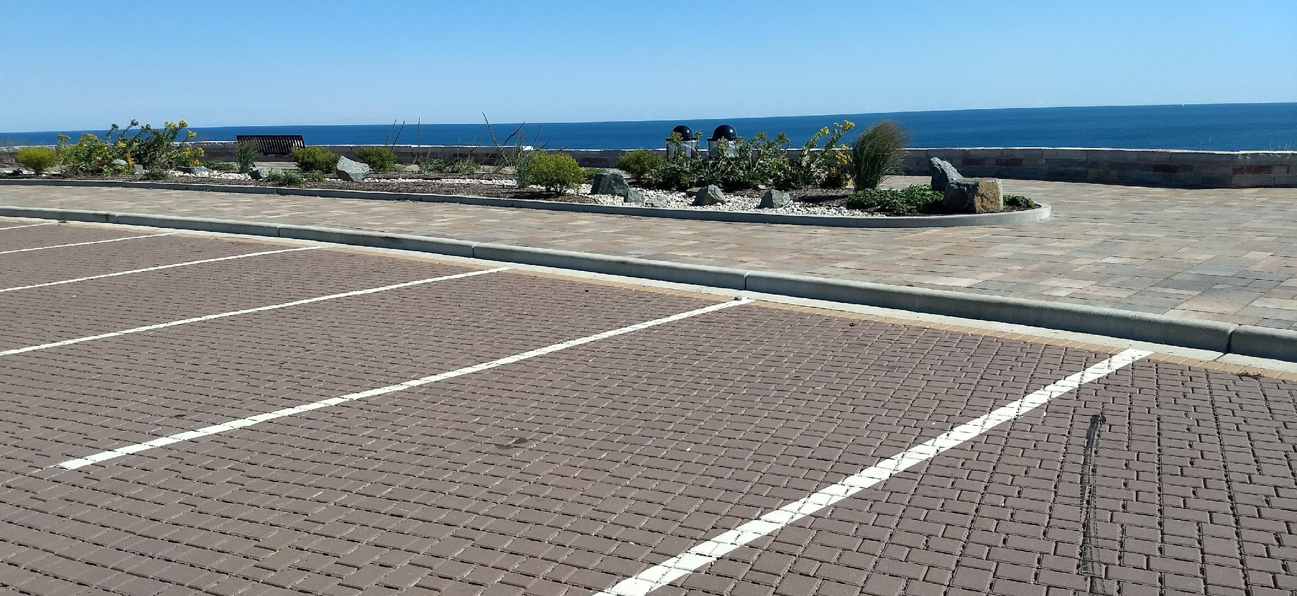
5. Permeable Pavement
Special paving materials that can absorb and infiltrate water.
Concrete, asphalt, and brick pavers all have permeable options.
Image Source: Adam Bechle, permeable pavers in Oak Creek Wis. near Lake Michigan. Water can drain in between the spaces between the pavers
Notes:
While many of the examples of green infrastructure we have already talked about increase infiltration, the explicit purpose of permeable paving is to do this. Permeable pavement contains special paving materials that can absorb and infiltrate water. Concrete, asphalt, and brick pavers all have permeable options.
Found in Racine at Gateway Technical College and Wind Point Lighthouse
Image Source: Adam Bechle, permeable pavers in Oak Creek Wis. near Lake Michigan. Water can drain in between the spaces between the pavers

Slide 13
Connection to Hydrologic Cycle #3
1. decrease runoff and enhance transpiration
2. increase infiltration
3. decrease runoff to engineered gray storm management system
Notes:
Image source: U.S. Army Corps of Engineers

Slide 14
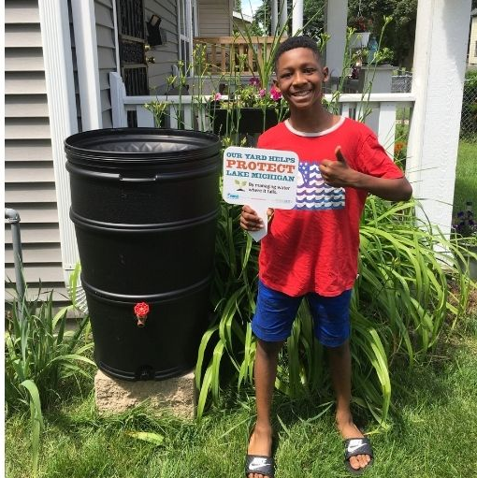
6. Rainwater Harvesting
Systems that collect and store rainwater for later use, like for watering plants. Often installed to collect roof runoff.
Rain barrels are a common form of rainwater harvesting
Image Source: Milwaukee Metropolitan School District, A rain barrel installed in Milwaukee to collect roof runoff
Notes:
Rainwater harvesting systems collect and store rainwater for later use, like for watering plants. They are often installed to collect roof runoff.
Many homes in Racine have a rain barrel.
Another green infrastructure system is downspout disconnection from the storm sewer system, letting roof water drain onto lawns instead. All downspouts are disconnected from the storm sewer system in Racine.
Image Source: Milwaukee Metropolitan School District, A rain barrel installed in Milwaukee to collect roof runoff

Slide 15
Connection to Hydrologic Cycle #4
1. decrease runoff and enhance transpiration
2. increase infiltration
3. decrease runoff to engineered gray storm management system
Notes:
Image source: U.S. Army Corps of Engineers

