Slide 1
The Hydrologic Cycle
Lesson 5 Introduction to Green Infrastructure
Wisconsin Sea Grant | October 2025 | Coastal Engineering Education: People, Place and Practice: Lesson 5: Introduction to Green Infrastructure Image used with written permission by JB the Explorer
This curriculum was prepared by Adam Bechle, Ginny Carlton, and Anne Moser under award number NA21NOS4290005 from the Great Lakes Bay Watershed Education and Training (B-WET) program of the National Oceanic and Atmospheric Administration (NOAA), U.S. Department of Commerce. The statements, findings, conclusions and recommendations are those of the author(s) and do not necessarily reflect the views of NOAA or the U.S. Department of Commerce.
Notes:
Image Source: https://www.flickr.com/photos/producerjb/43643260870 Racine Breakwater Lighthouse
JB the Explorer took this photo of the Racine Breakwater Lighthouse in July of 2017 while at the Racine Harbor.
This lighthouse was first lit in November of 1901.
In the distance, you can see the Wind Point Lighthouse.
Image used with written permission by JB the Explorer as provided via JB's Native Garden@PlantNativeWI
Previously on Twitter and now on X @ExplorerJB

Slide 2
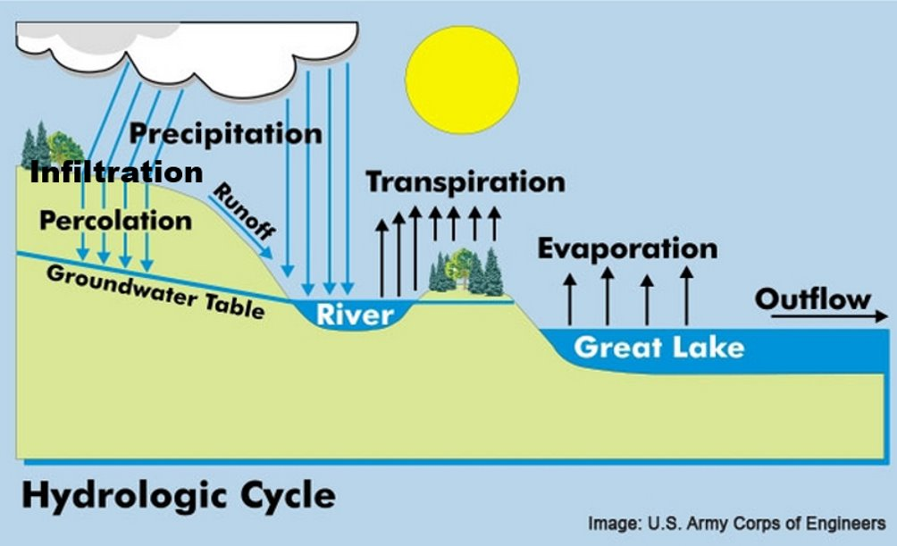
The Hydrologic Cycle: Transpiration and Evaporation
Notes:
A very important component of the water cycle for managing runoff is transpiration. Transpiration is the process through which plant roots absorb water and then release the water in the form of vapor through the leaves. Transpiration is an important factor in the water cycle as it is one of the major sources of water into the atmosphere.
When we don’t have plants on the landscape, or if the number of plants is significantly reduced, then the transpiration rate is reduced. A reduced transpiration rate means the runoff rate is likely to increase. If the amount of runoff is high, then the risk of flooding may also increase.
Image source: U.S. Army Corps of Engineers

