Slide 1
Coastal Engineering at North Beach
Part 1
Lesson 6 Coastal Engineering at North Beach
Wisconsin Sea Grant | October 2025| Coastal Engineering Education: People, Place and Practice: Lesson 6:Coastal Engineering at North Beach Image used with written permission by JB the Explorer
This curriculum was prepared by Adam Bechle, Ginny Carlton, and Anne Moser under award number NA21NOS4290005 from the Great Lakes Bay Watershed Education and Training (B-WET) program of the National Oceanic and Atmospheric Administration (NOAA), U.S. Department of Commerce. The statements, findings, conclusions and recommendations are those of the author(s) and do not necessarily reflect the views of NOAA or the U.S. Department of Commerce.
Notes:
Image Source: https://www.flickr.com/photos/producerjb/43643260870 Racine Breakwater Lighthouse
JB the Explorer took this photo of the Racine Breakwater Lighthouse in July of 2017 while at the Racine Harbor.
This lighthouse was first lit in November of 1901.
In the distance, you can see the Wind Point Lighthouse.
Image used with written permission by JB the Explorer as provided via JB's Native Garden@PlantNativeWI
Previously on Twitter and now on X @ExplorerJB

Slide 2


Protecting the Coast — A Top-Down Approach
Top: Manage Land Use,
Water & Vegetation
Slopes: Manage Water,
Vegetation & Stability
Toe: Reduce Wave Impact
Beach: Manage Water, Vegetation & Slope
Notes:
Remember one aspect of coastal engineers’ work is to protect homes and properties. Also remember the wave tank demonstration we conducted. The waves impact the shoreline differently depending on a variety of factors including the depth of the water, the height of the wave, the angle of wave movement, and the position on the landscape (top, slope, toe).
Image source: Adam Bechle, coastal engineer, Wisconsin Sea Grant

Slide 3
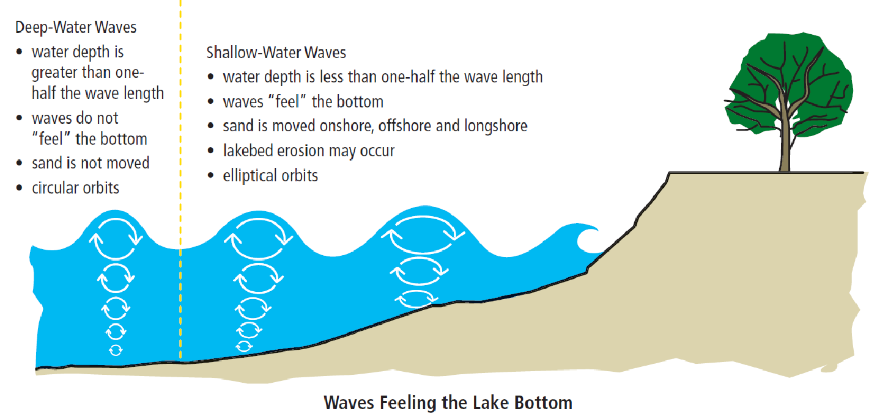
Beach
Causes waves to break before hitting bluff toe
Image: USACE/Wisconsin Sea Grant: Living on the Coast
Notes:
When we did the wave tank demonstration, we also saw that a beach allows the waves to break before hitting the bluff toe. Our experimentation indicated the water depth influenced the amount of erosion that occurred. The shape of the beach (its height and width profiles) also influences the amount of erosion and sediment transport that occur in any given location.
Image source: Image: USACE/Wisconsin Sea Grant: Living on the Coast

Slide 4

Engineering Design Process Model by TeachEngineering
Notes:
Since we are looking at the beach as coastal engineers, we will use the engineering design process to guide our thinking.
Image source: TeachEnginering

Slide 5
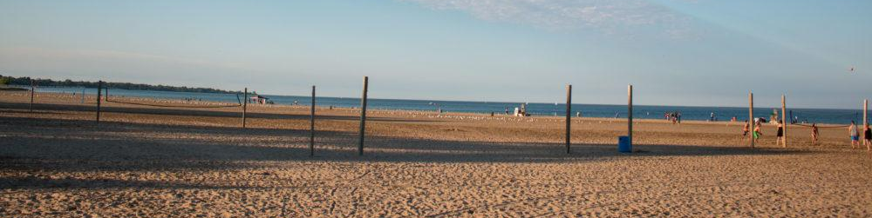
North Beach — A Place of Constant Change
A mix of natural and man-made features that make this place a great place to be!
Image Source: Go Valley Kids Website
Notes:
When you go to North Beach, the sand and Lake Michigan are obvious natural features. A closer look reveals various problems across the landscape, as well as the engineered solutions that have been installed to resolve the concerns.
So, although perhaps North Beach looks pretty much the same every time you go, the landscape is constantly changing. Let’s look at some of the concerns coastal engineers have worked on at North Beach over the years.
Image Source: Go Valley Kids website
https://govalleykids.com/beach-day-road-trip-north-beach/

Slide 6


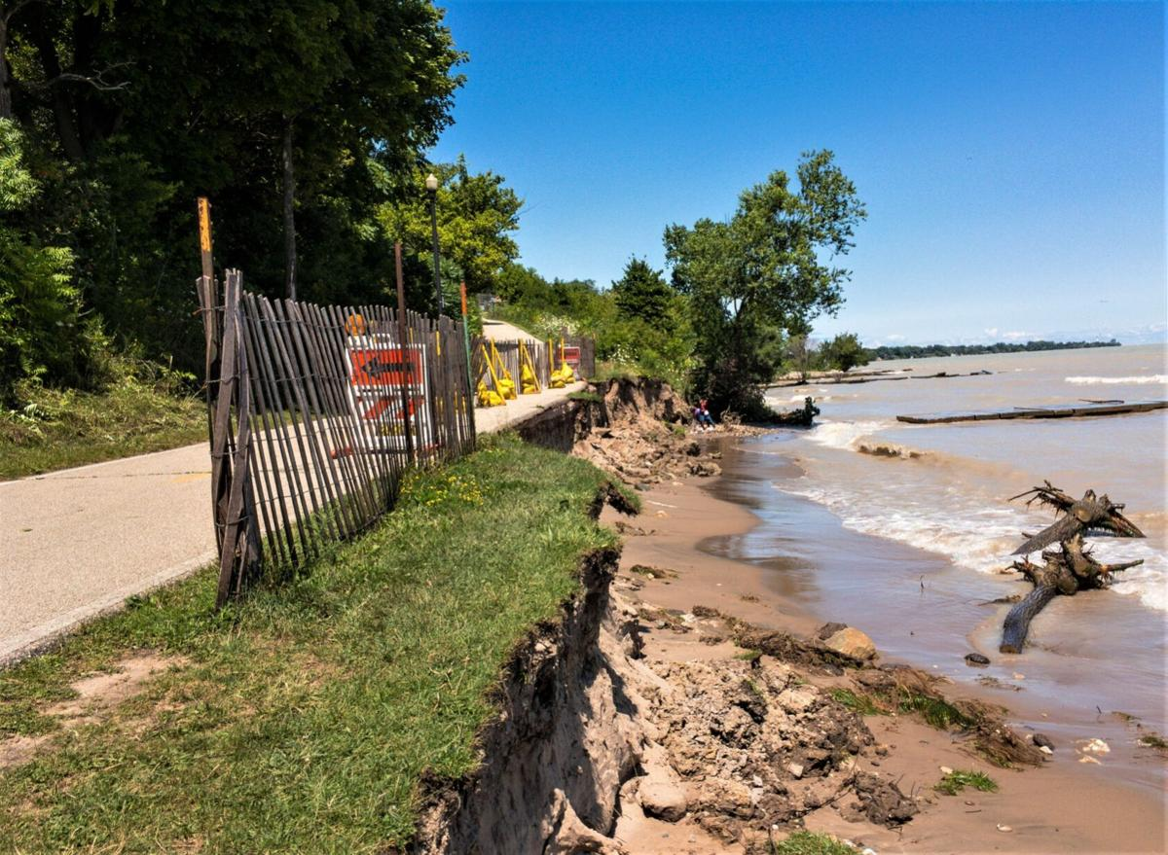
Problem #1 Beach erosion
Causes are waves and currents
Image Source: Christina Lieffring, Racine Journal Times
Notes:
As we look at the issues at North Beach, be sure to take notes in your organizer – it will be useful at the end of today’s lesson and when we take our field trip to North Beach.
One problem coastal engineers have attempted to resolve is Beach Erosion. In the summer of 2020, the erosion that occurred alongside the path at Zoo Beach resulted in the trail being closed.
Zoo beach trail severely eroding; City and FEMA working on restoration details by Christina Lieffring. Aug 5, 2020
https://journaltimes.com/news/local/zoo-beach-trail-severely-eroding-city-and-fema-working-on-restoration-details/article_1347c921-848e-50a9-9f97-5ca7eef49abf.htm
Image Source: Christina Lieffring, Racine Journal Times

Slide 7
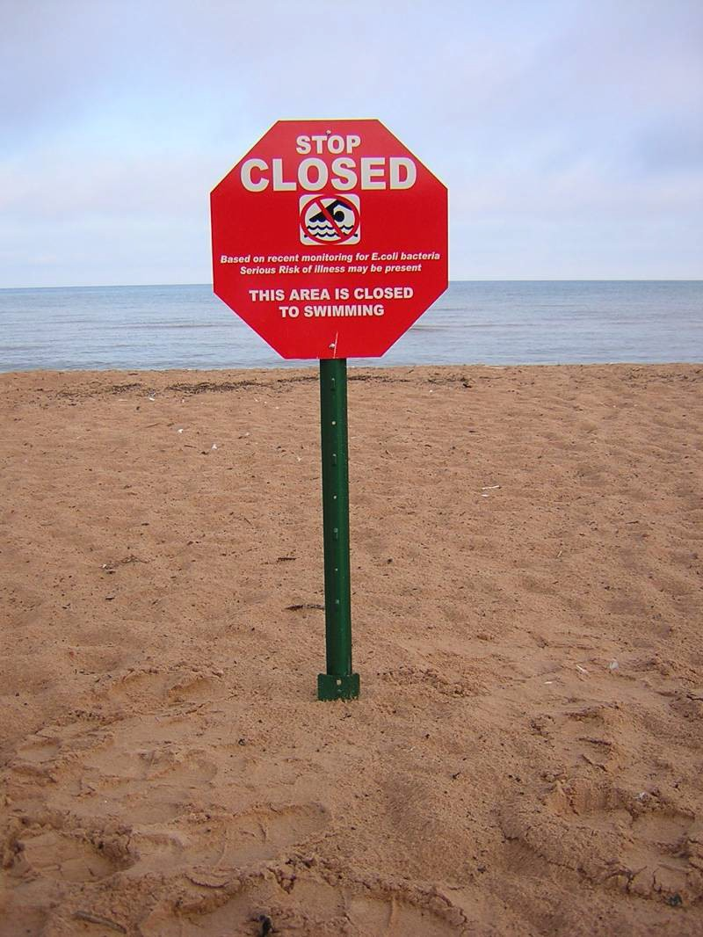
Problem #2 Beach closures
Causes include E. coli, algal blooms, sea gull feces, litter
Image Source: Julie Kinzelman
Notes:
Besides erosion, another concern is having to close the beach due to health and safety concerns. Escherichia coli, commonly called E. coli, is a bacteria found in sewage which can cause illness in humans. If there is too much E. Coli in the water, the beach has to close for safety.
Bacteria like E. coli can get to the beach from a number of sources, including sea gull feces, pet feces, algal blooms, and runoff from upstream areas (where the bacteria is picked up by runoff and transported to the lake by the storm sewer system).
Litter is also a problem.
Image source: Julie Kinzelman, City of Racine Health Department PowerPoint

Slide 8
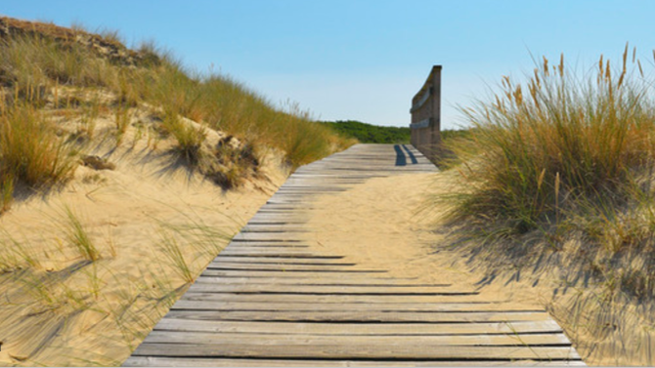
Problem #3 Boardwalks buried by sand
Cause is wind picks up sand that is not held down
Image Source: Christina Lieffring, Racine Journal Times
Notes:
A third problem at North Beach that coastal engineers may be able to help resolve is sand burying the boardwalks.
“Winds displaced sand from the beach area that covered certain portions of the boardwalk between two popular attractions at Racine’s North Beach. As an alternative to installing manmade structures, and in keeping with the city of Racine’s commitment to the environment, [engineers and city officials] sought to utilize vegetation as a means of controlling wind blown sand which frequently covered this pathway with the added benefit of increasing the natural landscape.”
Source: Best Practice-Racine-DuneSwales.pdf
Image source: Christina Lieffring, Racine Journal Times
https://www.offset.com/photos/boardwalk-through-sand-dunes-and-beach-grass-at-nebel-germany-478288

Slide 9
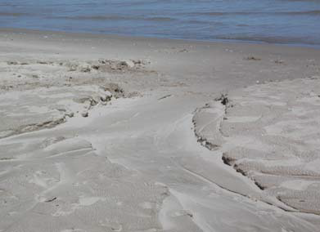
Problem #4 Washouts [shoreline erosion!]
Cause is runoff from the back beach area
Image Source: Julie Kinzelman, city of Racine Health Department
Notes:
If all those problems were not enough, another problem at North Beach was washouts. After large rain events there was frequent, visible evidence of shoreline erosion (as washouts) resulting, in part, from runoff originating in the back beach area and flowing over the beach, taking sand with it.
Source: Best Practice-Racine-DuneSwales.pdf
Image source: Julie Kinzelman, city of Racine Health Department

Slide 10
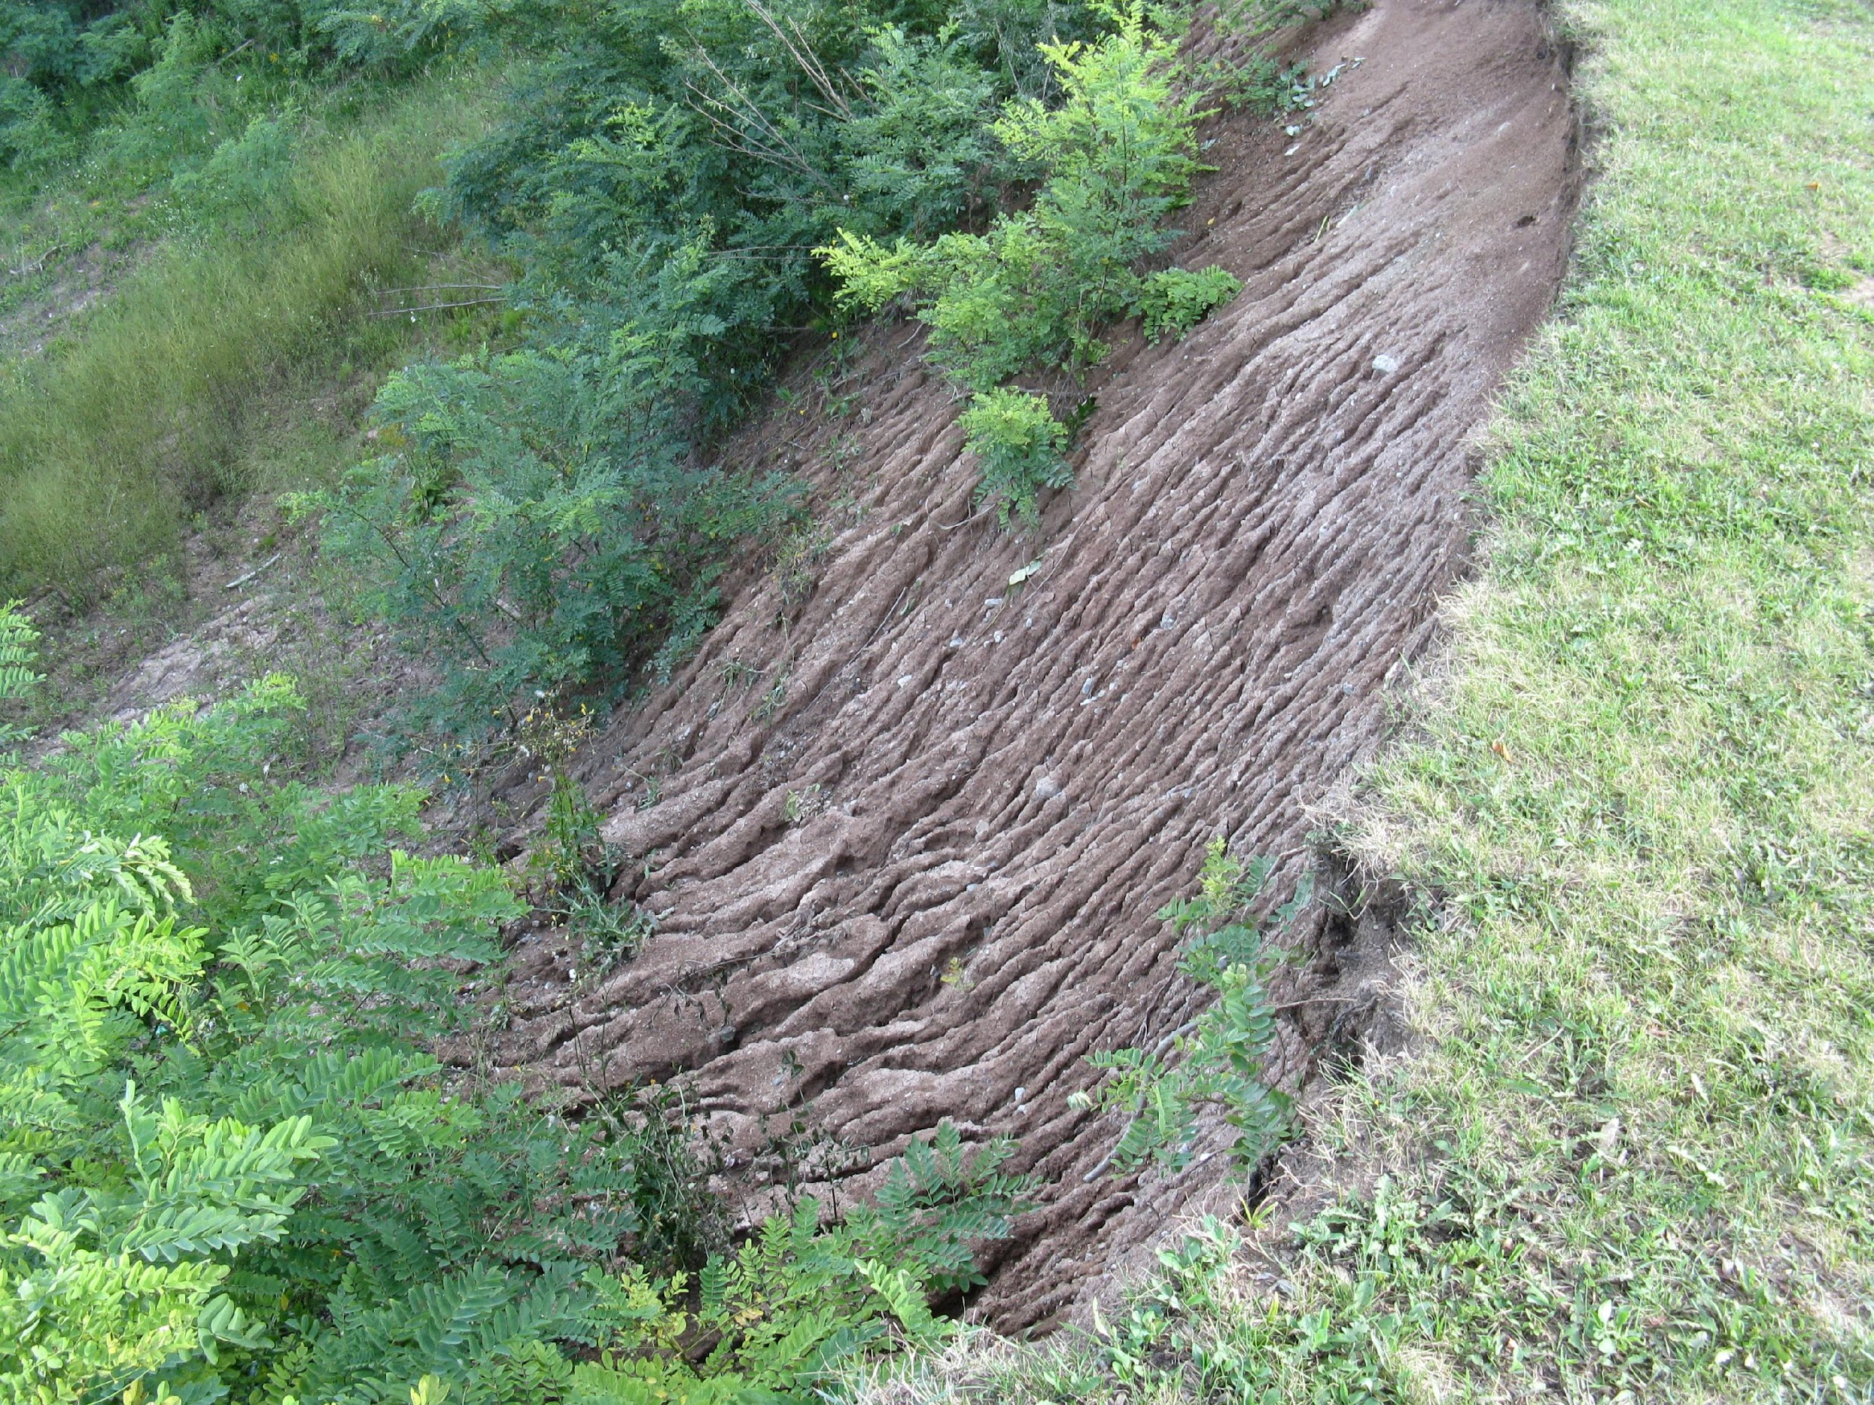
Problem #4 Washouts [bluff top runoff]
Cause is runoff from the bluff top
Image source: Adam Bechle, Wisconsin Sea Grant
Notes:
Water flowing down coastal slopes like bluffs can also be a problem. As the water flows downhill, it can erode the soil and cause washouts.
Image source: Adam Bechle, coastal engineer, Wisconsin Sea Grant

Slide 11
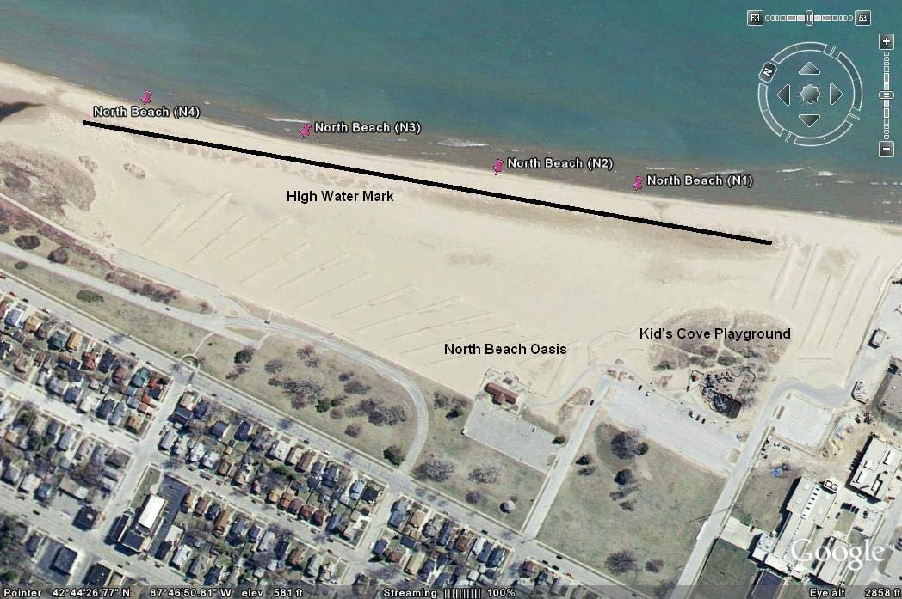
Imagine and Plan SOLUTIONS!
Big challenge: Where should solutions go?
Notes:
When engineers try to come up with solutions, they also need to think about how the area is currently being used. At the North Beach site there are parking lots, pathways to provide access to the beach, an oasis, and a playground.
One consideration or constraint is where should we put whatever solution we come up with?
Source: Best Practice-Racine-DuneSwales.pdf

Slide 12
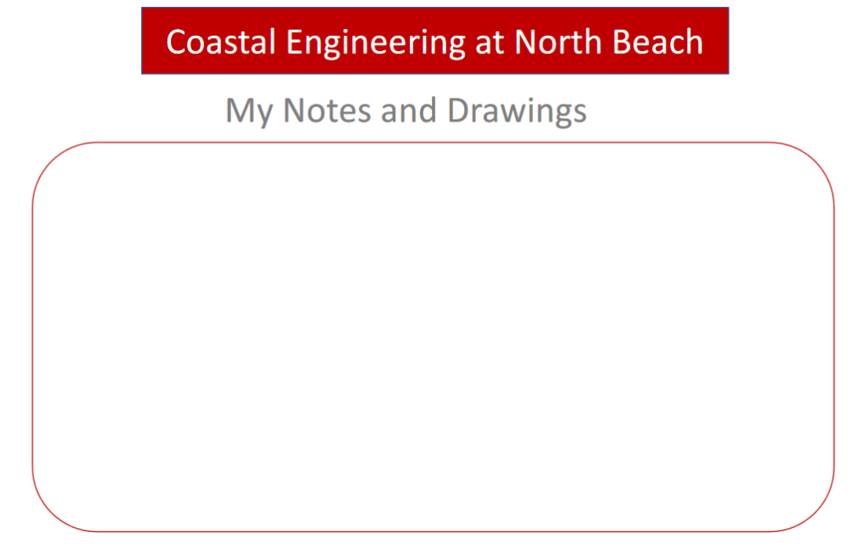
Plan and Create SOLUTIONS!
Big challenge: Where should solutions go?
Notes:
Tell students to take a few minutes to use the last page of their graphic organizers to draw out or describe where you think erosion would be the biggest problem and thus where engineered solutions should go.
Note 1 to instructor: Erosion would be the biggest problem where the beach is narrowest and waves can erode the bluffs. Draw attention to earlier graphic about how beaches break waves. Plus, maybe you wouldn't want a big pile of rock on the nice sandy beach.
Note 2 to instructor: The next several slides and part 2 of the slideshow indicate where the structures actually are on North Beach and why they are in those locations.
Note 3 to instructor: The harbor is there for wave protection not erosion control so that would be a different story.
Image source: Best Practice-Racine-DuneSwales.pdf

Slide 13
Let’s look at five solutions at North Beach

Slide 14
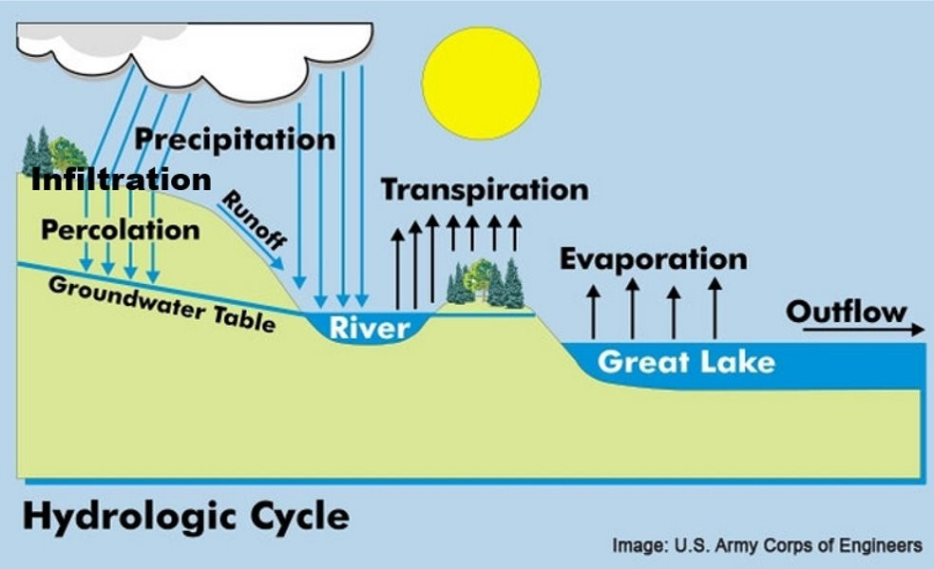
Recall the Hydrologic Cycle
Which type of water movement does infrastructure try to influence?
Infiltration
Transpiration/Evaporation
Runoff
Waves
Currents or water levels
Hint: for each system, there can be more than one correct answer!
Notes:
As I talk about each of the solutions in the next few slides, I would like you to think about which type of water movement each coastal engineering solution attempts to influence. We have talked about infiltration, runoff, transpiration and evaporation

Slide 15
Problem #1
Erosion
Solution #1
Installed Engineered Gray Structures
Notes:
So, what can engineers do to solve these concerns? As we have seen in previous lessons -- when you worked to minimize beach erosion and avoid damage to your house -- engineers can install various structures. Gray structures are generally “hard infrastructure.”

Slide 16
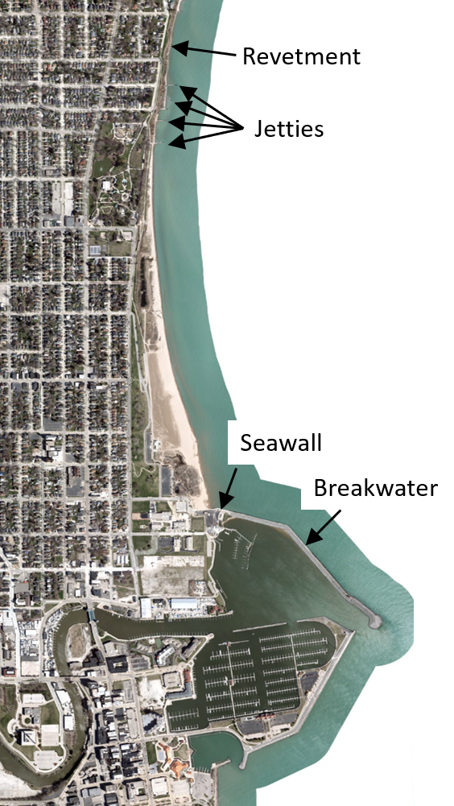
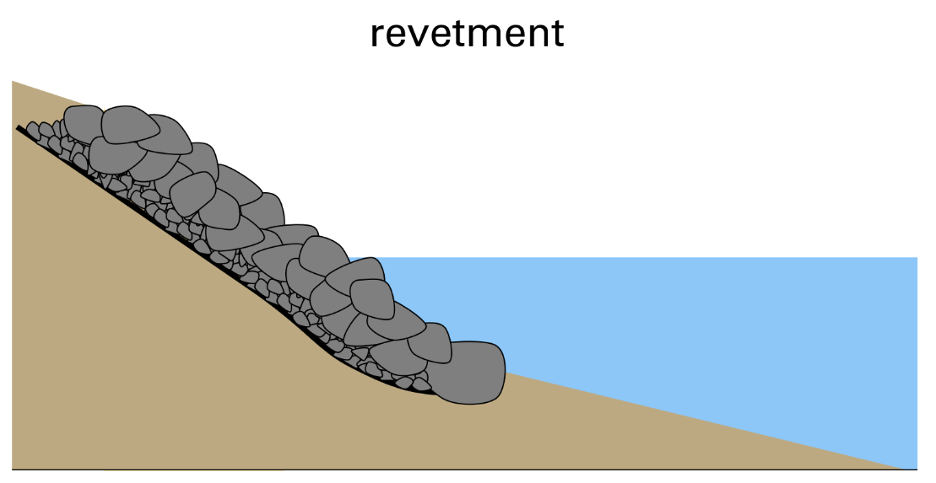
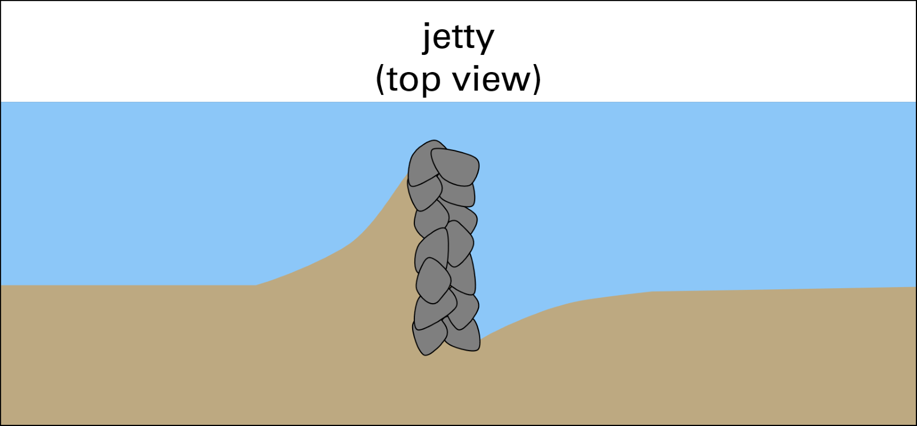
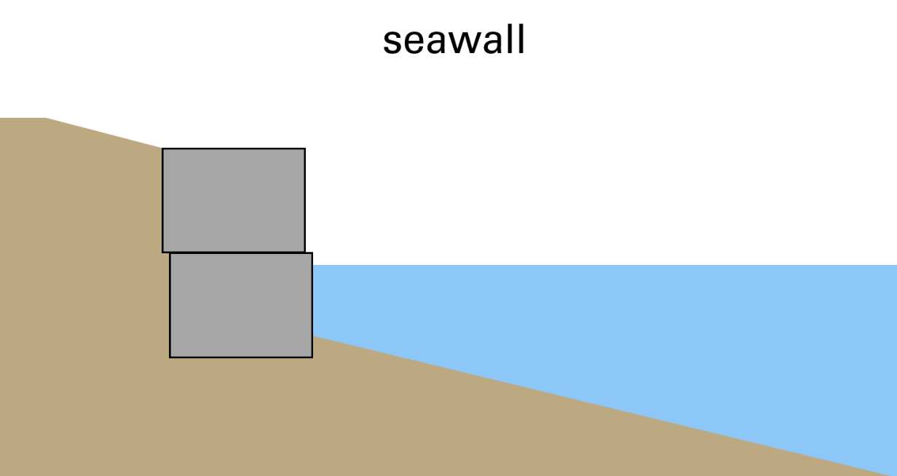
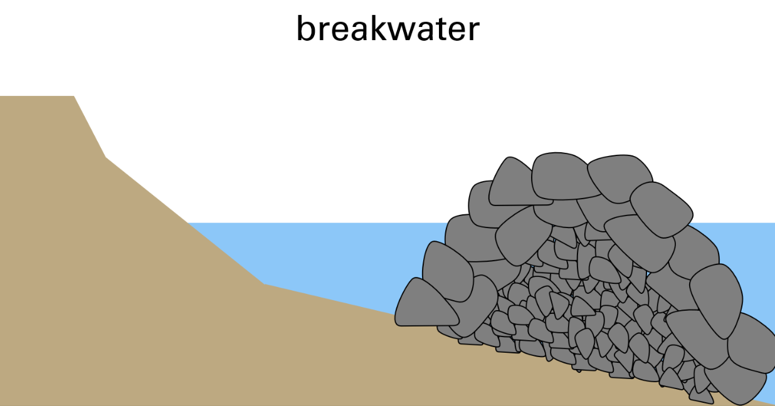
Gray Infrastructure at North Beach
Notes:
North Beach has a variety of engineered coastal structures including a revetment, jetties, a seawall and breakwater that protect the shoreline and the harbor at the mouth of the Root River. Not all of the shoreline has coastal structures – only the areas that need protection the most from waves and erosion like the harbor and Michigan Boulevard, a road that runs right next to the lake where the beach is very narrow.
These engineered structures help to deal with problem #1-beach erosion
Challenge: where to install them?
Image source: Map Data: Esri, HERE, Garmin, Intermap, increment P Corp., GEBCO, USGS, FAO, NPS, NRCAN, GeoBase, IGN, Kadaster NL, Ordnance Survey, Esri Japan, METI, Esri China (Hong Kong), (c) OpenStreetMap contributors, and the GIS User Community
Graphics source: Adam Bechle, coastal engineer, Wisconsin Sea Grant

Slide 17
Which type of water movement does engineered gray infrastructure try to influence?
Recall the Hydrologic Cycle
Infiltration
Transpiration/Evaporation
Runoff
Waves
Currents or water levels
Hint: for each system, there can be more than one correct answer!
Notes:
These gray infrastructure systems are primarily designed to influence runoff and erosion due to waves and currents. Because they may also cause water to puddle or pond on the beach, infiltration as well as evaporation rates may be influenced. Transpiration is not impacted because there are not any plants in these engineered solutions.
Image source: U.S. Army Corps of Engineers

Slide 18
Problem # 2
Beach closures
Solution #2
Beach Management Practices
[ Beach Slope Maintenance
+ Beach Grooming ]
Notes:
Engineers or health department officials can also implement a variety of beach management practices to address concerns related to beach closures.

Slide 19
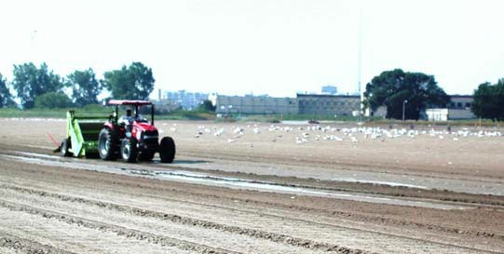
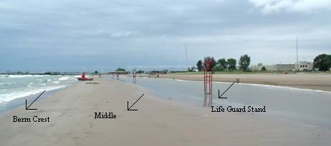
2a. Beach Slope Maintenance
Make slope of beach steep enough =
Water can drain, less waves =
Less E. coli =
Fewer closed beaches!
Image Source: Julie Kinzelman, city of Racine Health Department
Notes:
Specifically, engineers can work with beach managers to help create a beach that is not a good place for E. coli to live. Wet beach sand allows E. coli to grow and multiply.
A flat beach face, as we saw in our water tank experiments, allows waves to wash over the beach, keeping the beach wet.
Large swales trap water and the sand remain wet
Flat beach face allows for the encroachment of waves
Deep beach grooming w/o leveling can promote drying
Solution A – Beach slope maintenance - If the slope of the beach is steep enough without low flat spots, water can drain from the beach. This will also keep waves from constantly washing over large parts of the beach. Engineers can help design beach nourishment, or the addition of sand, to raise the beach slope and fill low spots to help keep the sand dry.
Images source: Julie Kinzelman, city of Racine Health Department

Slide 20
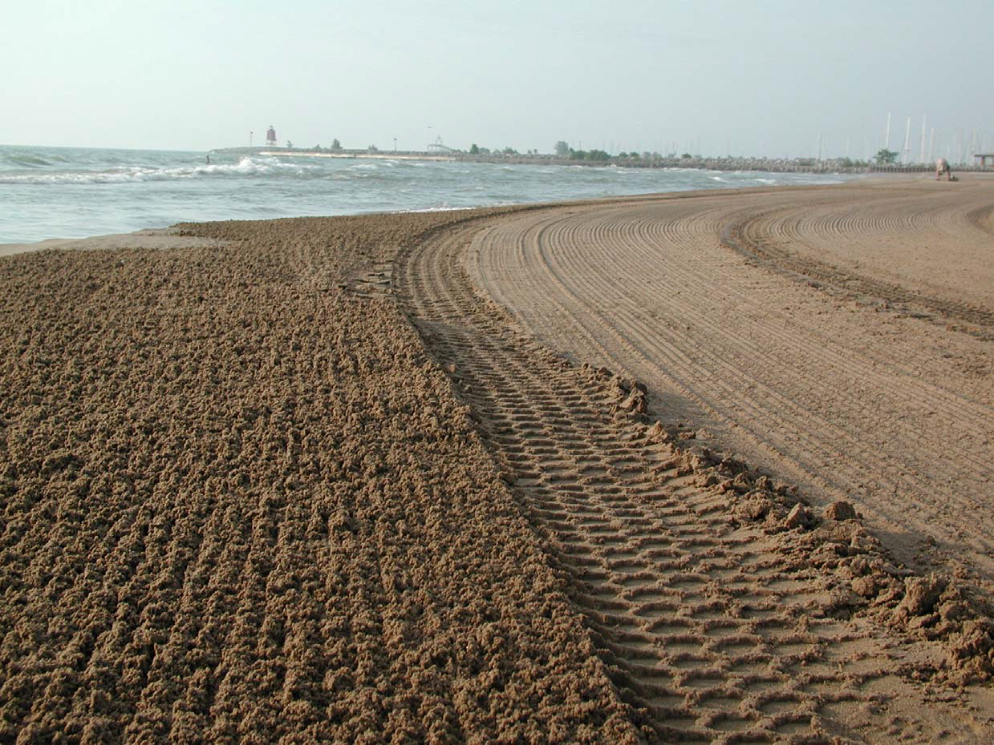
2b. Beach Grooming
Deep grooming =
Faster drying =
Less E. coli =
Fewer closed beaches!
Old
New
Image Source: Julie Kinzelman, city of Racine Health Department
Notes:
Solution B – Beach grooming - The beach is groomed to remove litter and help beach sand dry out to reduce the growth of E. coli. Grooming is a bit like raking the beach sand with a special piece of equipment pulled by a tractor. The grooming can turn over the sand and help it dry out, making E. coli unhappy and the beach cleaner and safer.
This image shows the new way of grooming the beach on the left, and the old way of grooming the beach on the right. The deeper grooming increases the drying rate of the sand which decreases the E. coli content.
This beach maintenance process helps to resolve problem #2—closed beaches
Image source: Julie Kinzelman, city of Racine Health Department

Slide 21
Which type of water movement does beach management practices try to influence?
Recall the Hydrologic Cycle
Infiltration
Transpiration/Evaporation
Runoff
Waves
Currents or water levels
Hint: for each system, there can be more than one correct answer!
Notes:
This beach management practice is primarily designed to influence infiltration and evaporation rates. Runoff may also be influenced especially if the slope of the beach is altered. Transpiration is not impacted because there are not any plants in these engineered solutions.
Image source: U.S. Army Corps of Engineers

Slide 22
Problem #3 and #4
Sand everywhere, Washouts
Solution #3
Engineered Dune & Swale
Notes:
The third engineering solution at North Beach we will discuss is called engineered dunes and swale wetland.

Slide 23
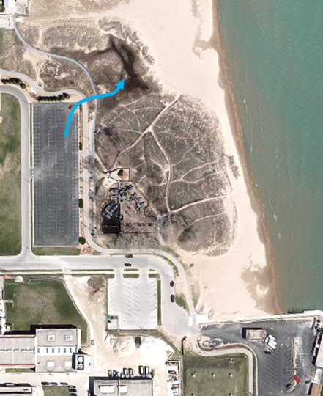
Challenge to be addressed
Swale/Wetland​
Sand is everywhere and washouts are common. Challenge is how to control flow of water from
parking lot.
Parking Lot​
Image source: Southeastern Wisconsin Regional Planning Commission
Notes:
Let's take a closer look at the problem coastal engineers are trying to solve. The goal was to control the flow of water from the parking lot by creating a flow pathway from the main North Beach parking lot to engineered dune and swale wetland.
Image source: Southeastern Wisconsin Regional Planning Commission

Slide 24
Let's calculate the problem.
Swale/Wetland​
Parking Lot​
Image source: Southeastern Wisconsin Regional Planning Commission
Notes:
In order to get an idea of the scope of the problem, let's take a break from the PowerPoint to calculate the amount of water that can run off a parking lot and the size of the area (e.g., a rain garden or in this case a swale/wetland) that will be needed to store the water.

