Slide 1
Coastal Engineering at North Beach Part 2
Lesson 6 Coastal Engineering at North Beach
Wisconsin Sea Grant | October 2025 | Coastal Engineering Education: People, Place and Practice: Lesson 6: Coastal Engineering at North Beach Image used with written permission by JB the Explorer
This curriculum was prepared by Adam Bechle, Ginny Carlton, and Anne Moser under award number NA21NOS4290005 from the Great Lakes Bay Watershed Education and Training (B-WET) program of the National Oceanic and Atmospheric Administration (NOAA), U.S. Department of Commerce. The statements, findings, conclusions and recommendations are those of the author(s) and do not necessarily reflect the views of NOAA or the U.S. Department of Commerce.
Notes:
Image Source: https://www.flickr.com/photos/producerjb/43643260870 Racine Breakwater Lighthouse
JB the Explorer took this photo of the Racine Breakwater Lighthouse in July of 2017 while at the Racine Harbor.
This lighthouse was first lit in November of 1901.
In the distance, you can see the Wind Point Lighthouse.
Image used with written permission by JB the Explorer as provided via JB's Native Garden@PlantNativeWI
Previously on Twitter and now on X @ExplorerJB

Slide 2
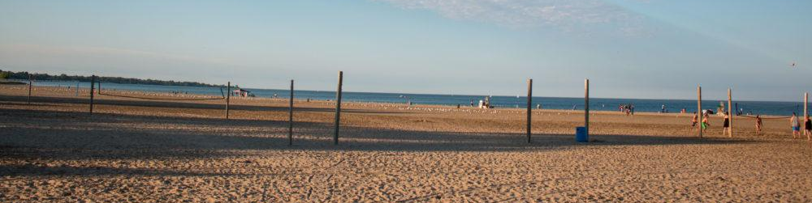
North Beach — A Place of Constant Change
A mix of natural and man-made features that make this place a great place to be!
Image Source: Go Valley Kids Website
Notes:
Remember: we are looking at our field site, North Beach, and the ways it is a place of constant change. Some of these changes are natural, some are man-made.
Image Source: https://govalleykids.com/beach-day-road-trip-north-beach/

Slide 3


Four Problems at North Beach
Problem #1 Beach erosion
Problem #2 Beach closures
Problem #3 Boardwalks buried by sand
Problem #4 Washouts
Notes:
Again, we are looking at how coastal engineers solve these four problems that this constant change creates…

Slide 4


Problem #3 and #4 ​
Boardwalks buried by sand, washouts ​
Solution #3​
Engineered Dune & Swale​
​
Notes:
Before we did our calculations, we were looking at our solution number 3 – the engineered dune and swale at North Beach.

Slide 5


Comparing our Estimate to Actual Rain Garden Size
We just calculated the amount of runoff from the parking lot and the rain garden size needed to handle this runoff.
Now let’s look at the dune and swale wetland that was created at North Beach. Do you think our estimated size will be close to what was actually built?
Notes:
We just calculated the amount of rainwater that annually falls on the parking lot. What were your results? Why might our answers not be identical?
We also just calculated the size of a rain garden that would be needed if we used a seven percent scaling factor. What were your results? Why might our answers not be identical?
What are your results when you made the calculation using a twenty percent scaling factor?
Obviously when a seven percent scaling factor is used, the amount of land needed for a rain garden is less than if we decided to install a rain garden based on the twenty percent scaling factor. The dune and swale wetland that the city of Racine built isn’t exactly a rain garden but it does many of the same things as a rain garden – it captures runoff so it can infiltrate the water and have plants evapotranspirate the water.
Earlier we said that one of the constraints engineers must consider is where to put any engineered solutions they want to install.
Where do you think a rain garden should be placed to handle the rainwater that falls on the Kids Cove playground parking lot? Why do you think that location would be a good place?

Slide 6
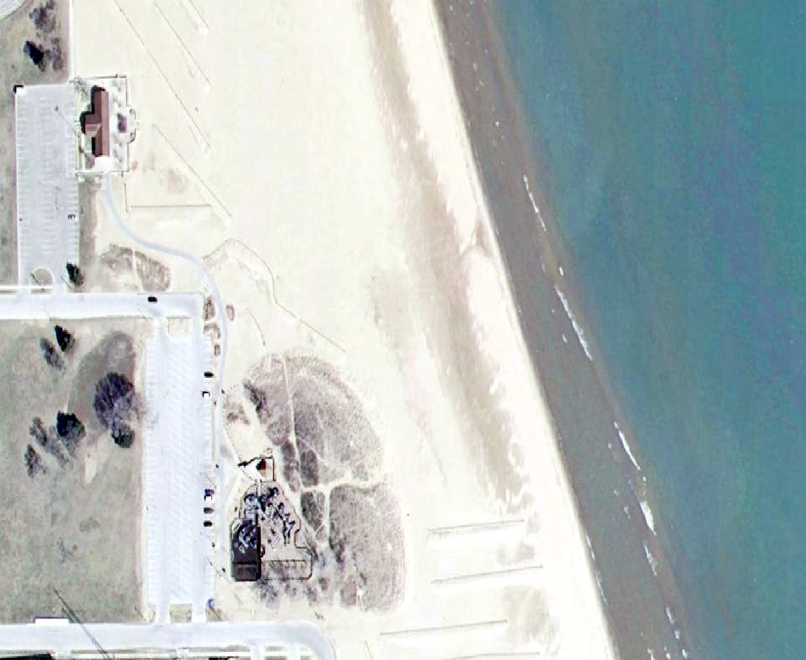
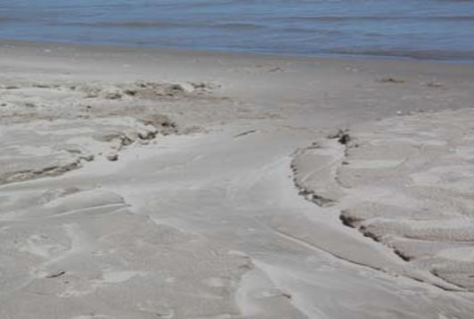
North Beach Before 2005
Before - 2005
Runoff washes out beach
Kids Cove
Parking Lot
Sources: Julie Kinzelman
Sources: Esri, HERE, Garmin, Intermap, increment P Corp., GEBCO, USGS, FAO, NPS, NRCAN, GeoBase, IGN, Kadaster NL, Ordnance Survey, Esri
Notes:
This is what North Beach looked like in 2005 right when the city started making the dune and swale wetland. If the goal is to treat runoff from the parking lot near Kids Cove Playground, where do you think they could build this wetland?
Image source: Sources: Esri, HERE, Garmin, Intermap, increment P Corp., GEBCO, USGS, FAO, NPS, NRCAN, GeoBase,

Slide 7
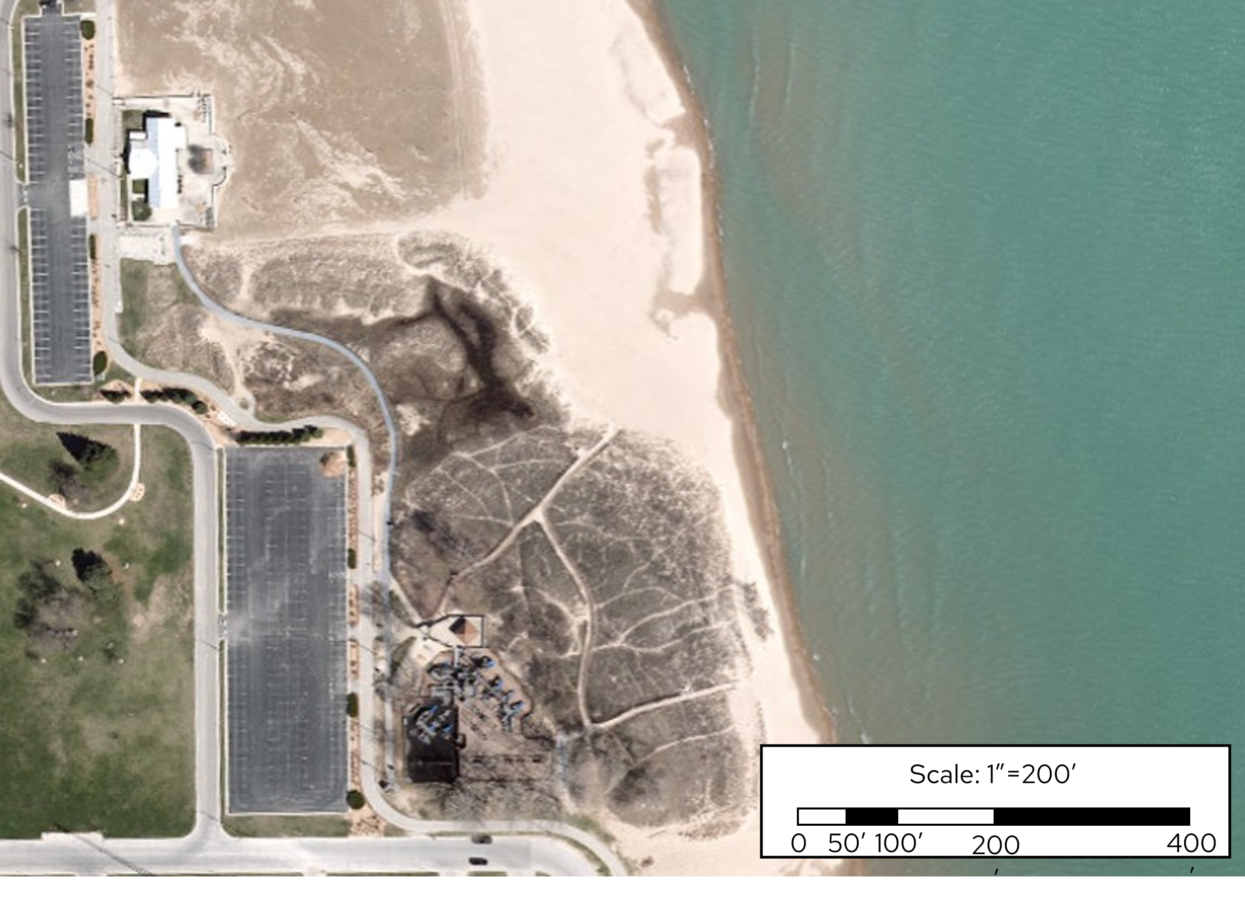
Solution #3
Engineered Dune & Swale
After - 2020
Dune and
Swale Wetland
Sources: Esri, HERE, Garmin, Intermap, increment P Corp., GEBCO, USGS, FAO, NPS, NRCAN, GeoBase, IGN, Kadaster NL, Ordnance Survey, Esri
Notes:
The top corner of the parking lot was chosen as the location to make the dune and swale wetland. This was the only open space near the parking lot. It is downhill of the parking lot so water will drain from the parking lot into the wetland.
Using the map scale, we can see how close our calculated rain garden area is to the actual size of the wetland today.
Image source: Esri, HERE, Garmin, Intermap, increment P Corp., GEBCO, USGS, FAO, NPS, NRCAN, GeoBase, IGN, Kadaster NL, Ordnance Survey, Esri

Slide 8
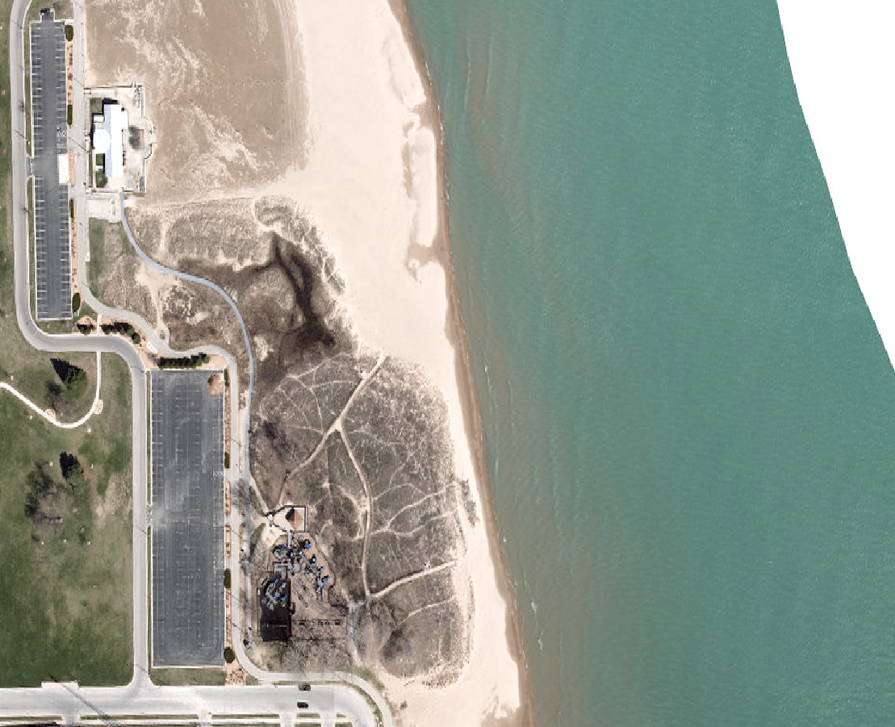
Estimate Area of
Engineered Dune & Swale
After - 2020
60 ft
100 ft
Estimate Area
60 ft x 100 ft = 6,000 ft²
Sources: Esri, HERE, Garmin, Intermap, increment P Corp., GEBCO, USGS, FAO, NPS, NRCAN, GeoBase, IGN, Kadaster NL, Ordnance Survey, Esri
Notes:
The wetland has a complicated shape which is hard to calculate the exact area of. Oftentimes, engineers need to make estimates to get a rough idea of what they are working with rather than spending a lot of time to do complex measurements. We’ll do that here to estimate the area of the wetland.
To estimate the area of the wetland, we’ll simplify it to a rectangle. The wetland is roughly 100 feet by 60 feet. If we multiply the lengths of the sides, we can estimate the area to be about 6,000 square feet.
How close is that to your calculated rain garden sizes? What scaling factor was closer to the actual wetland size?
Image Sources: Esri, HERE, Garmin, Intermap, increment P Corp., GEBCO, USGS, FAO, NPS, NRCAN, GeoBase, IGN, Kadaster NL, Ordnance Survey, Esri

Slide 9
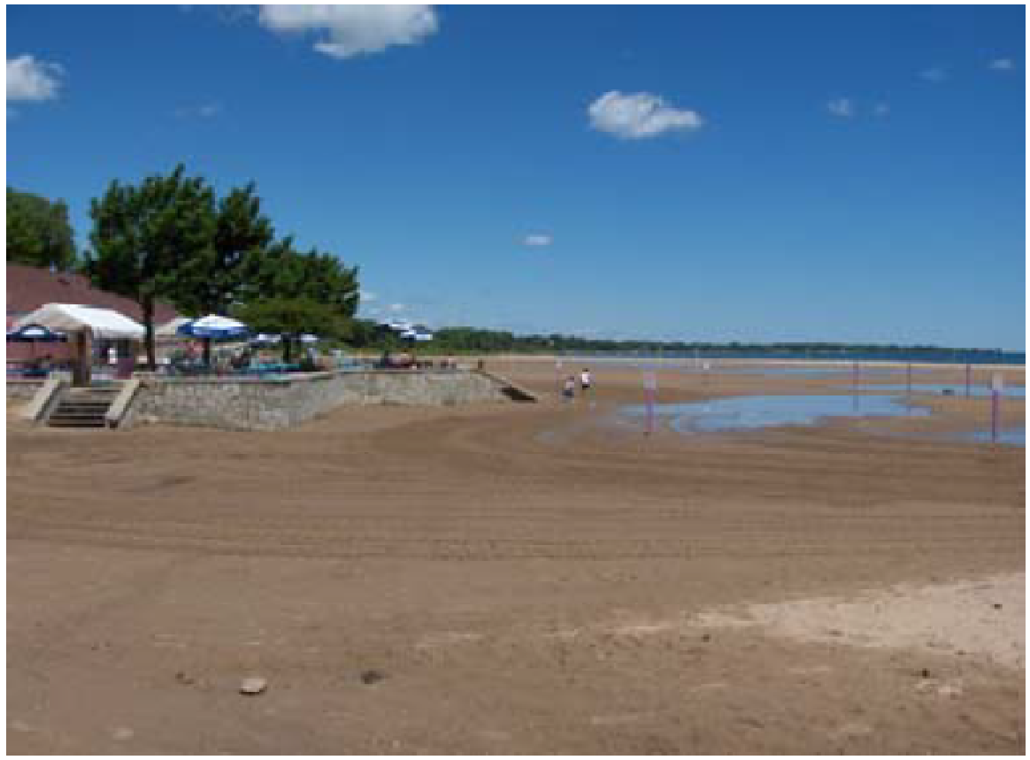
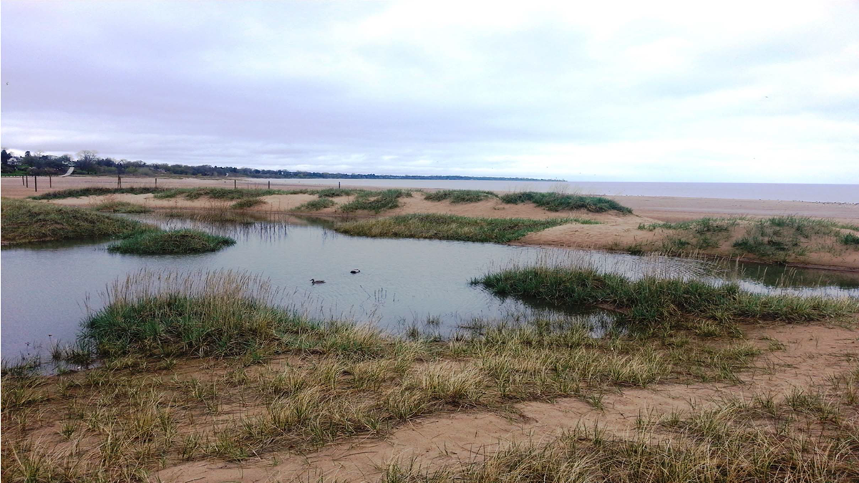
Engineered Dune & Swale Comparison​
Before
Image Source: City of Racine
After
Notes:
BEFORE Large rain events would lead to stormwater runoff flowing over the swimming beach, leaving wet areas and washouts.
AFTER This constructed wetland consists of dunes with swales—where the water collects—between them. Capturing and infiltrating runoff in this wetland reduces the amount of runoff that reaches the beach. The engineered dune and swale wetland system can be seen capturing runoff from the main North Beach parking lot.
Image source: City of Racine

Slide 10
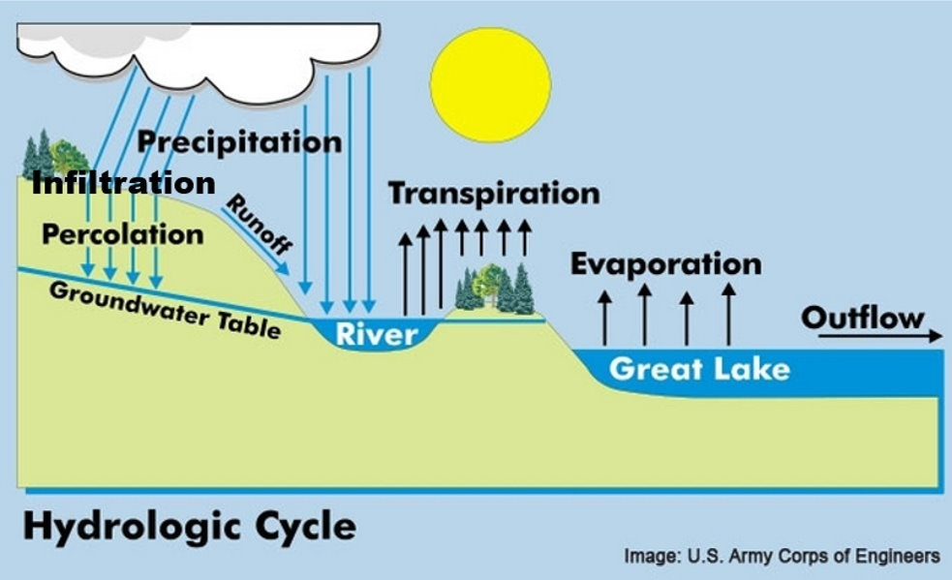
Which type of water movement does the engineered dune and swale try to influence?
Recall the Hydrologic Cycle
Infiltration
Transpiration/Evaporation
Runoff
Waves
Currents or water levels
Hint: for each system, there can be more than one correct answer!
Notes:
Image source: U.S. Army Corps of Engineers

Slide 11
Problem #2 & #4
Beach Closures, Washouts
Solution #4
English Street Infiltration Basin
Notes:
The English Street outfall used to discharge untreated stormwater directly to the beach. This untreated stormwater often was high in harmful bacteria (E. coli) and had a negative impact on water quality at the beach. In 2001, this outfall was reconstructed to remove pollutants from the runoff before it gets to the beach.
In 2001, The English Street Infiltration basin was constructed at the English Street outfall with the goal to remove pollutants from the runoff before it gets to the beach. The English Street Infiltration Basin is a series of constructed wetland cells which slowly pass water through, allowing further particle settling, filtration of the water by the vegetation, and infiltration of water to the groundwater.

Slide 12
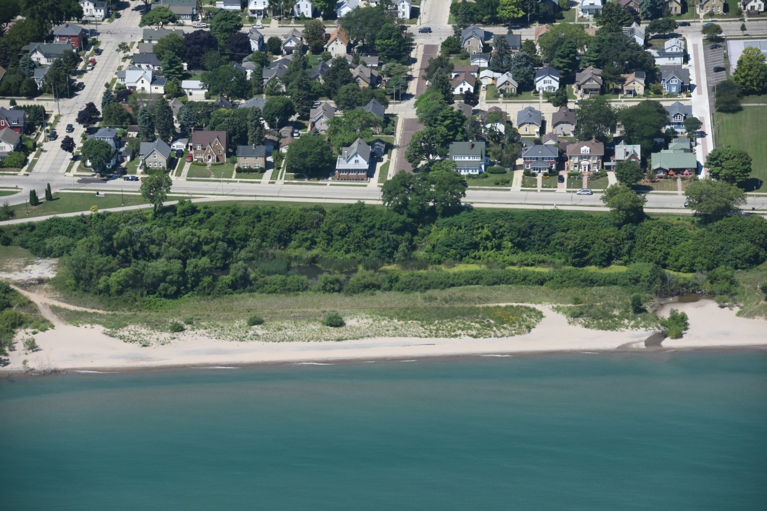
Solution #4
English Street Infiltration Basin
Image Source: Capt. Dennis Carr, Wisconsin Wing, Civil Air Patrol
Notes:
Compared to the North Beach dune and swale wetland, the English Street Infiltration Basin handles a lot more runoff since it drains a much larger area – entire neighborhoods vs. a single parking lot. That means the English Street Infiltration Basin is quite a bit larger and more sophisticated.
The lush vegetation within the constructed wetland slows the movement of water which promotes settling of sediments and other materials that had been carried in the water. Additionally, as we talked about earlier, the plants can transpire water back into the atmosphere.
Image Source: Capt. Dennis Carr, Wisconsin Wing, Civil Air Patrol
(a) it exists (b) it’s bigger than the dune-swale wetland because it treats more water and (c) they will learn more about it in the Healthy Beaches field trip in the spring.

Slide 13
Which type of water movement does the English Street Infiltration Basin try to influence?
Recall the Hydrologic Cycle
Infiltration
Transpiration/Evaporation
Runoff
Waves
Currents or water levels
Hint: for each system, there can be more than one correct answer!
Notes:
This green infrastructure system influences infiltration rates, transpiration rates and runoff.
Image source: U.S. Army Corps of Engineers

Slide 14
Problem #4 Washouts
Solution #5
Plant Native Vegetation on Bluff

Slide 15
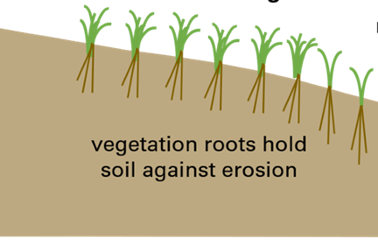
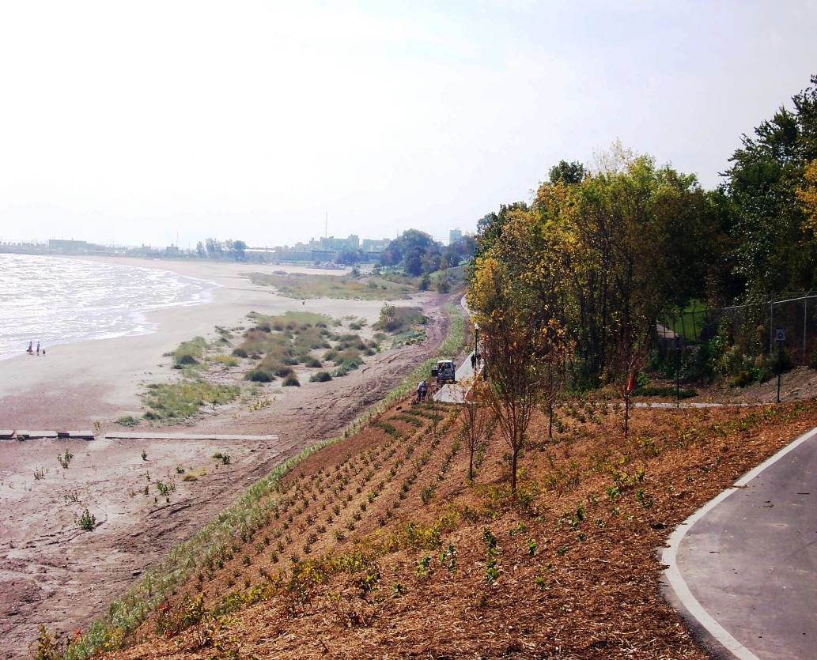
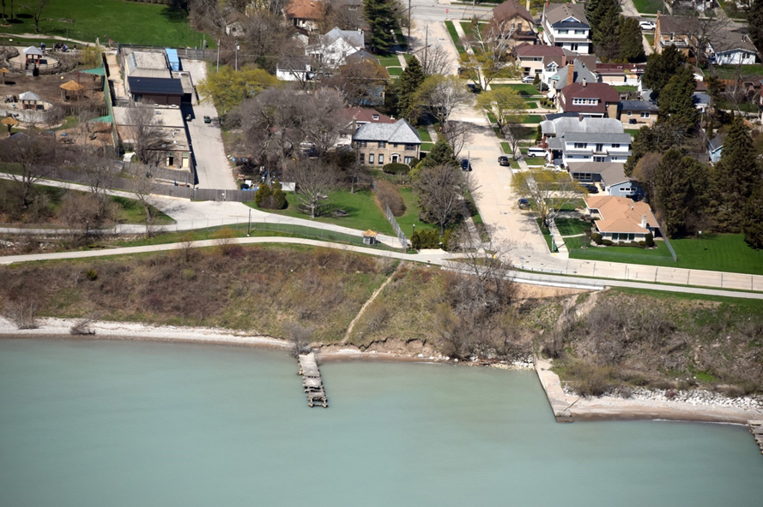
Bank Stabilization
Solution #5
Plant Native Vegetation on Bluff
Image Source: City of Racine
Image Source: Capt. Dennis Carr, Wisconsin Wing, Civil Air Patrol
Notes:
When the Lake Michigan Pathway was constructed in 2006, the bluff was planted with a variety of native vegetation species. The roots of these plants hold the soil on the bluff in place thereby acting against the force of erosion. The plant roots also allow water to infiltrate, which reduces runoff to the beach.
This image on the right shows the bluff vegetation as viewed from an airplane. Even in the fall and winter months when the plants are not actively growing, their roots continue to help hold the bank's soil in place.
Image source: city of Racine
Aerial image source: Image Source: Capt. Dennis Carr, Wisconsin Wing, Civil Air Patrol

Slide 16
Which type of water movement does the native vegetation on the bluff try to influence?
Recall the Hydrologic Cycle
Infiltration
Transpiration/Evaporation
Runoff
Waves
Currents or water levels
Hint: for each system, there can be more than one correct answer!
Notes:
So, which type of water movement does native vegetation planted on a bluff try to influence?
Answer: The native vegetation on the bluff influences infiltration rates, transpiration rates and runoff.
Image source: U.S. Army Corps of Engineers

Slide 17
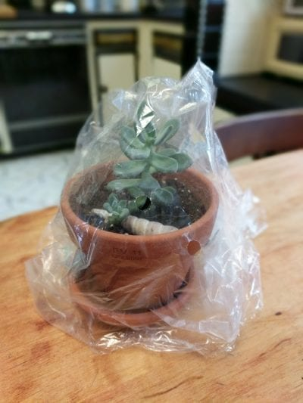
Recall our plant
Image source: Gardening Know How
Notes:
If students didn't include transpiration in their response, a reminder of the transpiration activity of the previous lesson may be used to reinforce the important role plants play in the hydrologic cycle.
If students did include transpiration in their response, you can state that even though plants may transpire less in the winter than in the summer when they are actively growing, water that moves back to the atmosphere through the transpiration process is not going to move across the landscape as runoff.
Image source: Gardening Know How
Image Source: Capt. Dennis Carr, Wisconsin Wing, Civil Air Patrol

Slide 18
Five Engineered Solutions at North Beach
Solution #1 Engineered Gray Structures
Solution #2 Beach Management Practices​
Solution #3 Engineered Dune & Swale​
Solution #4 English Street Infiltration Basin
Solution #5 Plant Native Vegetation on Bluff
Notes:
5 Great solutions!

Slide 19
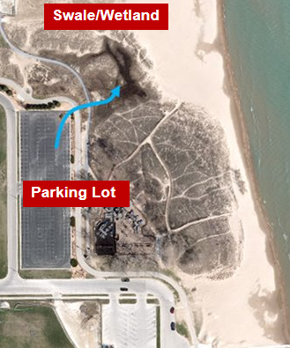
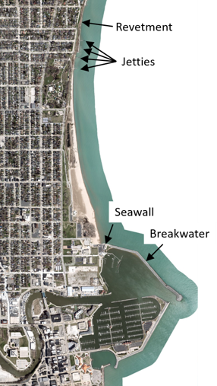
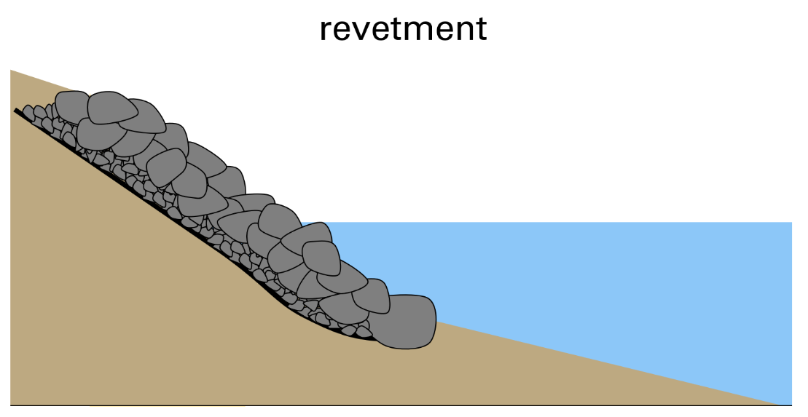
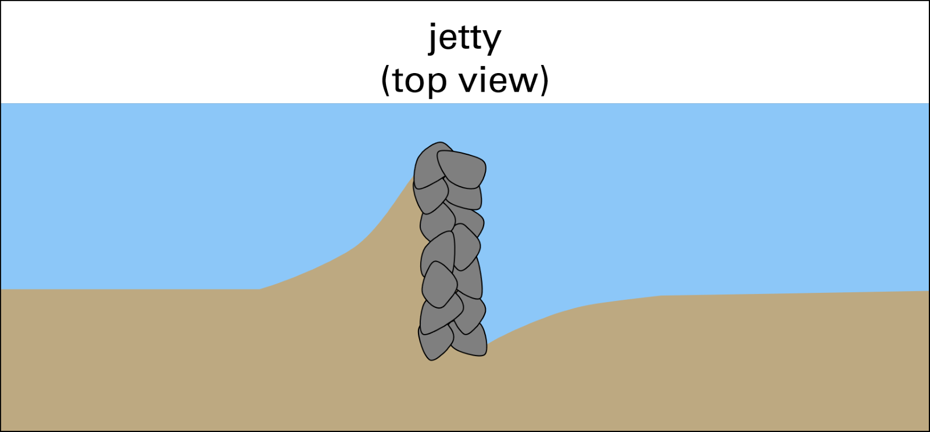
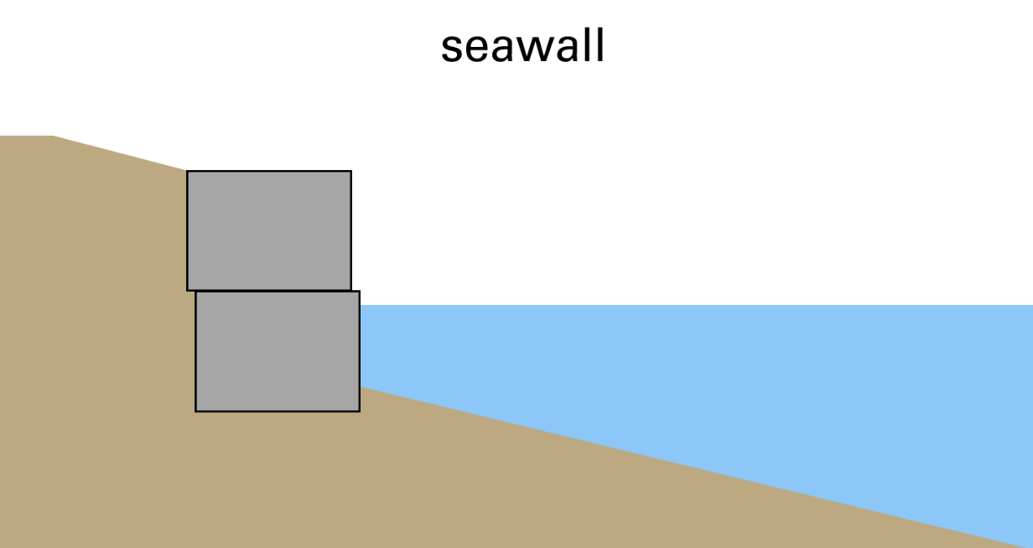

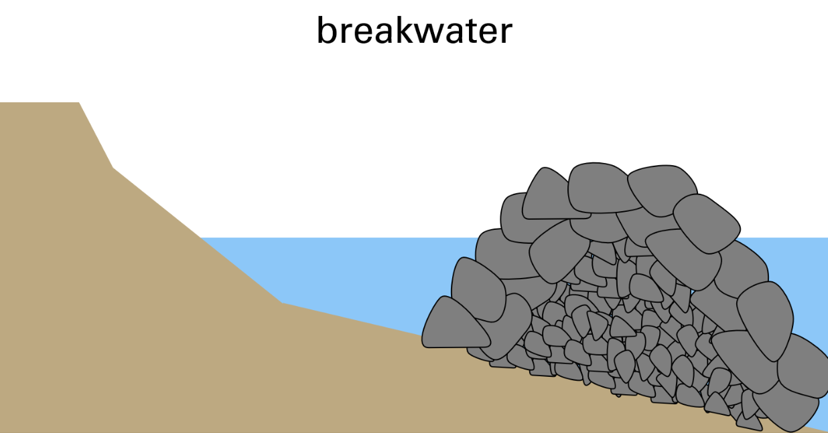
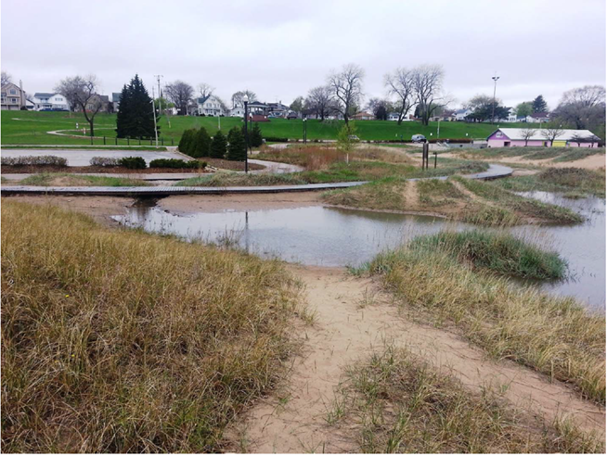
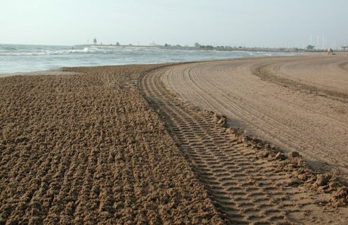
A Collage of Images Representing Engineered Solutions at North Beach
Notes:
Look at that!
Images: see other slides for image sources.

Slide 20
Working With a Lot of the Hydrologic Cycle
Notes:
The hydrologic cycle was key to understanding the causes of many of the problems at North Beach. Precipitation and runoff caused erosion, washouts, and pollution. Engineers used the water cycle to lower the amount of runoff that was causing problems at North Beach. Engineers designed solutions that would increase infiltration, transpiration, and evaporation. These solutions lower the amount of runoff that can reach North Beach and Lake Michigan.
Image source: U.S. Army Corps of Engineers

Slide 21
Green
v
Gray
Infrastructure
Notes:
Remember:
Gray infrastructure refers to structures such as dams, seawalls, roads, pipes or water treatment plants.
Green infrastructure is a set of practices that incorporates natural features to manage stormwater runoff.

Slide 22
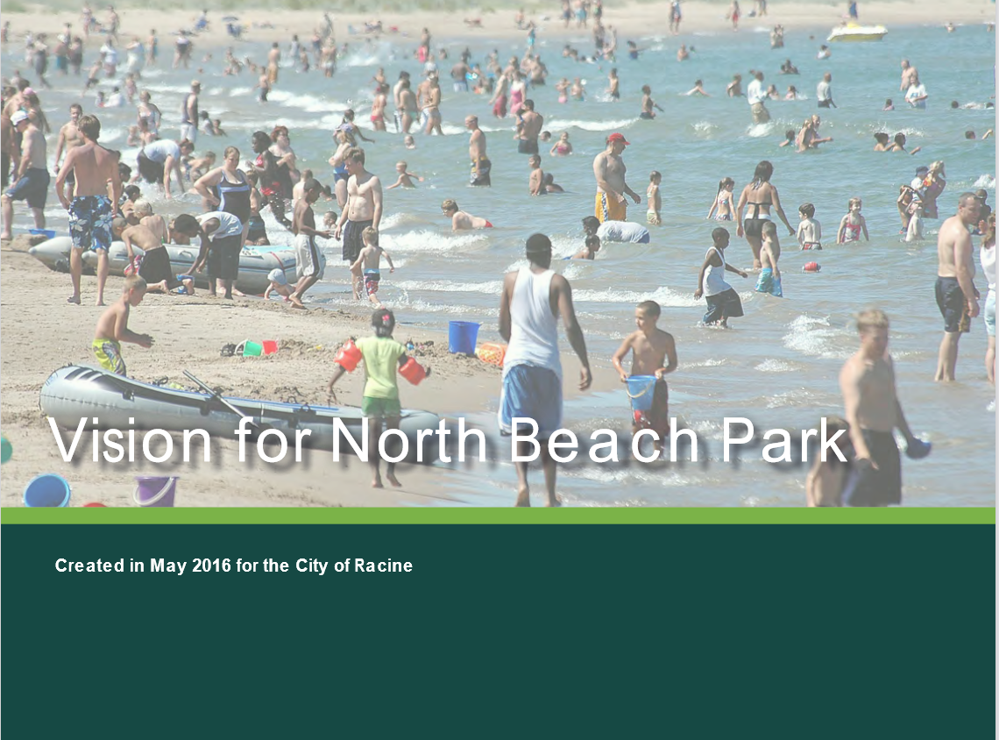
Vision for North Beach Park
Notes:
We do not have time to discuss all the imagined solutions and all the plans that were put forward to solve the problems at North Beach. If you want to learn more you can read the "Vision for North Beach Park" report. When we go on our field trip to North Beach, we will get to observe some of the engineered solutions!
Source: https://cityofracine.org/uploadedFiles/_MainSiteContent/Departments/Health/_Documents/Laboratory/NBReport_FINAL_Rev.10.2016(Reduced).pdf
Image source: city of Racine

