Slide 1
Green Infrastructure –
Nature-Based Shorelines
Lesson 6 Coastal Engineering at North Beach
Wisconsin Sea Grant | October 2025 | Coastal Engineering Education: People, Place and Practice: Lesson 6:Coastal Engineering at North Beach Image used with written permission by JB the Explorer
This curriculum was prepared by Adam Bechle , Ginny Carlton, and Anne Moser under award number NA21NOS4290005 from the Great Lakes Bay Watershed Education and Training (B-WET) program of the National Oceanic and Atmospheric Administration (NOAA), U.S. Department of Commerce. The statements, findings, conclusions and recommendations are those of the author(s) and do not necessarily reflect the views of NOAA or the U.S. Department of Commerce.
Notes:
Image Source: https://www.flickr.com/photos/producerjb/43643260870 Racine Breakwater Lighthouse
JB the Explorer took this photo of the Racine Breakwater Lighthouse in July of 2017 while at the Racine Harbor.
This lighthouse was first lit in November of 1901.
In the distance, you can see the Wind Point Lighthouse.
Image used with written permission by JB the Explorer as provided via JB's Native Garden@PlantNativeWI
Previously on Twitter and now on X @ExplorerJB

Slide 2
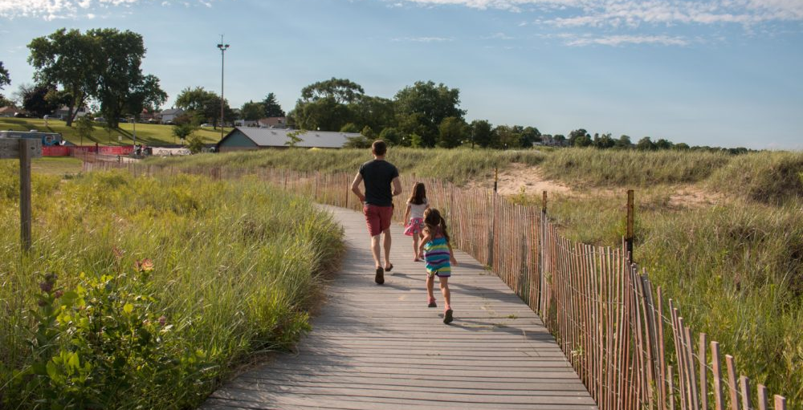
What infrastructure do you see?
Image Source: Go Valley Kids Website
Notes:
When looking at this image, what infrastructure do you see that can help prevent erosion? Did you answer the boardwalk and the snow fencing?
The boardwalk and snow fencing are examples of gray infrastructure, man-made objects placed on the landscape to address a particular concern. In a previous slide show, we saw other examples of gray infrastructure including revetments, jetties, sea walls, and breakwaters.
The boardwalk prevents erosion by encouraging people to walk (or skip) along a designated path. The snow fencing helps to keep sand from blowing onto the boardwalk.
Another bit of infrastructure, which you may not have mentioned, is the plant material. Plants that are grown to address a particular issue can be part of a green infrastructure strategy. In this case the plants also help prevent sand from blowing.
Image Source: Go Valley Kids! website: Beach Day Road Trip: North Beach
https://govalleykids.com/beach-day-road-trip-north-beach/

Slide 3
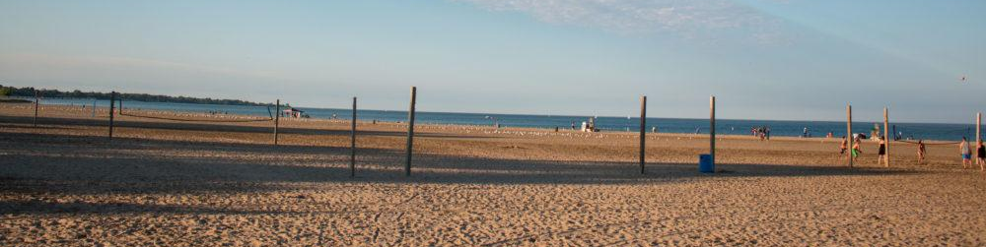
North Beach
A mix of natural and man-made features that make this place a great place to be!
It’s also a place of constant change!
Image Source: Go Valley Kids Website
Notes:
Recall the last time we talked about North Beach being a place of constant change. Some of these changes are natural, some are man-made.
Image Source: Go Valley Kids! website: Beach Day Road Trip: North Beach
https://govalleykids.com/beach-day-road-trip-north-beach/

Slide 4
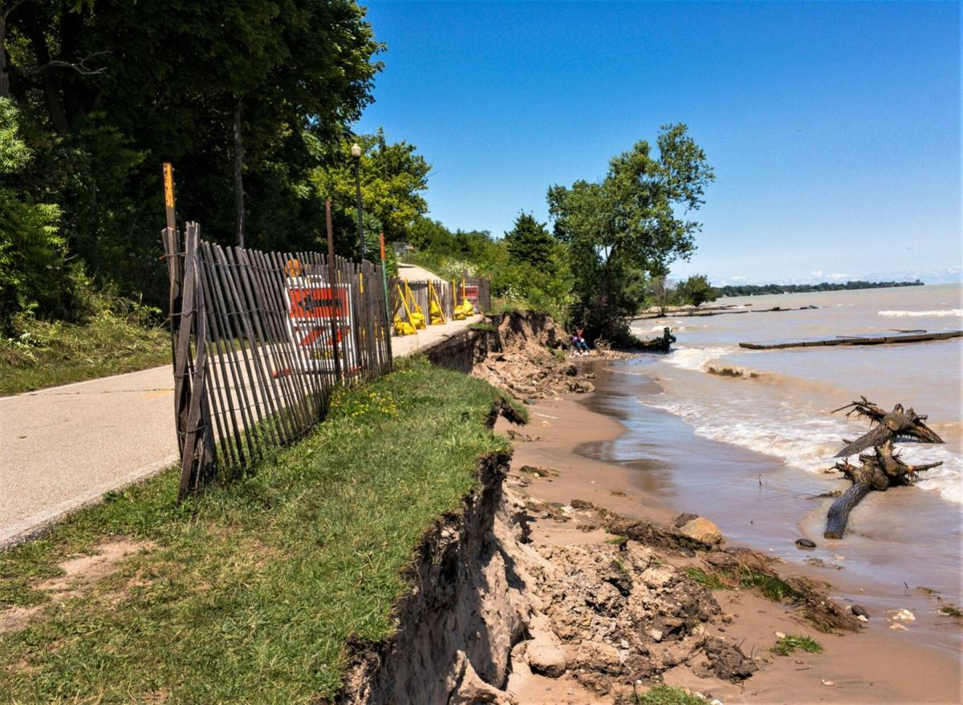
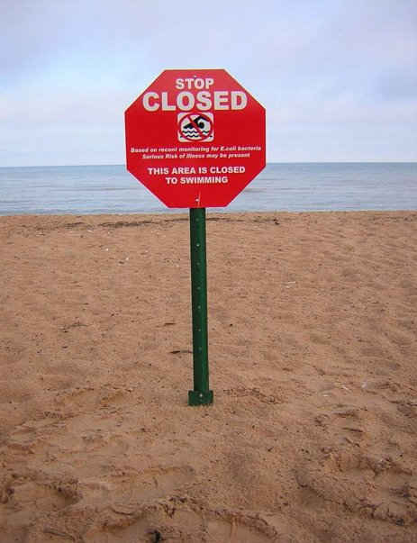
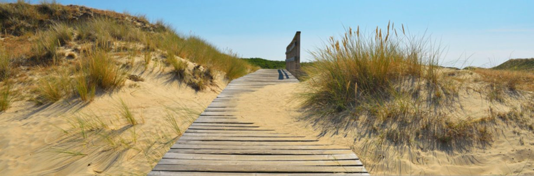
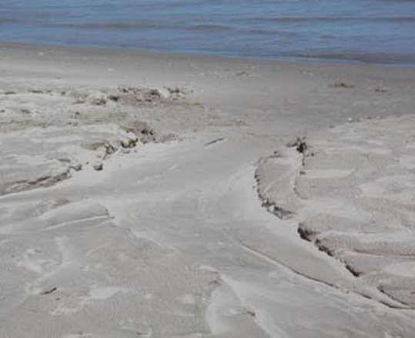

Ask About and Research the Problem
Problem #1 Beach Erosion
Problem #2 Beach Closures
Problem #3 Sand Burying Boardwalks
Problem #4 Washouts
Image Source: Christina Lieffring, Racine Journal Times
Notes:
We introduced four problems, beach erosion, beach closures, sand burying boardwalks and washouts.
Note to educator: Some slides within this presentation contain the Engineering Design Process graphic. The graphic is refined by incorporating red circles around one, or more, of the seven steps within the engineering design process. The circled steps are meant to correlate with that step in the engineering design process that the particular slide is addressing/reinforcing. Additionally, slides titled with red font are also designed to reinforce the engineering design process.
Image sources: Zoo beach trail severely eroding; City and FEMA working on restoration details
Christina Lieffring
Aug 5, 2020
https://journaltimes.com/news/local/zoo-beach-trail-severely-eroding-city-and-fema-working-on-restoration-details/article_1347c921-848e-50a9-9f97-5ca7eef49abf.html

Slide 5
Installed Engineered Gray Structures
EDP Solution Type 1
Notes:
We discussed one solution type—installed engineered gray structures.

Slide 6
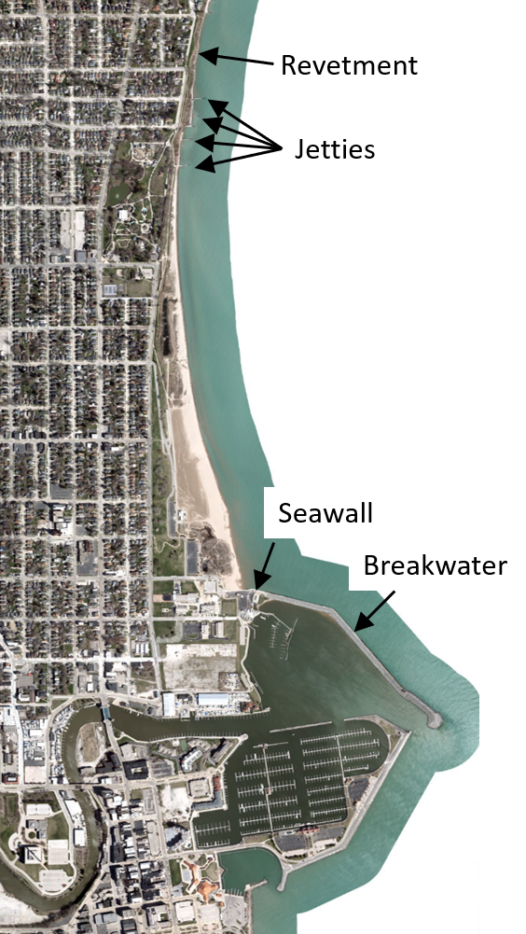
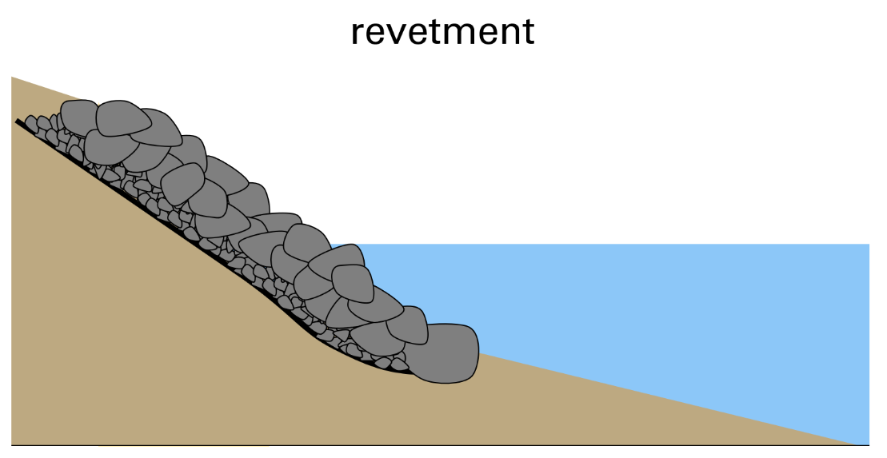
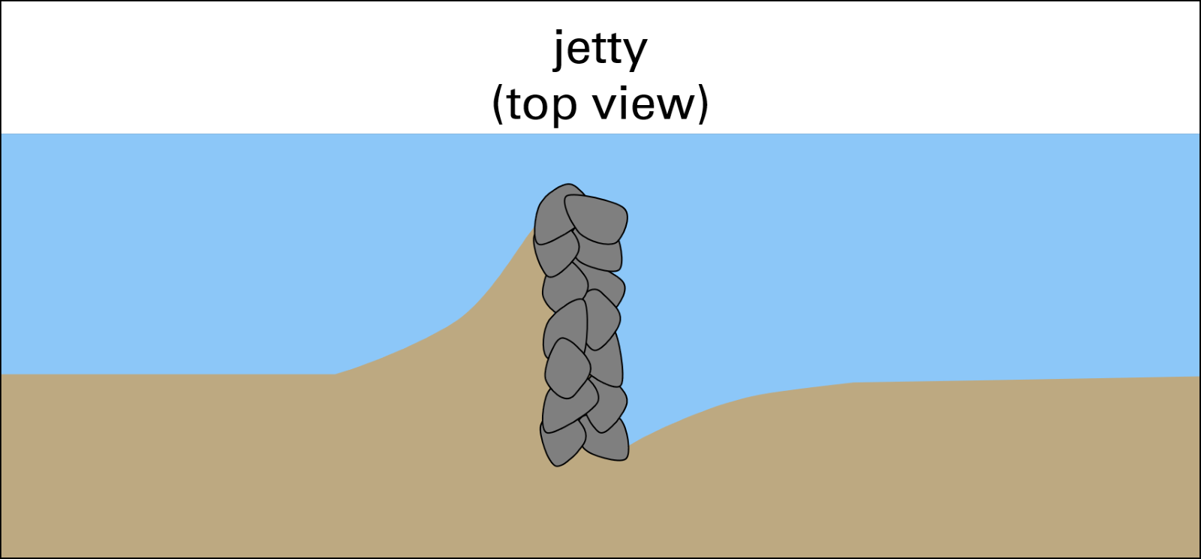
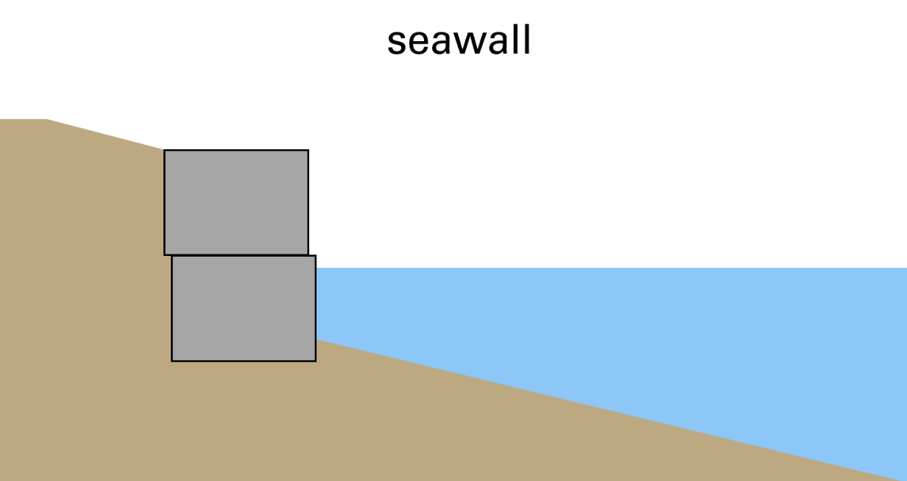
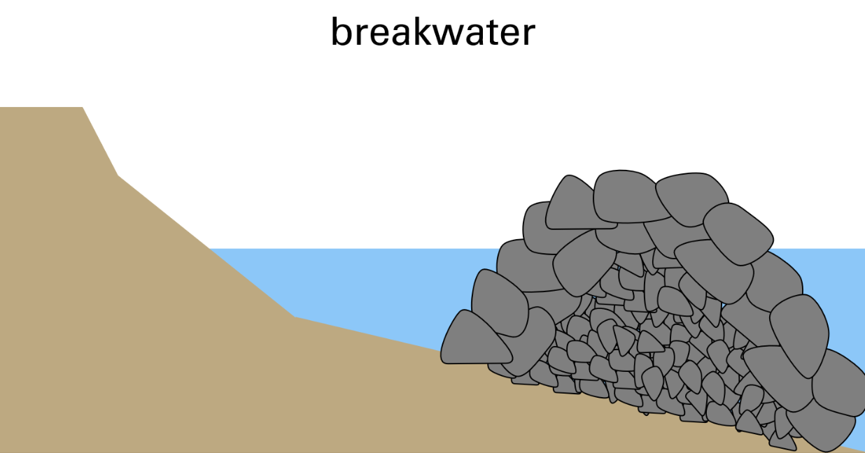
Examples of Gray Infrastructure
Notes:
We saw how gray infrastrucutre projects such as revetments, jetties, seawalls and breakwaters can assist with the problem of beach erosion.
Image source:Map Data: Esri, HERE, Garmin, Intermap, increment P Corp., GEBCO, USGS, FAO, NPS, NRCAN, GeoBase, IGN, Kadaster NL, Ordnance Survey, Esri Japan, METI, Esri China (Hong Kong), (c) OpenStreetMap contributors, and the GIS User Community
Graphic source Adam Bechle, coastal engineer, Wisconsin Sea Grant

Slide 7
EDP Solution Type 2: Beach Management Practices
EDP Solution Type 2
Beach Management Practices
Notes:
During the last lesson, we also looked at a second solution type---beach management practices.

Slide 8
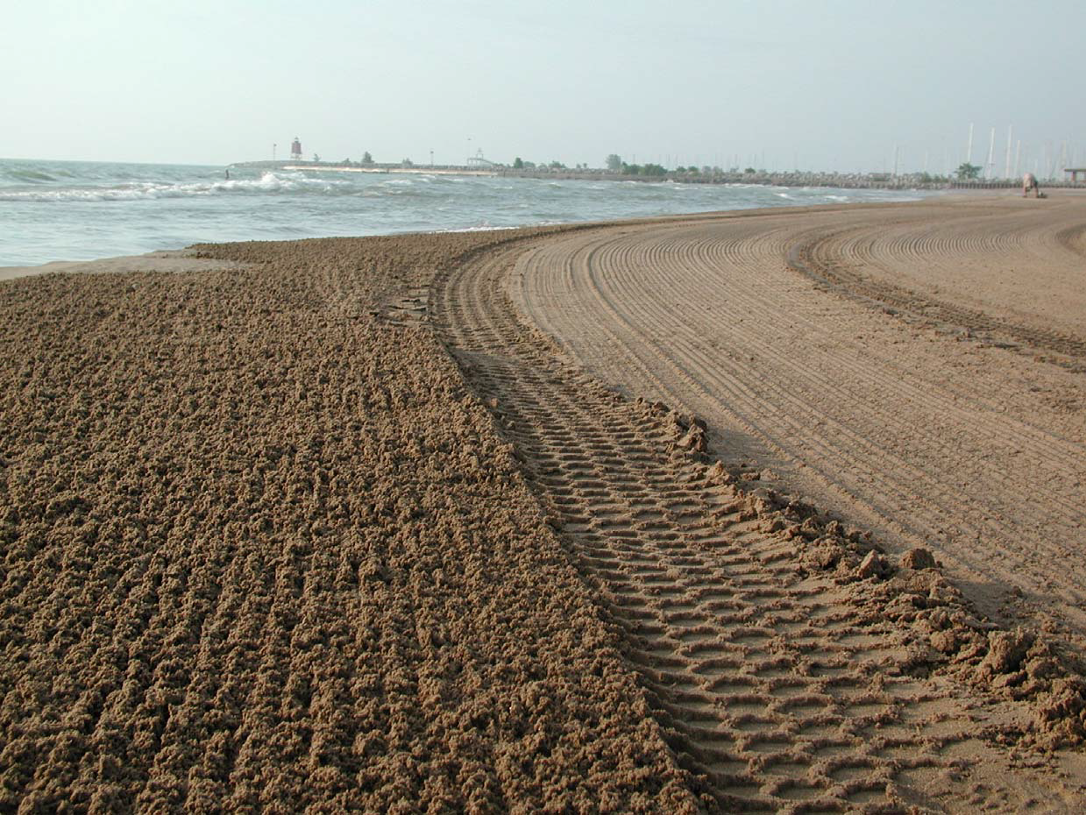
Altered Beach Grooming Strategies-2000, 2001
Old
New
Image Source: Julie Kinzelman, City of Racine Health Department
Notes:
Specifically, we saw how beach grooming strategies help to resolve problem #2—closed beaches
Image Source: Julie Kinzelman, City of Racine Health Department

Slide 9
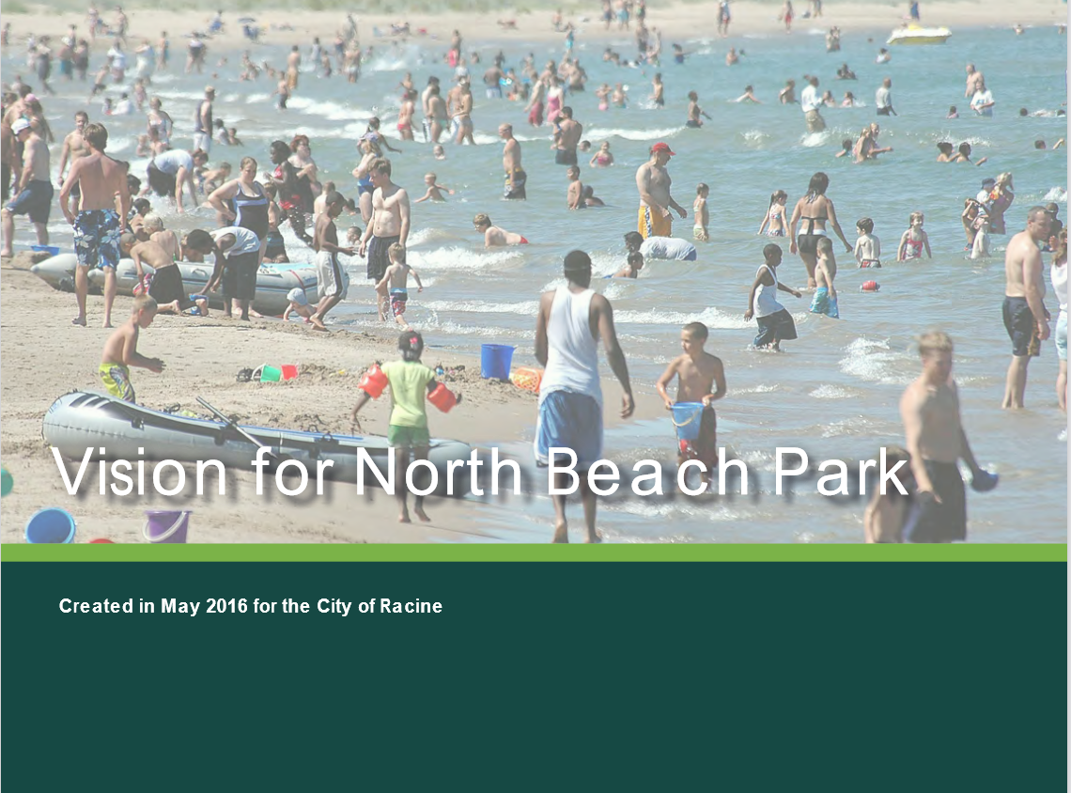
Visions for North Beach Park
Notes:
We did not, and still do not, have time to discuss all the solutions and plans that were put forward to solve the problems at North Beach. If you want to learn more, you can read the Vision for North Beach Park report.
Image source: City of Racine
Source: https://cityofracine.org/uploadedFiles/_MainSiteContent/Departments/Health/_Documents/Laboratory/NBReport_FINAL_Rev.10.2016(Reduced).pdf

Slide 10
EDP Solution Type 3: Installed Engineered Green Infrastructure Projects
EDP Solution Type 3
Installed Engineered
Green Infrastructure Projects
Notes:
However, today we're going to look at a third solution type—installed green infrastrucutre projects. These green infrastructure approaches strive to handle stormwater at its sources, in other words, where the rain falls, and where it would naturally move to, if there were no human influences. Besides using sand and stone to alter erosion and sediment transport patterns, green infrastructure projects often use plants in the process.

Slide 11
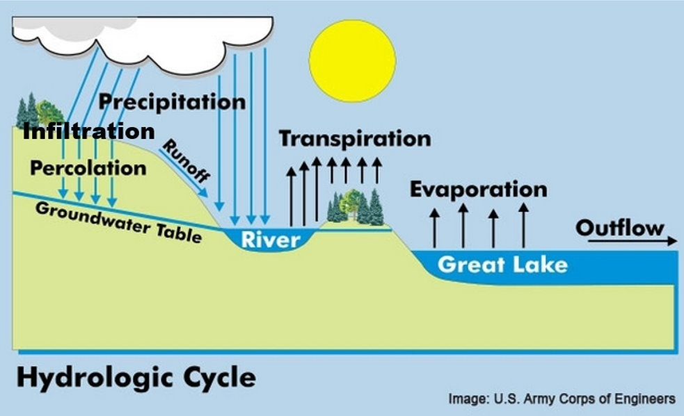
What Type of Water Movement Does Green Infrastructure Influence?
Which type of water movement does each green infrastructure try to influence?
(For each system, there can be more than one correct answer.)
Infiltration
Transpiration/Evaporation
Runoff
Notes:
Just like in the last lesson, as I talk about each of the engineered systems, I would like you to think about which type of water movement each green infrastructure system illustrated in the next few slides attempts to influence?
Graphic Source: U.S. Army Corps of Engineers

Slide 12
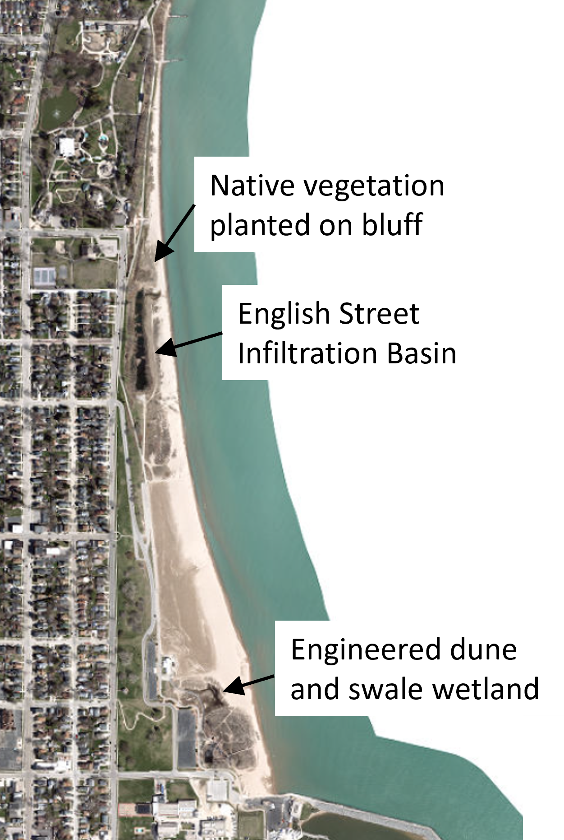
Three Green Infrastructure Projects at North Beach
Notes:
There are three green infrastructure projects at North Beach. The first involves native vegetation planted on the bluff. The second is called the English Street Infiltration Basin. And the last is an engineered dune and swale wetland.
Image source:Map Data: Esri, HERE, Garmin, Intermap, increment P Corp., GEBCO, USGS, FAO, NPS, NRCAN, GeoBase, IGN, Kadaster NL, Ordnance Survey, Esri Japan, METI, Esri China (Hong Kong), (c) OpenStreetMap contributors, and the GIS User Community

Slide 13
Imagine and Plan a Solution a. Plant Native Vegetation on Bluff
Notes:
The first green infrastrucuture project at North Beach involved planting native vegetation on a bluff.

Slide 14
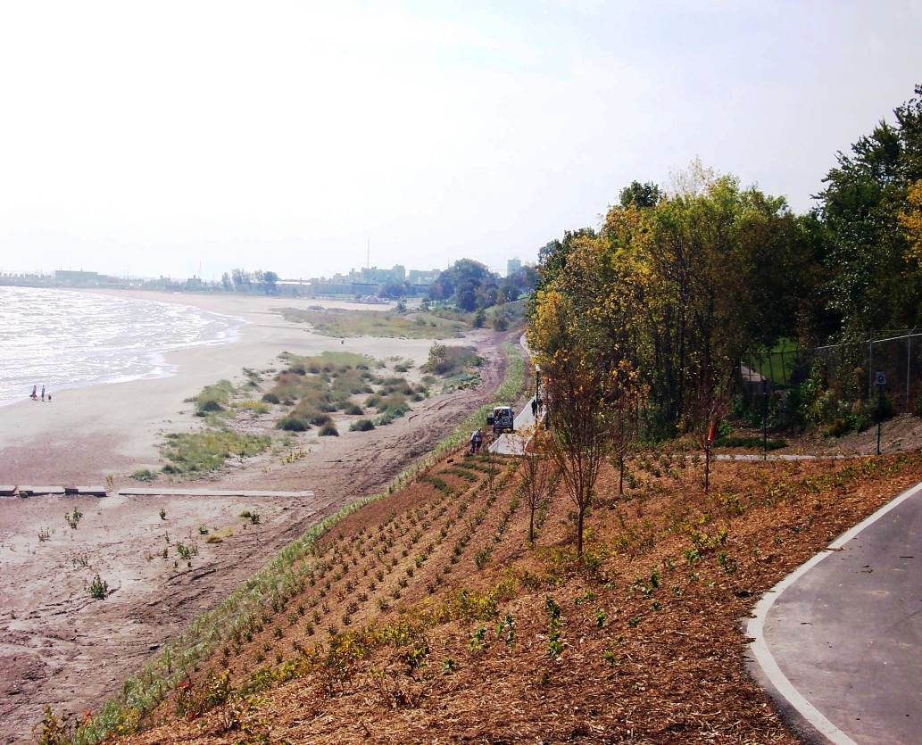
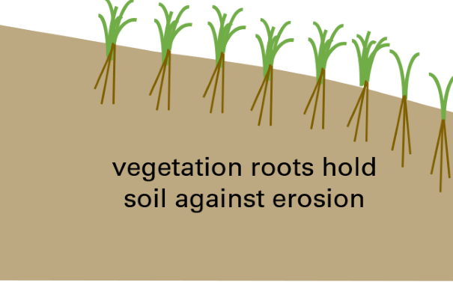
Bank Stabilization with Native Plants at Zoo Beach
(Racine, WI)
Image Source: Julie Kinzelman, City of Racine Health Department
Notes:
When the Lake Michigan Pathway was constructed in 2006, the bluff was planted with a variety of native vegetation species. The roots of these plants hold the soil on the bluff in place, thereby acting against the force of erosion. The plant roots also allow water to infiltrate which reduces runoff to the beach.
This solution of planting native vegetation on the bluff helps to solve problem #4-washouts.
Image Source: Julie Kinzelman, city of Racine Health Department

Slide 15
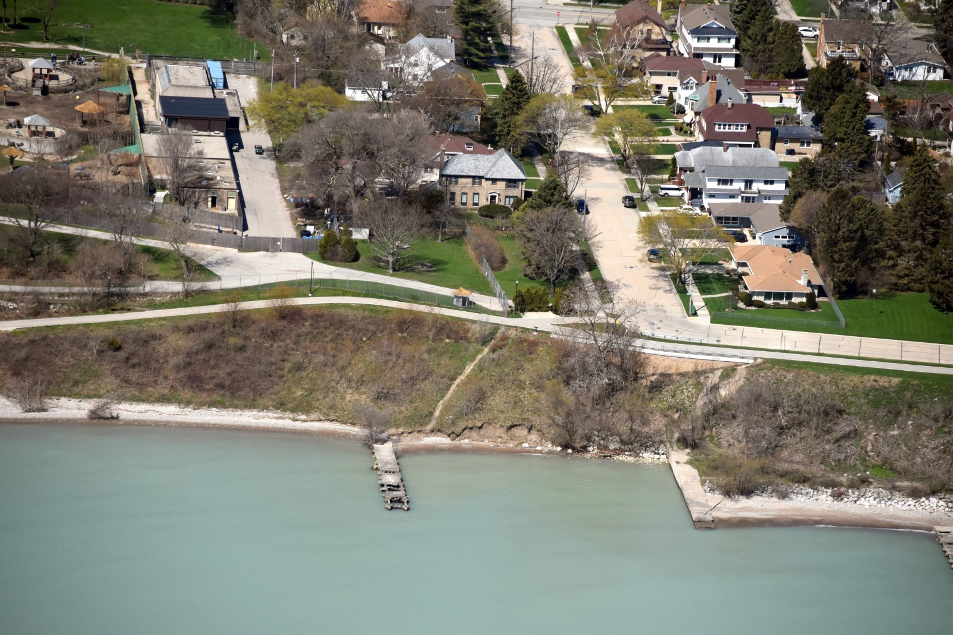
a. Improve Native Vegetation on Bluff
Image Source: Capt. Dennis Carr, Wisconsin Wing, Civil Air Patrol
Notes:
This image shows the bluff vegetation as viewed from an airplane. Even in the fall and winter months when the plants are not actively growing, their roots continue to help hold the bank's soil in place.
Image Source: Capt. Dennis Carr, Wisconsin Wing, Civil Air Patrol

Slide 16
Which type of Water Movement Does Native Vegetation Planted on a Bluff Influence?
Which type of water movement does native vegetation planted on bluff try to influence?
(For each system, can be more than one.)
Infiltration
Transpiration/Evaporation
Runoff
Image Source: Julie Kinzelman, City of Racine Health Department
Notes:
So, which type of water movement does native vegetation planted on a bluff try to influence?
Answer: The native vegetation on the bluff influences infiltration rates, transpiration rates, and runoff.
Image Source: Julie Kinzelman, City of Racine Health Department
Graphic Source: U.S. Army Corps of Engineers

Slide 17
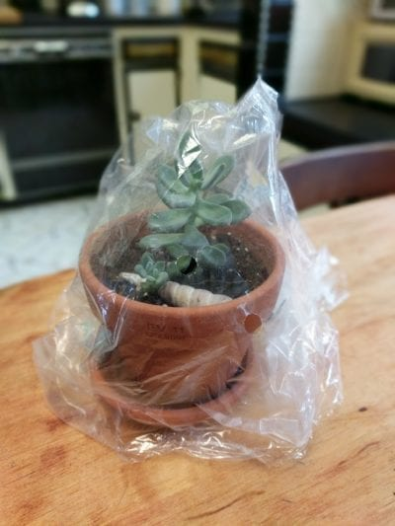
Check in – remember our plant?
Image source: Gardening Know How
Notes:
Note:
If students didn't include transpiration in their response, a reminder of the transpiration activity of the previous lesson may be used to reinforce this important role plants play in the hydrologic cycle.
If students did include transpiration in their response, you can state that even though plants may transpire less in the winter than in the summer when they are actively growing, water that moves back to the atmosphere through the transpiration process is not going to move across the landscape as runoff.
Image source: Gardening Know How
https://www.gardeningknowhow.com/special/greenhouses/plastic-bag-greenhouse-tips.htm

Slide 18
Imagine and Plan a Solution b. Engineered Dune & Swale Wetland
Notes:
The second green infrastructure project at North Beach we will discuss is engineered dunes and swale wetland.

Slide 19
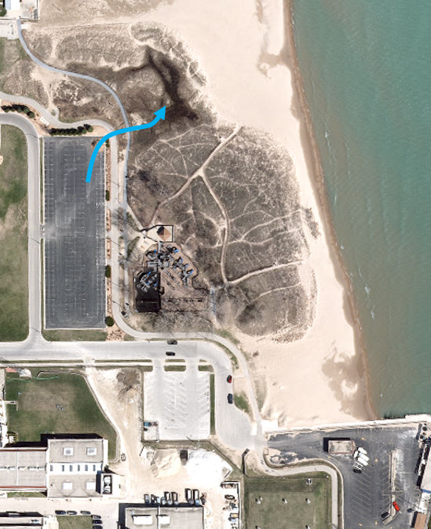
Control flow of water from parking lot
Swale wetland
Parking lot
Image Source: Map Data: Sources: Esri, HERE, Garmin, Intermap, increment P Corp., GEBCO, USGS, FAO, NPS, NRCAN, GeoBase, IGN, Kadaster NL, Ordnance Survey, Esri Japan, METI, Esri China (Hong Kong), (c) OpenStreetMap contributors, and the GIS User Community
Notes:
Let's take a closer look at the problem this infrastructure was trying to solve. The goal was to control the flow of water from the parking lot by creating a flow pathway from the main North Beach parking lot to engineered dune and swale wetland.
Image source Map Data: Sources: Esri, HERE, Garmin, Intermap, increment P Corp., GEBCO, USGS, FAO, NPS, NRCAN, GeoBase, IGN, Kadaster NL, Ordnance Survey, Esri Japan, METI, Esri China (Hong Kong), (c) OpenStreetMap contributors, and the GIS User Community

Slide 20
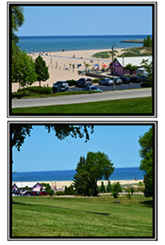
BREAK to CALCULATE PARKING LOT RUNOFF
Image Source: City of Racine
Notes:
In order to get an idea of the scope of the problem, let's take a break from the PowerPoint to calculate the amount of water that can run off a parking lot.
Image Source: City of Racine

Slide 21
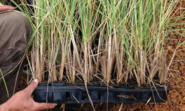
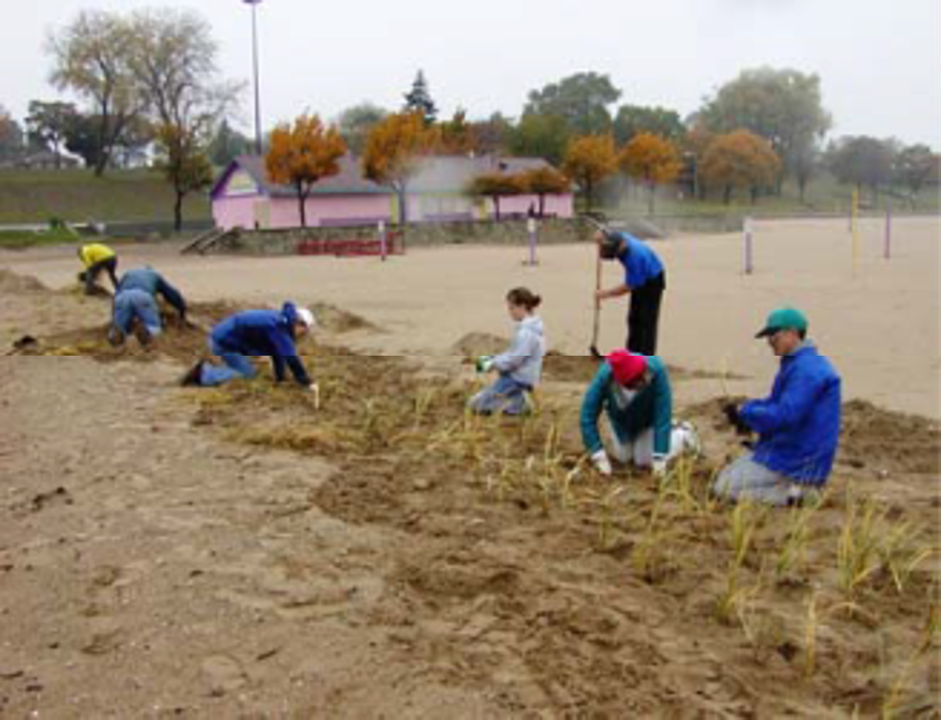
Create and Test a Prototype
2004 Make a Difference Day
Image Source: Julie Kinzelman, City of Racine
Notes:
Now that we have a clearer idea of the amount of parking lot runoff water that needed to be dealt with, let's take a closer look at what engineering a dune and swale wetland entailed. After shaping the beach into long narrow berm, beach grass was planted. This was done as part of the 2004 Make a Difference Day celebration.
This is where you come in...
Beach grass image source: https://www.cicconifarms.com/Beach_Grass.html
Source: Best Practice-Racine-DuneSwales.pdf
Over time 2004 – 2008
Planting Images Source: Julie Kinzelman, City of Racine Health Department

Slide 22
Improve
2008 Make a Difference Day
Image Source: Julie Kinzelman, City of Racine Health Department
Notes:
The city of Racine Departments of Health and Parks, Recreation, and Cultural Services sought $1500 in funds from the Racine Community Foundation, Sustainable Racine Fund, to purchase plant plugs for the purpose of increasing the vegetation between the Kids Cove Playground and North Beach Oasis, two popular attractions at North Beach. The purchased plant plugs were used to augment existing vegetation and to vegetate newly created encouraged dunes as one of several citywide Make a Difference Day projects in October of 2008 and Earth Day 2009.
City of Racine Parks and Health Department employees work closely with Mr. Robert Oertel, Keep Our Beaches Open, and citizen volunteers.
Source: Best Practice-Racine-DuneSwales.pdf
Images Source: Julie Kinzelman, City of Racine Health Department

Slide 23
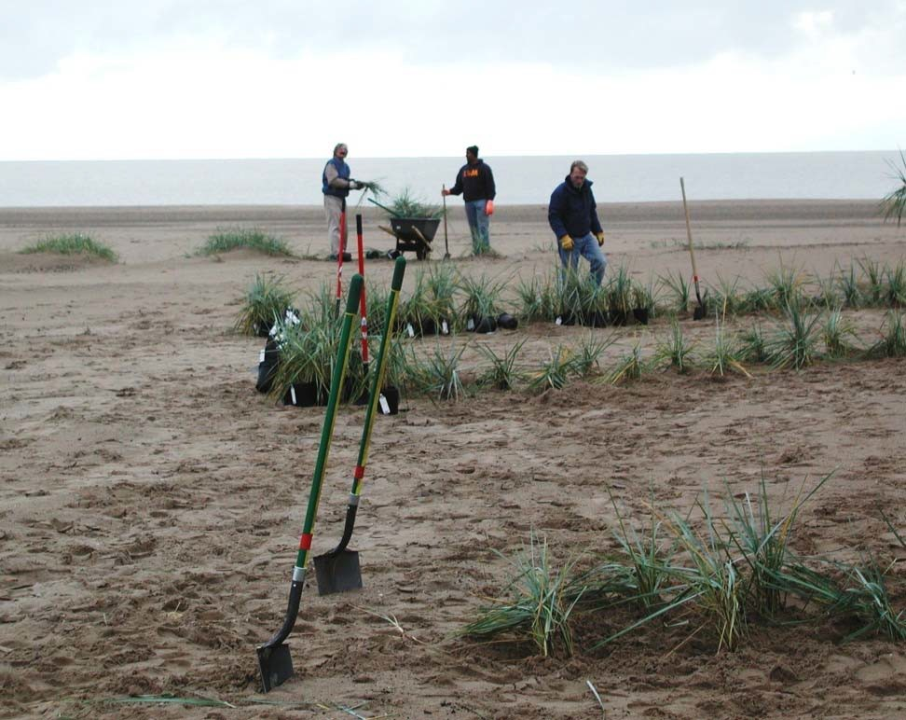
Volunteers Plant Beach Grass at North Beach
Capture runoff from large parking area
Constructed by municipal staff and volunteers
“Observational” engineering
Naturalized
Low cost ($1500)
Image Source: Julie Kinzelman, City of Racine Health Department
Notes:
This green infrastructure engineerered dune and swale wetland solution relied on volunteers who planted $1500 worth of plants, which eventually became "naturalized"--which means they reproduce and spread on their own.
"Observational" engineering allows the design to be changed as a result of conditions that are observed on site or about how the materials are behaving. This is often used in engineering projects involving soils because there is a lot of uncertainty about the actual soil conditions. See the Institute for Civil Engineering for more information - https://knowledgehub.ice.org.uk/cpd/delivery-exc/observational-method/
Image Source: Julie Kinzelman, City of Racine Health Department

Slide 24
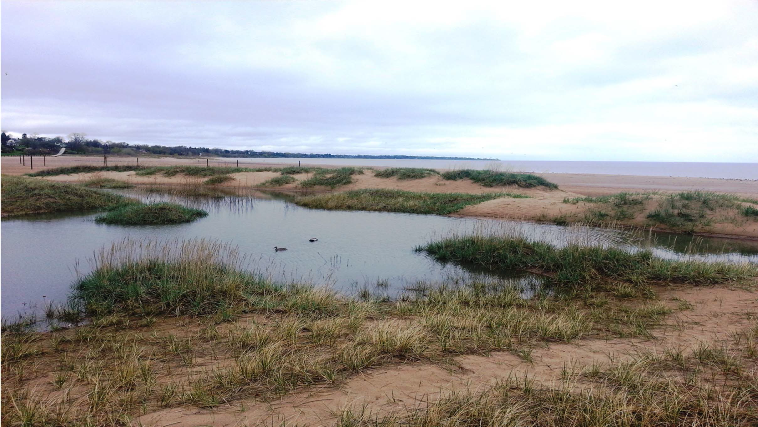
Improve 2014 Dunes in Action
Image Source: Julie Kinzelman, City of Racine Health Department
Notes:
By 2014 this was the result. This constructed wetland consists of dunes with swales—where the water collects—between the dunes. Capturing and infiltrating runoff in this wetland reduces the amount of runoff that reaches the beach.
Image Source: Julie Kinzelman, City of Racine Health Department

Slide 25
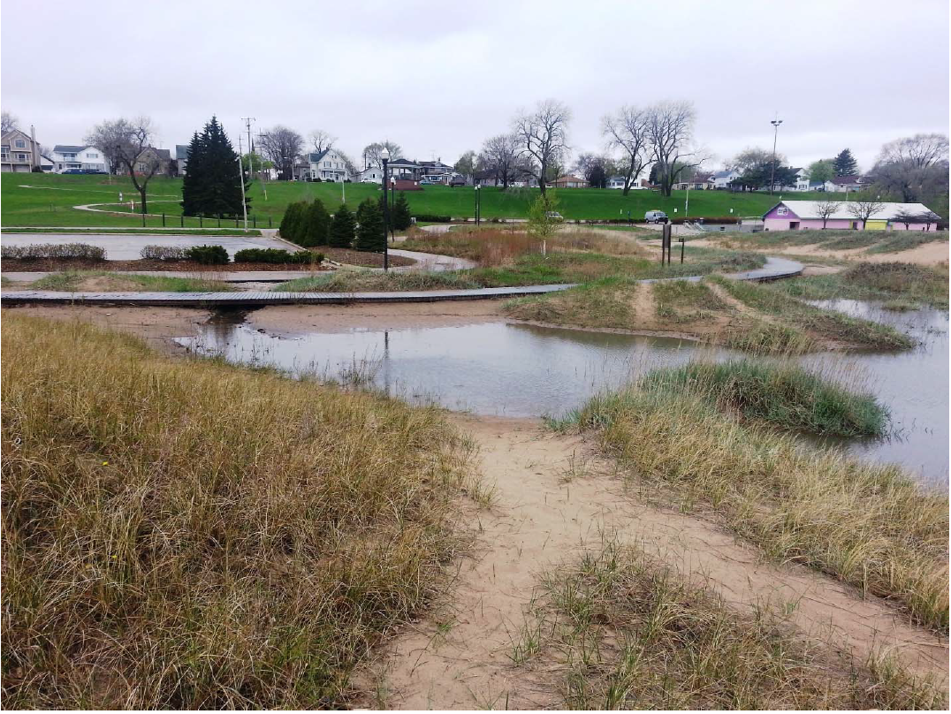
Dune and Swale Wetlands Capture Water
Image Source: City of Racine
Notes:
Credit: City of Racine
The engineered dune and swale wetland system can be seen capturing runoff from the main North Beach parking lot.
This green infrastructure system has helped solve problem #2-sand on boardwalks and problem #4 washouts.
Image source: City of Racine

Slide 26
Which type of Water Movement Does an Engineered Dune and Swale System Influence?
Which type of water movement does the engineered dune and swale wetland try to influence?
(For each system, can be more than one correct answer.)
Infiltration
Transpiration/Evaporation
Runoff
Image Source: City of Racine
Notes:
Which type of water movement does the engineered dune and swale wetland try to influence?
Answer: The native vegetation in the dune and swale influences infiltration rates, transpiration rates and runoff.
Image source: City of Racine
Graphic Source: U.S. Army Corps of Engineers

Slide 27
Imagine and Plan a Solution c. English Street Infiltration Basin
Notes:
The third, and final, green infrastructure project at North Beach we will discuss is the English Street Infiltration Basin.
Image source: https://www.cicconifarms.com/Beach_Grass.html

Slide 28
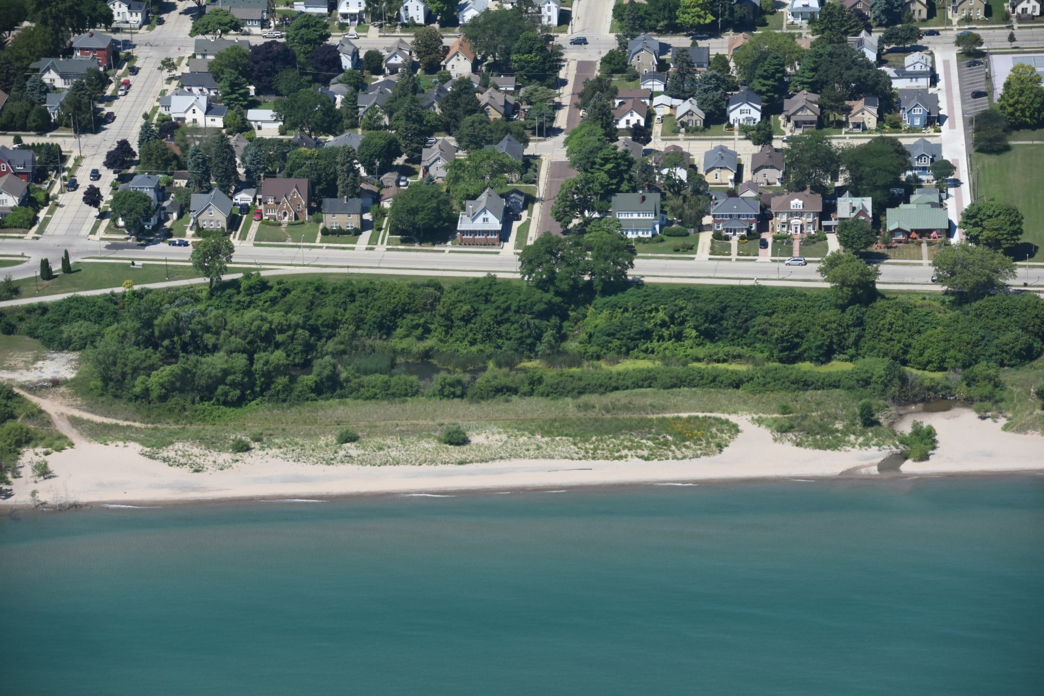
c. English Street Infiltration Basin
Image Source: Capt. Dennis Carr, Wisconsin Wing, Civil Air Patrol
Notes:
English Street Infiltration Basin/constructed wetland
The English Street outfall used to discharge untreated stormwater directly to the beach. This untreated stormwater was often high in harmful bacteria (E. coli) and had a negative impact on water quality at the beach. In 2001, this outfall was reconstructed to remove pollutants from the runoff before it gets to the beach.
In 2001, The English Street Infiltration Basin was constructed at the English Street outfall with the goal to remove pollutants from the runoff before it gets to the beach. The English Street Infiltration Basin is a series of constructed wetland cells which slowly pass water through, allowing further particle settling, filtration of the water by the vegetation, and infiltration of water to the groundwater.
Image Source: Capt. Dennis Carr, Wisconsin Wing, Civil Air Patrol

Slide 29
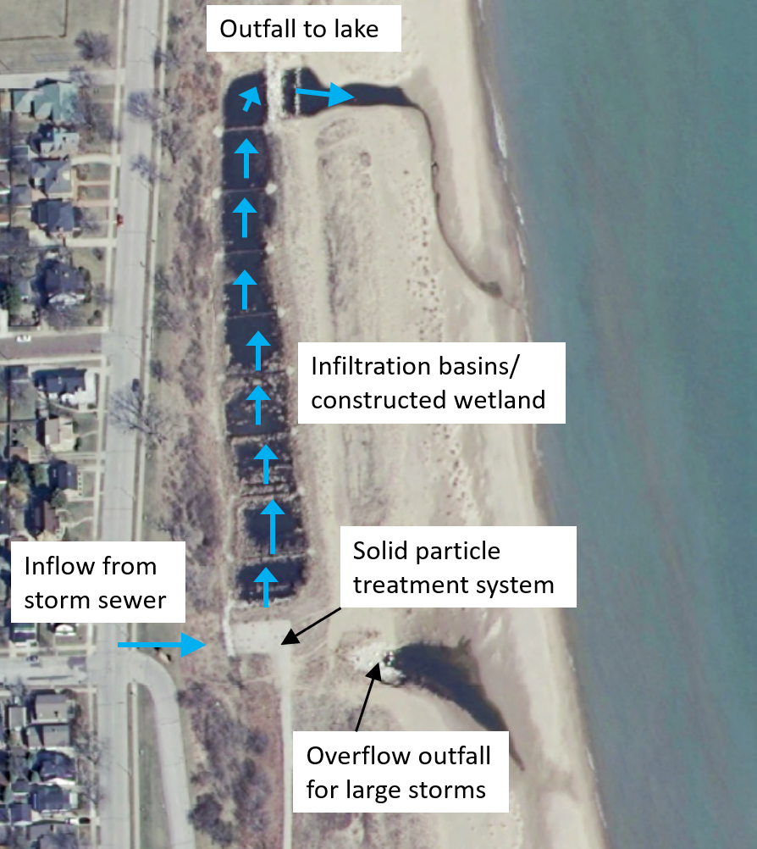
c. Improve
English Street Infiltration Basin
Constructed Wetland Cells
Image Source: Map Data: Southeastern Wisconsin Regional Planning Commission
Image Source: Map Data: Southeastern Wisconsin Regional Planning Commission
Notes:
The system consists of:
A series of constructed wetland cells that slowly pass water through, allowing further particle settling, filtration of the water by the vegetation, and infiltration of water to the groundwater.
The water flows through this system of multiple cells in the path designated by the blue arrows. It is then discharged into Lake Michigan at an outfall.
Image Source: Capt. Dennis Carr, Wisconsin Wing, Civil Air Patrol
Image Source: Map Data: Southeastern Wisconsin Regional Planning Commission

Slide 30
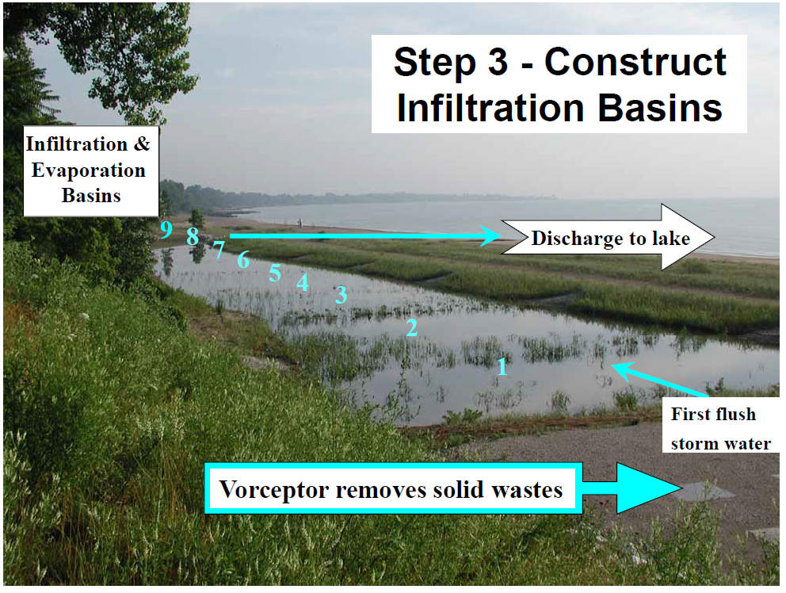
c. Improve English Street Infiltration Basin
Image Source: Julie Kinzelman, City of Racine
Notes:
The English Street Infiltration Basin influences water movement via infiltration, but also evaporation and transpiration.
Image Source: Julie Kinzelman, City of Racine Health Department

Slide 31
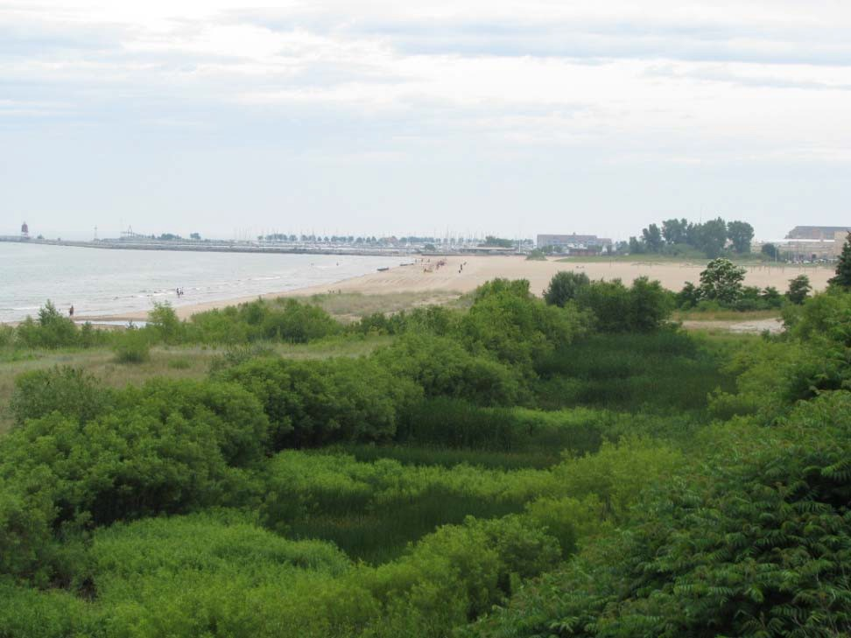
Lush Vegetation Slows Water Movement
Image Source: Julie Kinzelman, City of Racine Health Department
Notes:
The lush vegetation within the constructed wetland cells slows the movement of water, which promotes settling of sediments and other materials in the water. Additionally, as we talked about earlier, the plants can transpire water back into the atmosphere.
Image Source: Julie Kinzelman, City of Racine Health Department

Slide 32
Solid Particle Treatment System
Image source: Capt. Dennis Carr, Wisconsin Wing, Civil Air Patrol
Map Data: Southeastern Wisconsin Regional Planning Commission
Notes:
The system also consists of an underground solid particle treatment system (Vorceptor), which helps settle out large particles in the runoff. You can think of this like a big underground filter that can clean some of the pollutants out of the water before it gets to the wetland.
Image Source: Capt. Dennis Carr, Wisconsin Wing, Civil Air Patrol
Image Source: Map Data: Southeastern Wisconsin Regional Planning Commission

Slide 33
Overflow Outflow
Image source: Capt. Dennis Carr, Wisconsin Wing, Civil Air Patrol
Map Data: Southeastern Wisconsin Regional Planning Commission
Notes:
When there are large precipitation events, the treatment system can't handle all the water. The overflow outfall lets the water bypass the infiltration basin so the treatment system does not get damaged.
Image Source: Capt. Dennis Carr, Wisconsin Wing, Civil Air Patrol
Image Source: Map Data: Southeastern Wisconsin Regional Planning Commission

Slide 34
English Street Infiltration Basin Helps Solve Problem of Beach Closures and Wash Outs
Image Source: Julie Kinzelman, City of Racine
Notes:
This green infrastructure system has helped to solve problem #2-beach closures and problem #4-wash outs.
Image Source: Julie Kinzelman, City of Racine Health Department

Slide 35
Which type of Water Movement Does English Street Infiltration Basin Influence?
Which type of water movement does the English Street infiltration basin try to influence?
(For each system, can be more than one.)
Infiltration
Transpiration/Evaporation
Runoff
Image Source: Julie Kinzelman, City of Racine Health Department
Notes:
Which type of water movement does the Enlish Street infiltration basin influence?
Answer: This green infrastructure system influences infiltration rates, transpiration rates and runoff.
Image Source: Julie Kinzelman, City of Racine Health Department
Graphic Source: U.S. Army Corps of Engineers

